Slide 1
Methane on Mars and the quest for extraterrestrial life
Sébastien Viscardy
Royal Belgian Institute for Space Aeronomy (BIRA-IASB), Brussels, Belgium
ILEE Research Day (February 11 , 2020)
sebastien.viscardy@aeronomie.be

Slide 2
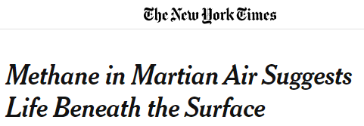
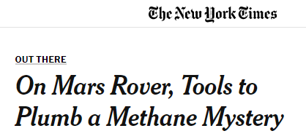
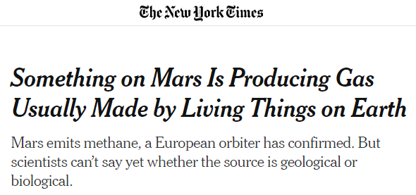
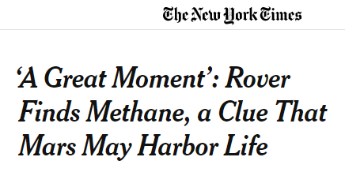
Martian methane in newspapers
Nov. 23, 2004
Nov. 22, 2011
Apr. 1, 2019
Dec. 6, 2014

Slide 3
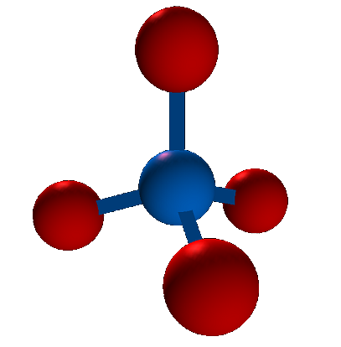
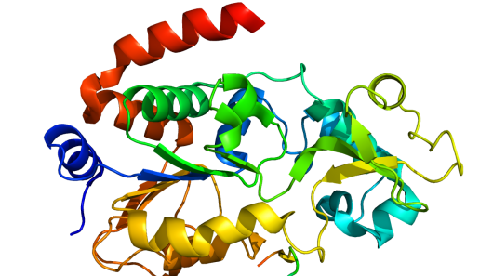
Methane : CH₄
H
C
H
H
H
Methane is the simplest organic molecule
Life as we know it is carbon-based
Formation of macromolecules ➔ complex systems

Slide 4
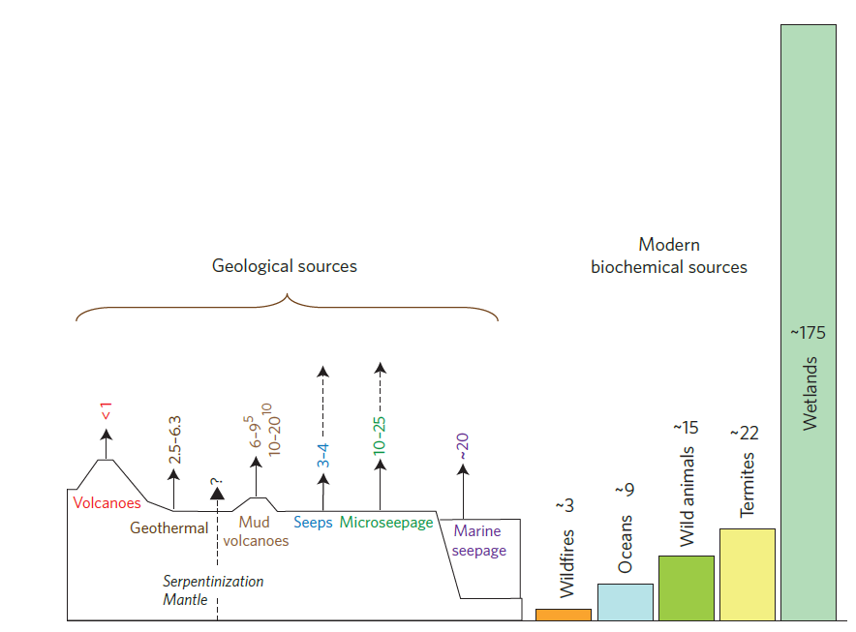
Natural methane sources on Earth
Methane : CH₄
H
C
H
H
7 – 14 %
86 – 93 %
H
Methane is the simplest organic molecule
Life as we know it is carbon-based
Formation of macromolecules ➔ complex systems
On Earth, methane is mainly of biological origin
Etiope, Nature (2012)

Slide 5
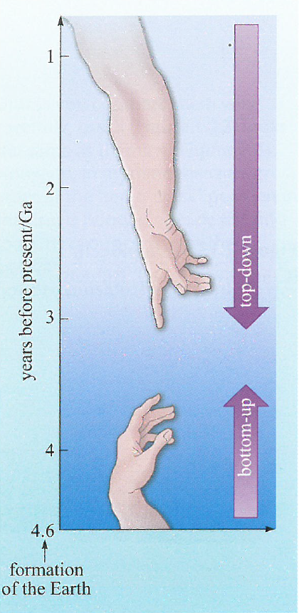
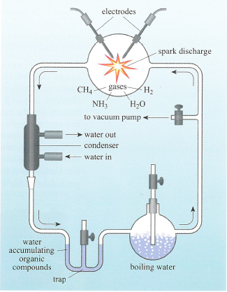
Searching for the origin of life
Bottom-up strategy: prebiotic chemistry
Hypothesis:
early terrestrial atmosphere composed of reduced species: CH₄, NH₃, and H₂
Stanley Miller’s experiments
Result: production of a number of organic molecules needed for life

Slide 6
Searching for the origin of life
Top-down strategy: this strategy looks at present-day biology and uses the information to extrapolate back towards the simplest entities
Methanogens: production of CH₄ from CO₂ and H₂
Methanotrophs: CH₄ used as a fuel

Slide 7
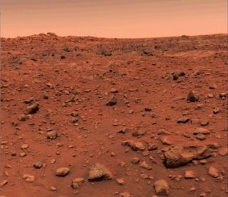
Searching for the origin of life
On Earth:
Methane is expected to be fundamental in the emergence of life
Methane is mainly produced by biological organisms
Methane can also be of geochemical origin
On Mars:
Any detection of methane could at least indicate that the red planet is more active than previously thought
It could also shed light on the potential habitability of Mars
Microbes residing beneath the surface???

Slide 8
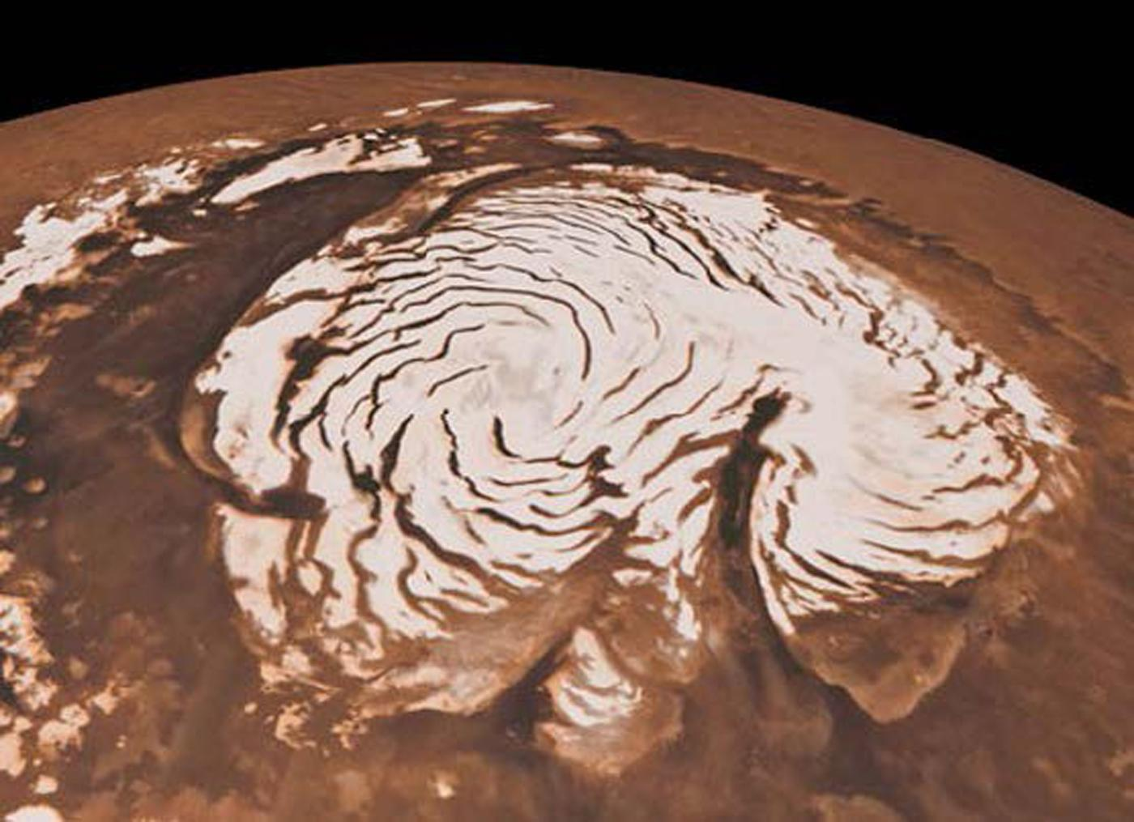
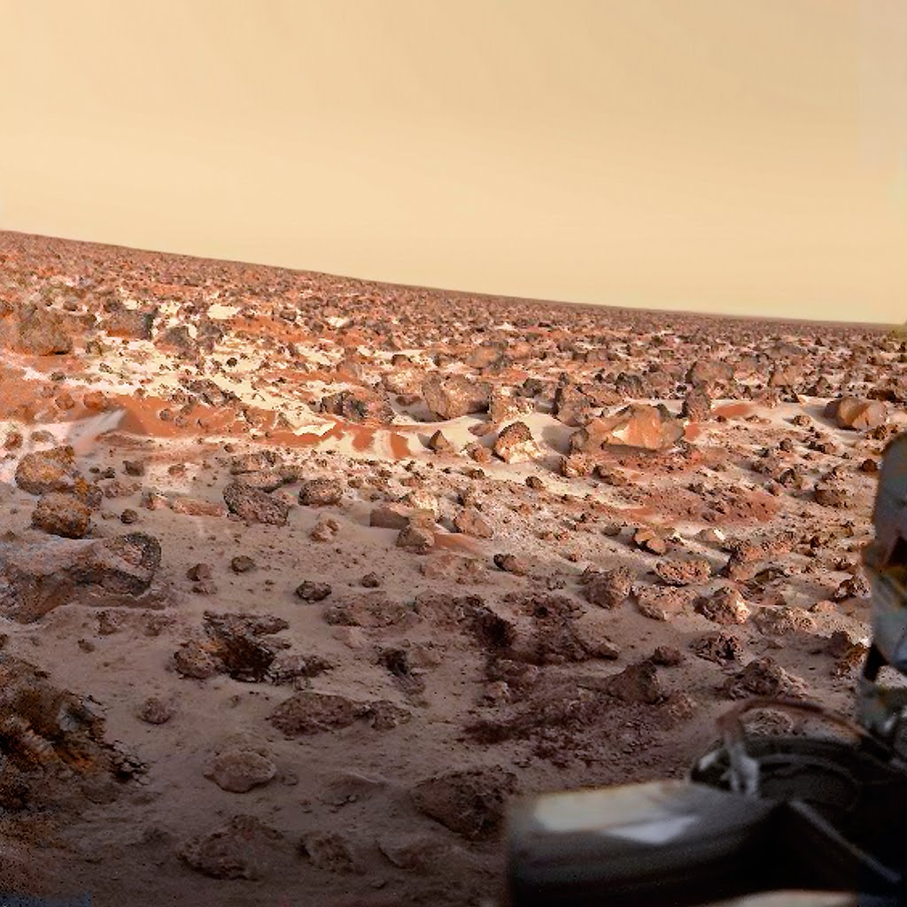
No liquid water at the surface of Mars
Polar ice cap
Water frost at high latitudes

Slide 9
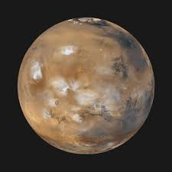
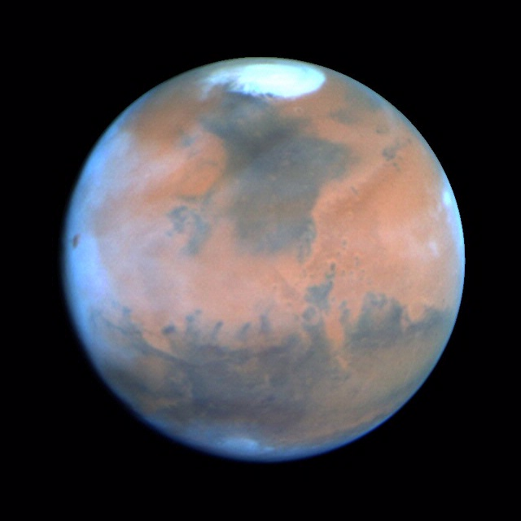
No liquid water at the surface of Mars
Water ice clouds

Slide 10
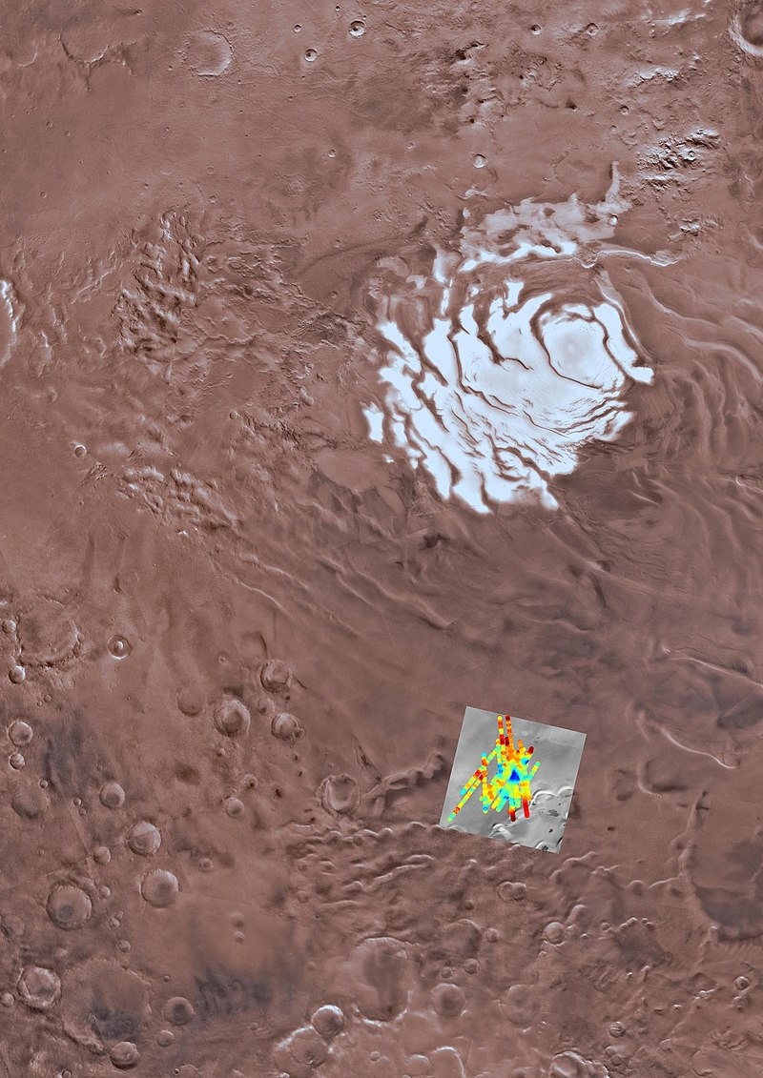
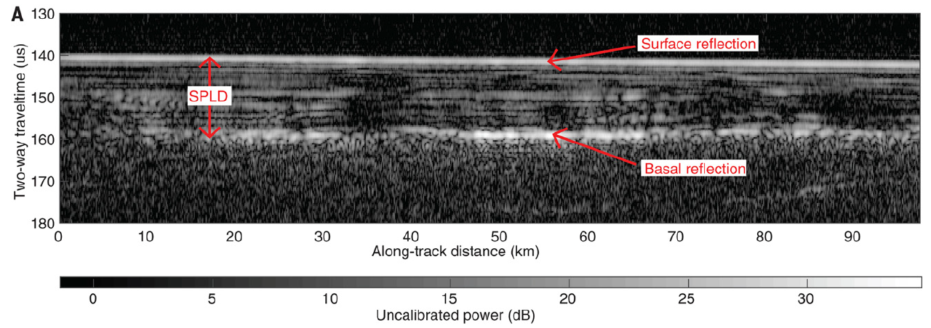
Liquid water below the surface of Mars?
liquid water

Slide 11
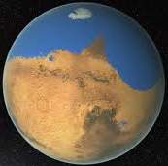
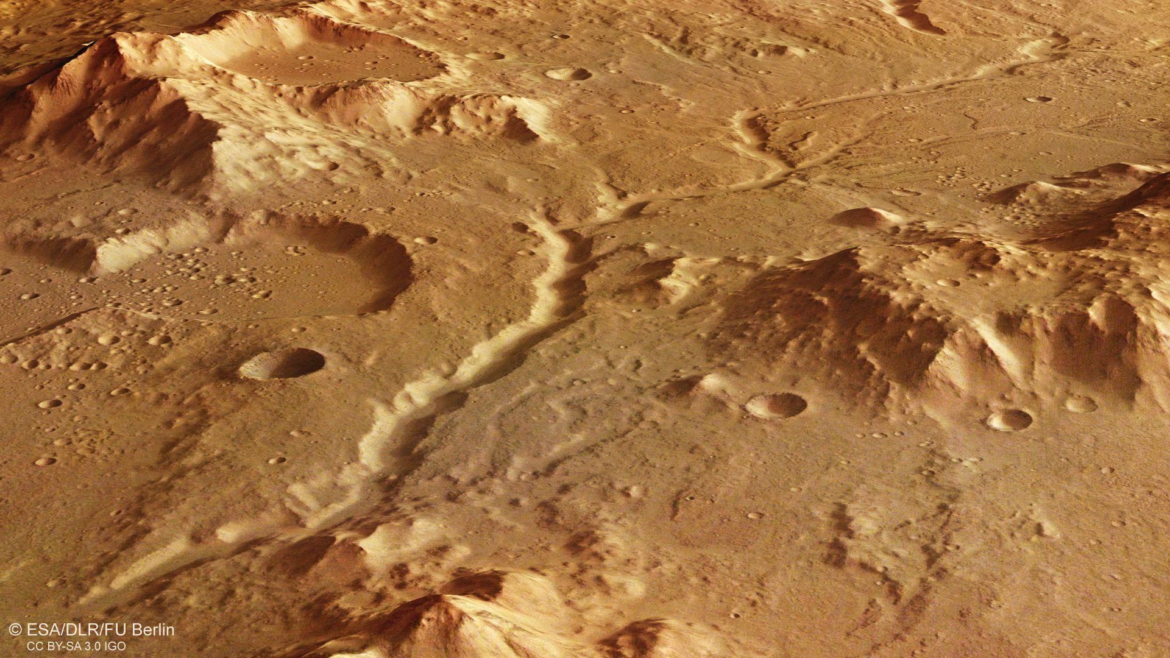
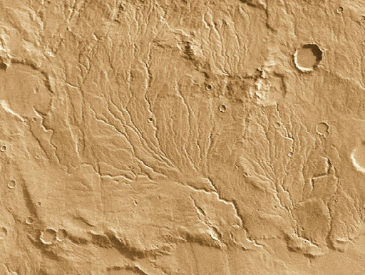
Evidence of liquid water at the surface of Mars… in the past!

Slide 12
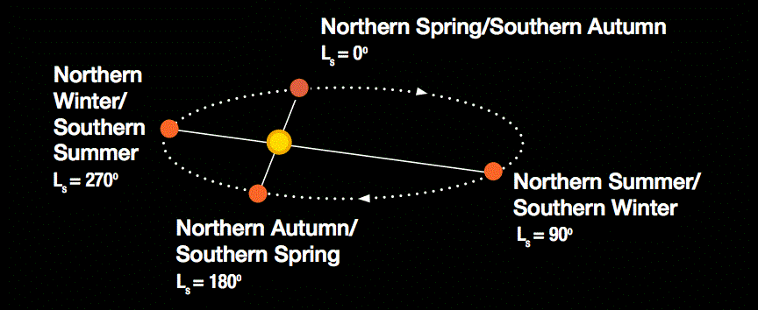
Seasons on Mars: Solar longitude L_{s} = [0° – 360°]
1 day on Mars = 24.62 hours (1 sol)
1 Mars year = 687 days = 667 sols (~1.9 Earth year)
Methane (CH₄) in volume mixing ratio
1 ppbv = 1 part per billion by volume = $\frac{1}{1,000,000,000}$ !!!

Slide 13
Atmospheric photochemistry
Mars’ atmosphere is oxidizing
➔ CH₄ is not stable
(pseudo-) first reactions
$\frac{dX(t)}{dt}=−kX(t)$ ; $X=[CH4]$
➔$X\left(t\right)=X\left(0\right)\exp{(−t/τ)}$
lifetime: $τ=−1/k=\text{\sim 300 }\text{years}$
photolysis
Oxidation
by OH and O(¹D)

Slide 14
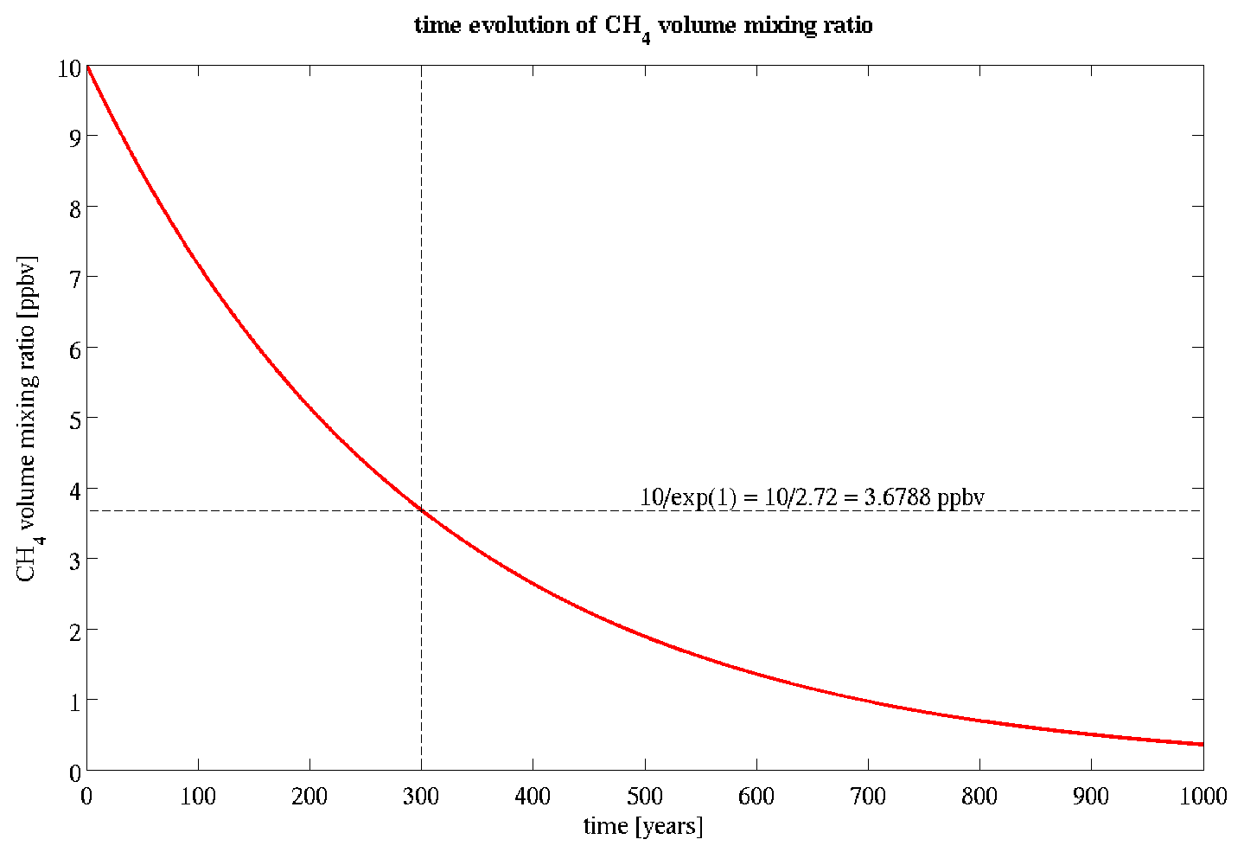
Atmospheric photochemistry
Mars’ atmosphere is oxidizing
➔ CH₄ is not stable
(pseudo-) first reactions
$\frac{dX(t)}{dt}=−kX(t)$ ; $X=[CH4]$
➔$X\left(t\right)=X\left(0\right)\exp{(−t/τ)}$
lifetime: $τ=−1/k=\text{\sim 300 }\text{years}$

Slide 15
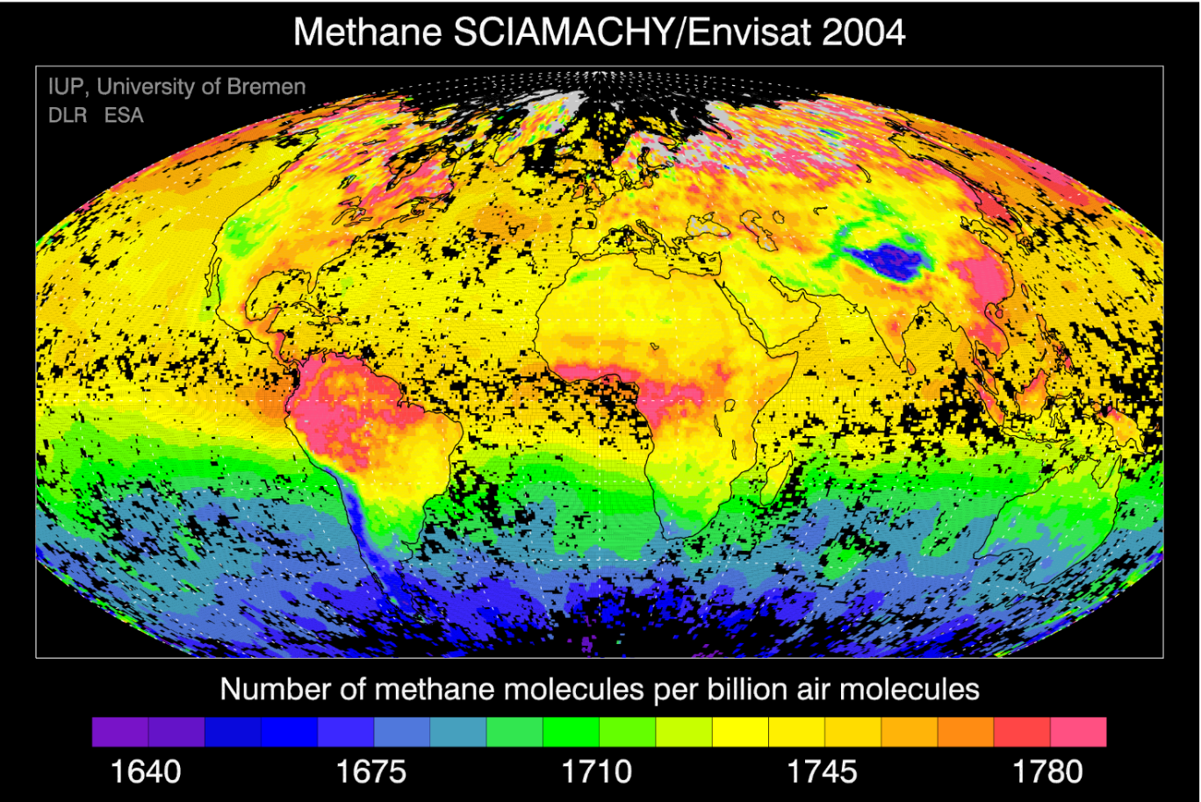
Atmospheric photochemistry
Atmospheric transport
Mars’ atmosphere is oxidizing
➔ CH₄ is not stable
(pseudo-) first reactions
$\frac{dX(t)}{dt}=−kX(t)$ ; $X=[CH4]$
➔$X\left(t\right)=X\left(0\right)\exp{(−t/τ)}$
lifetime: $τ=−1/k=\text{\sim 300 }\text{years}$
The atmospheric circulation is fast.
Any methane released from the surface becomes well-mixed around the planet after ~3 months
ppb

Slide 16
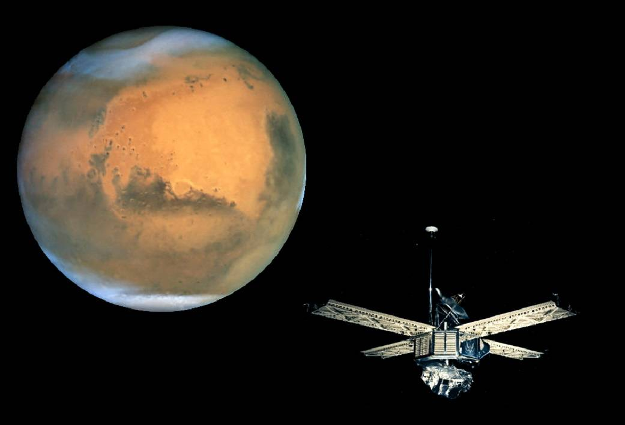
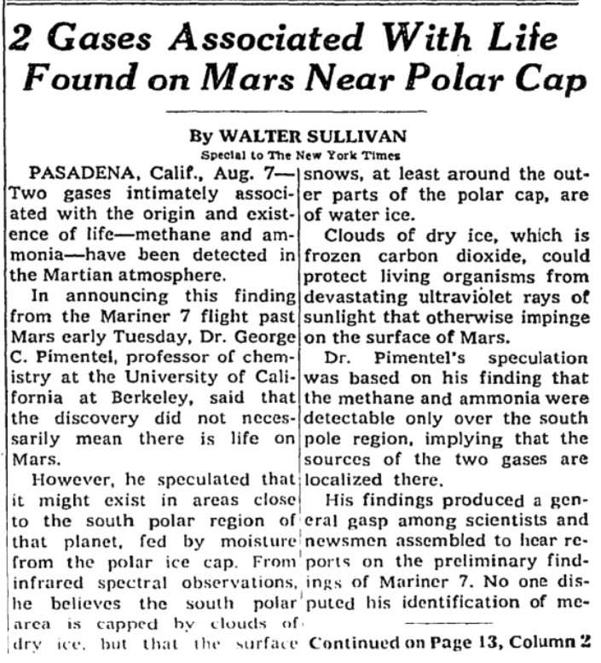
1969
2004
2008
2012
2016
2020
time
August 1969: first announcement of the detection of methane (Mariner 7)
The New York Times!
2 gases:
methane (CH₄)
ammonia (NH₃)

Slide 17
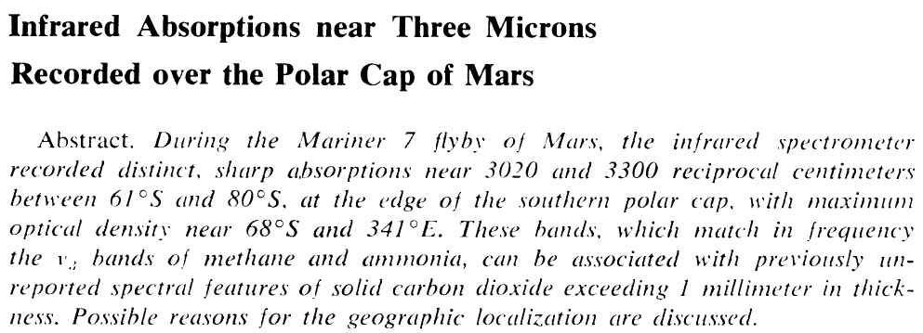
1969
1977
2004
2008
2012
2016
2020
time
August 1969: first announcement of the detection of methane (Mariner 7)
October 1969: Herr and Pimentel, Science
1977: Upper limit of 20 ppbv (Mariner 9)

Slide 18
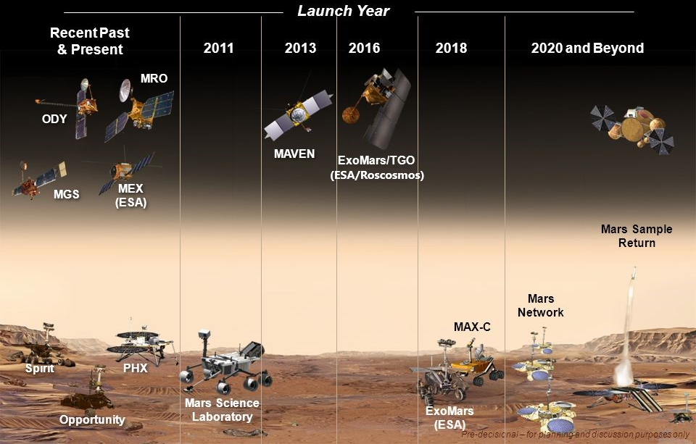
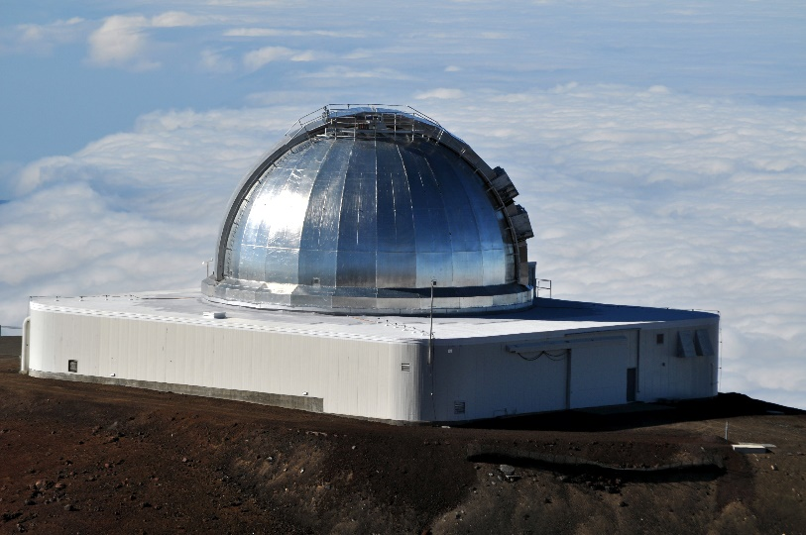
Observations of methane on Mars
+ Earth-based telescopes
NOMAD
ACS
TES
PFS
+ Stratospheric observatory
Curiosity

Slide 19
Observations of methane on Mars
+ Earth-based telescopes
NOMAD
ACS
TES
PFS
+ Stratospheric observatory
Curiosity

Slide 20
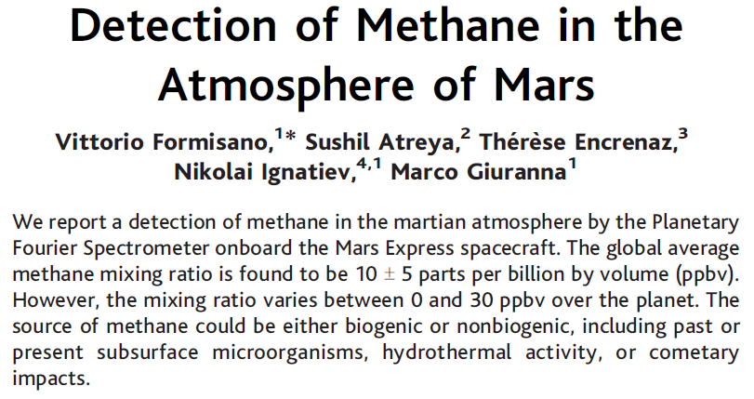
1969
1977
2004
2008
2012
2016
2020
time
2004 – 2011: Planetary Fourier Spectrometer PFS (Mars Express)
Global mean mixing ratio: 10 ± 5 ppbv
Mixing ratio varies between 0 and 30 ppbv
Formisano et al., Science (2004)

Slide 21
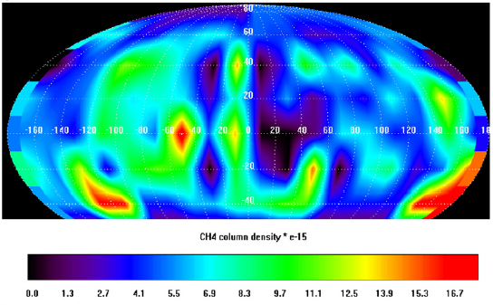
1969
1977
2004
2008
2011
2012
2016
2020
time
2004 – 2011: Planetary Fourier Spectrometer PFS (Mars Express)
Methane on Mars
High spatial variability (0 – 30 ppbv)
Methane on Earth
Low spatial variability (a few percent)
Geminale et al., PSS (2011)

Slide 22
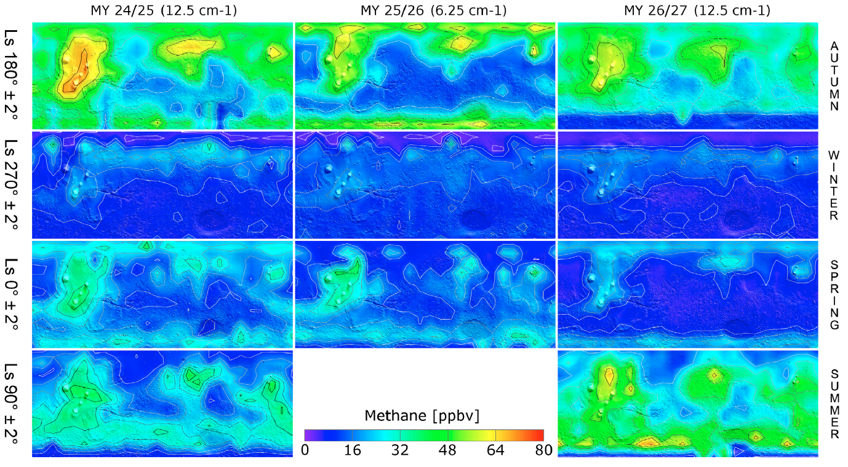
1969
1977
2004
2008
2010
2012
2016
2020
time
High seasonal and interannual variability
+ Earth-based telescopes
NOMAD
ACS
TES
PFS
+ Stratospheric observatory
Curiosity

Slide 23
1969
1977
2004
2008
2009
2012
2016
2020
time
+ Earth-based telescopes
NOMAD
ACS
TES
PFS
+ Stratospheric observatory
Curiosity

Slide 24
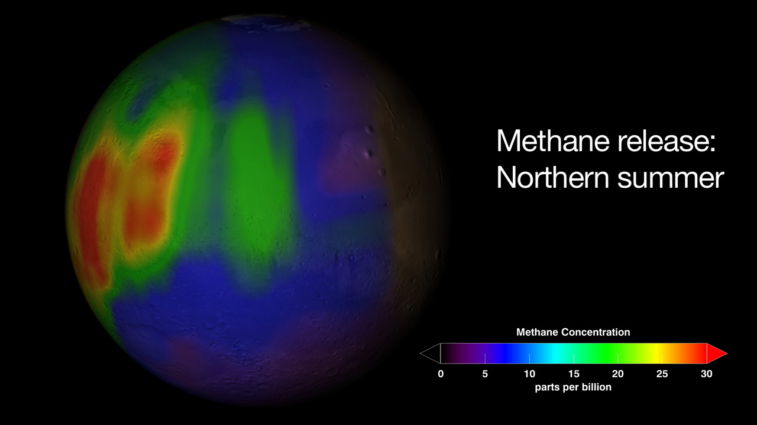
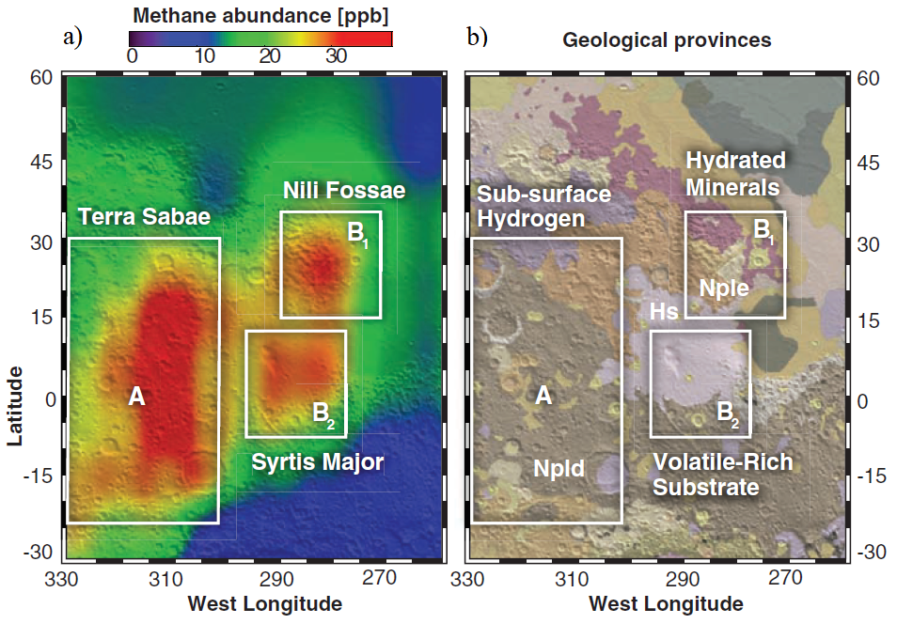
1969
1977
2004
2008
2009
2012
2016
2020
time
Mumma et al., Science (2009)
➔ Observations supported by the geological context

Slide 25
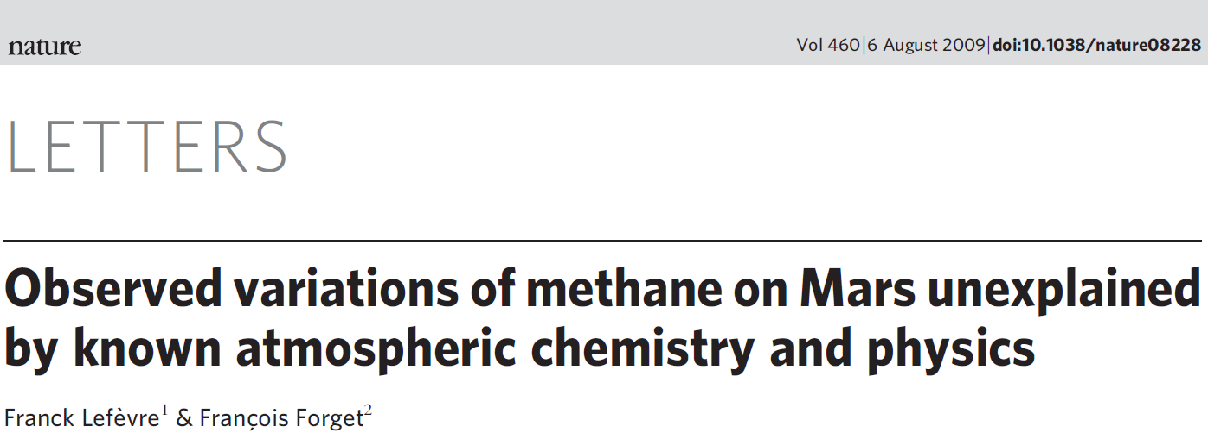
1969
1977
2004
2008
2009
2012
2016
2020
time
Lefèvre and Forget, Nature (2009)
Modeling with atmospheric photochemistry:
predicted lifetime: ~300 years
“observed” lifetime: < 200 days
$$÷600$$
➔ Fast sink process to be discovered?

Slide 26
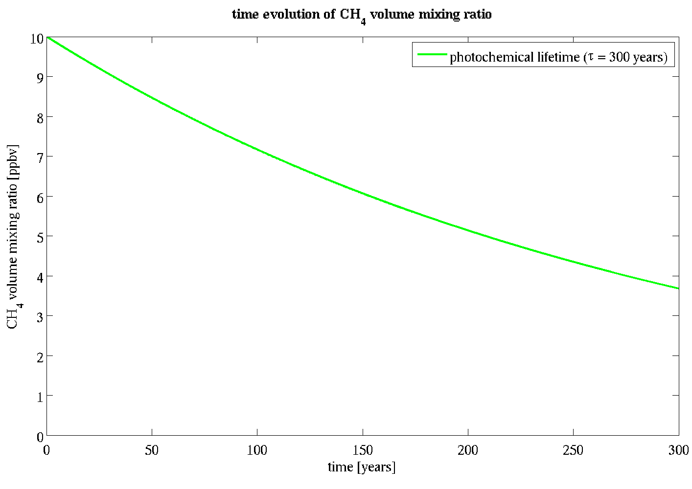
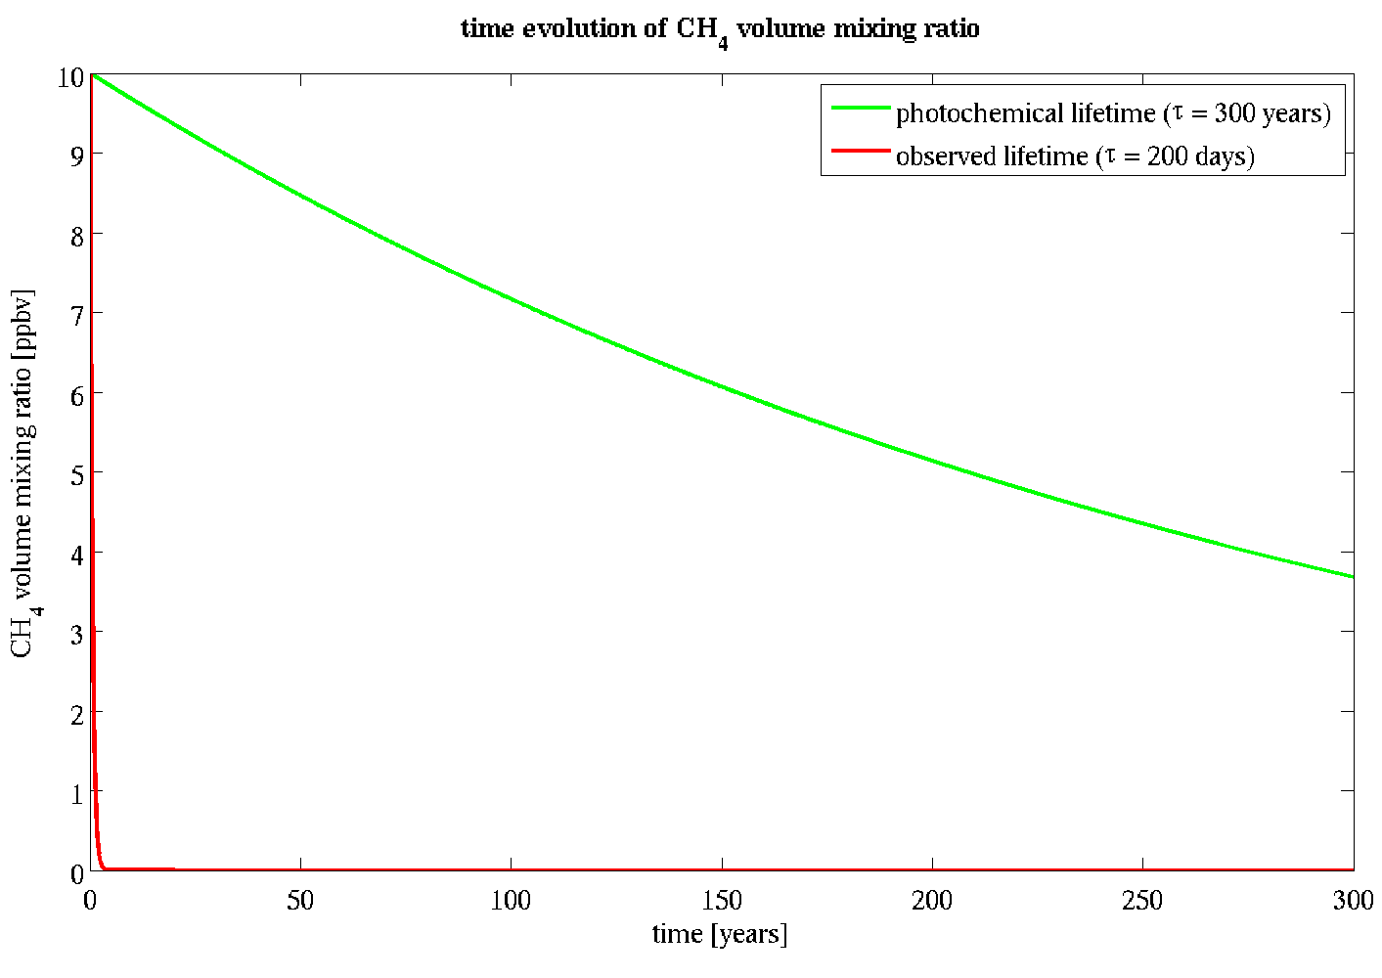
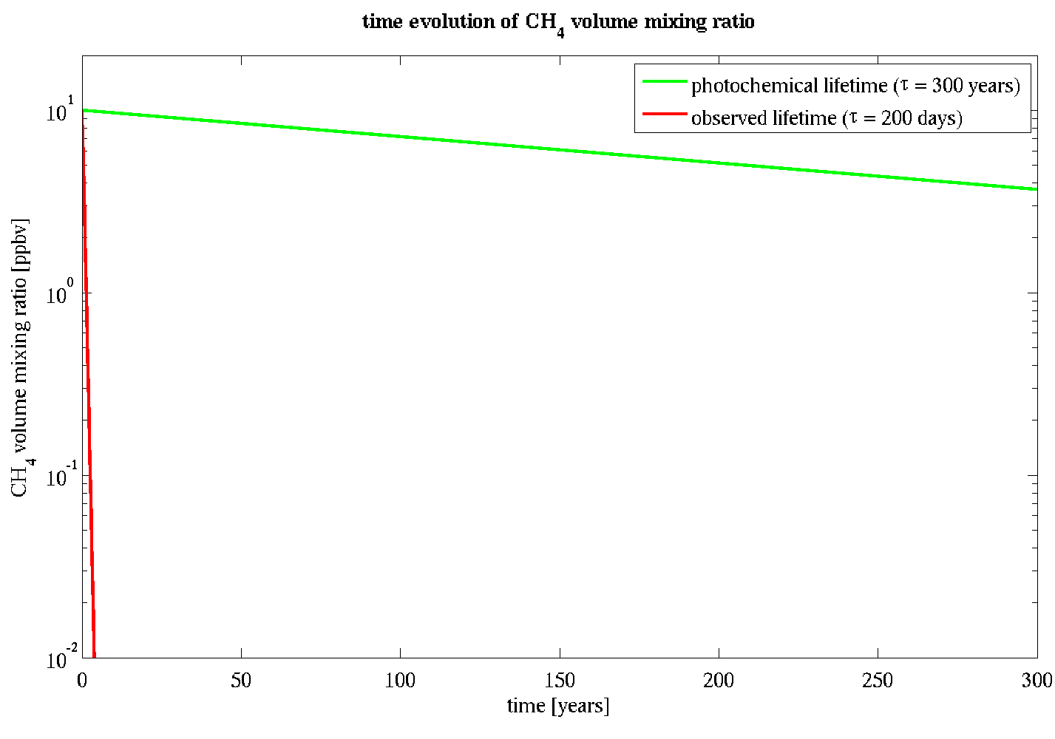
1969
1977
2004
2008
2009
2012
2016
2020
time
Lefèvre and Forget, Nature (2009)
Modeling with atmospheric photochemistry:
predicted lifetime: ~300 years
“observed” lifetime: < 200 days
$$÷600$$
➔ Fast sink process to be discovered?

Slide 27
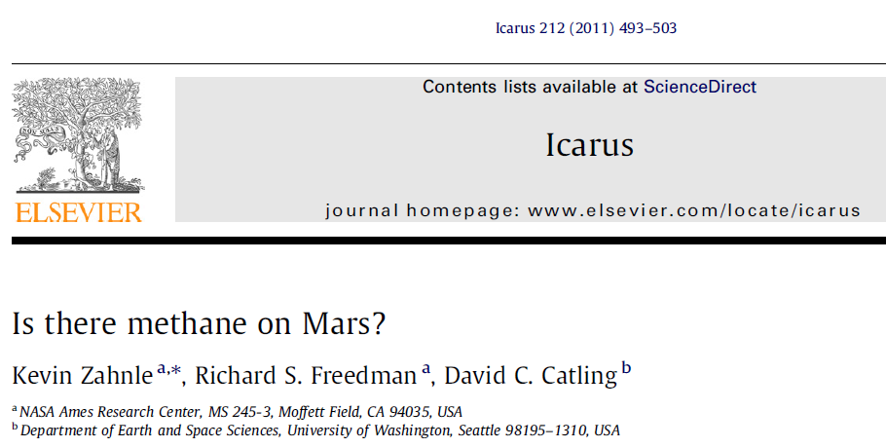
1969
1977
2004
2008
2011
2012
2016
2020
time
All the detections strongly questioned
If τ = 200 days, the oxygen in Mars’s atmosphere should be destroyed in 7000 years!

Slide 28
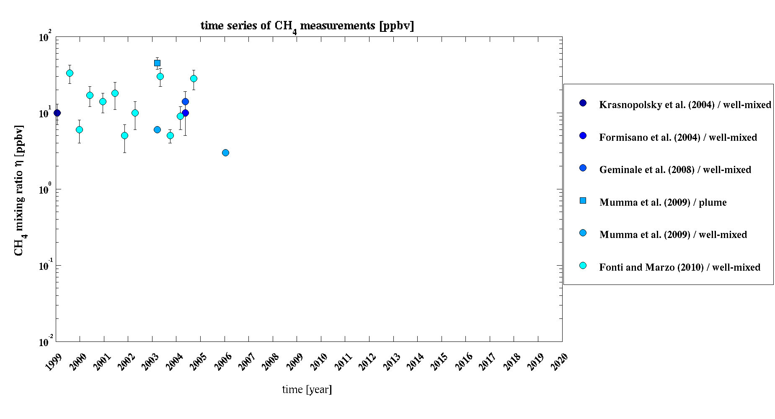
1969
1977
2004
2008
2011
2012
2016
2020
time
Data rejected:
TES, PFS,
ground-based telescopes
Data rejected:
TES, PFS,
Earth-based telescopes

Slide 29
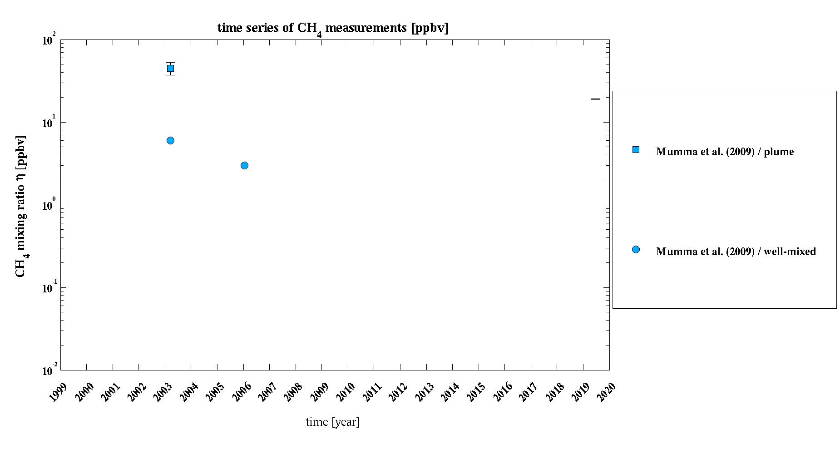
1969
1977
2004
2008
2011
2012
2016
2020
time
up to ~50 ppbv
Mumma et al., Science (2009)

Slide 30
1969
1977
2004
2008
2011
2012
2016
2020
time
up to ~50 ppbv
Mumma et al., Science (2009)
well-mixed:
6 ppbv

Slide 31
1969
1977
2004
2008
2011
2012
2016
2020
time
up to ~50 ppbv
Mumma et al., Science (2009)
well-mixed:
6 ppbv
3 ppbv

Slide 32
1969
1977
2004
2008
2011
2012
2016
2020
time
expected: τ = 300 years
observed: τ ≤ 4 years
destruction of methane much faster
than predicted by photochemical models

Slide 33
1969
1977
2004
2008
2012
2016
2020
time
+ Earth-based telescopes
NOMAD
ACS
TES
PFS
+ Stratospheric observatory
Curiosity

Slide 34
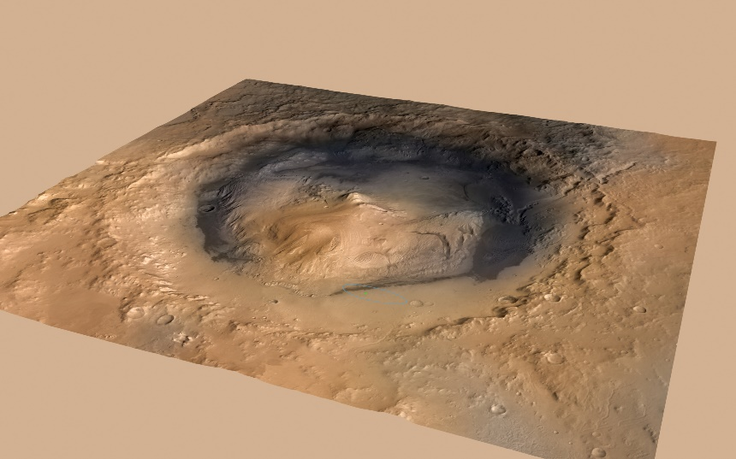
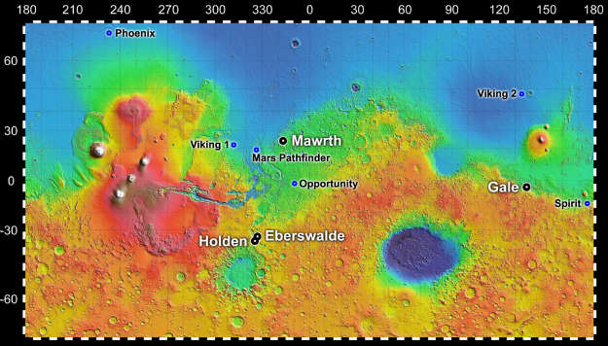
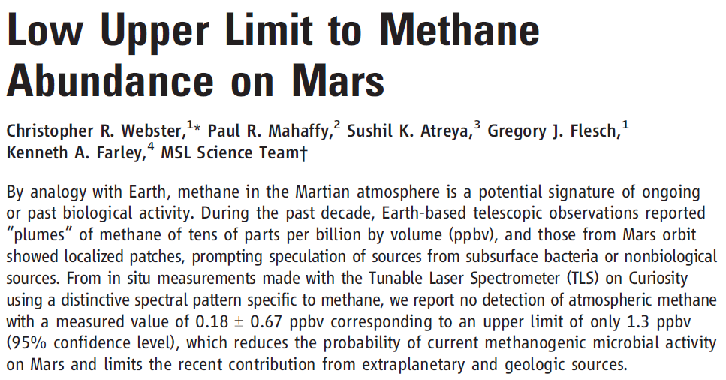
1969
1977
2004
2008
2012
2013
2016
2020
time
Webster et al., Science (2013)

Slide 35
1969
1977
2004
2008
2012
2013
2016
2020
time
End of the methane story?

Slide 36
1969
1977
2004
2008
2012
2013
2016
2020
time
End of the methane story?
NO!

Slide 37
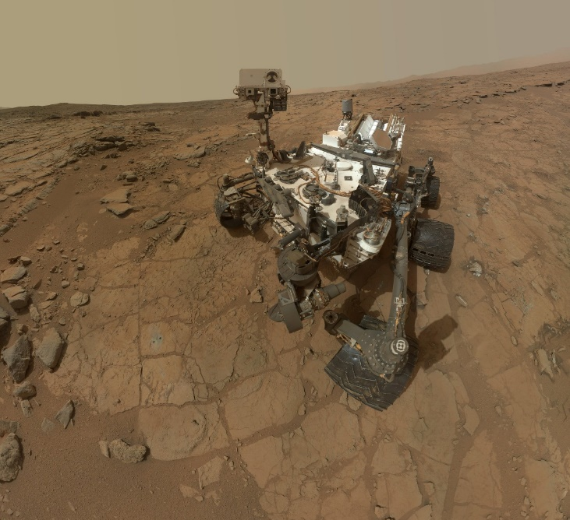
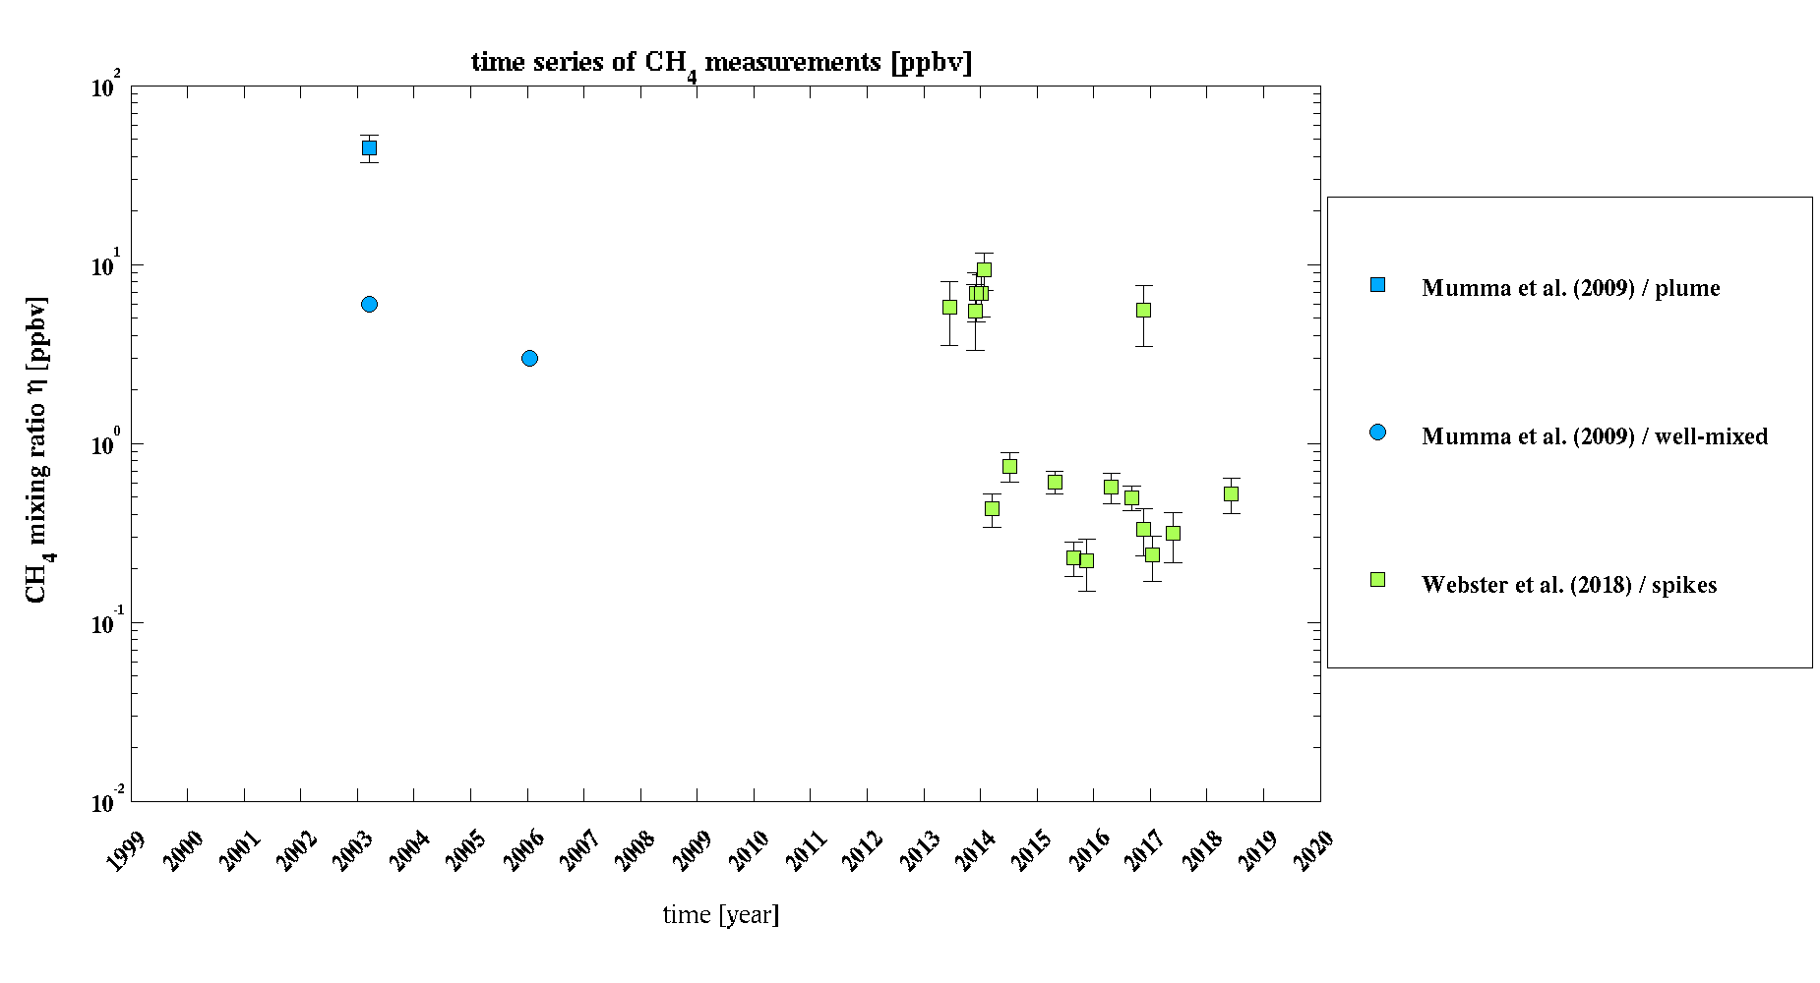
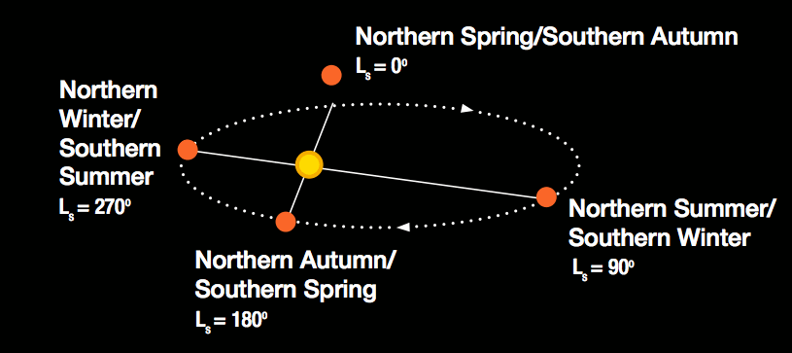
1969
1977
2004
2008
2012
2015
2016
2018
2020
time
Webster et al., Science (2015, 2018)

Slide 38
1969
1977
2004
2008
2012
2015
2016
2018
2020
time
Webster et al., Science (2018)
Seasonal cycle of the background

Slide 39
1969
1977
2004
2008
2012
2016
2020
time
+ Earth-based telescopes
NOMAD
ACS
TES
PFS
+ Stratospheric observatory
Curiosity

Slide 40
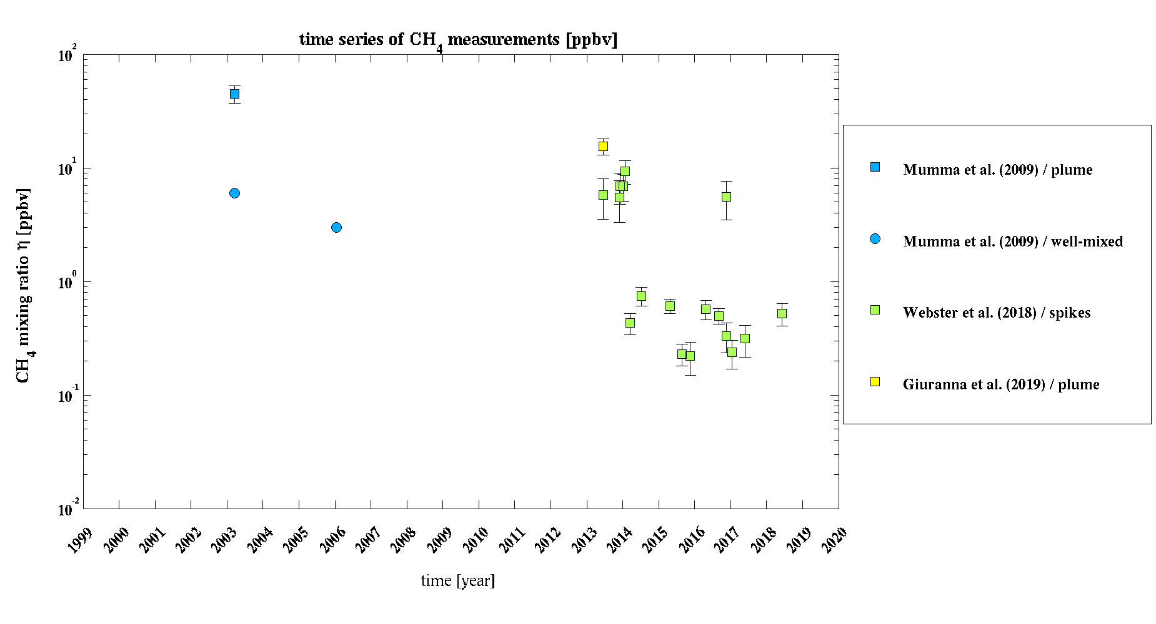
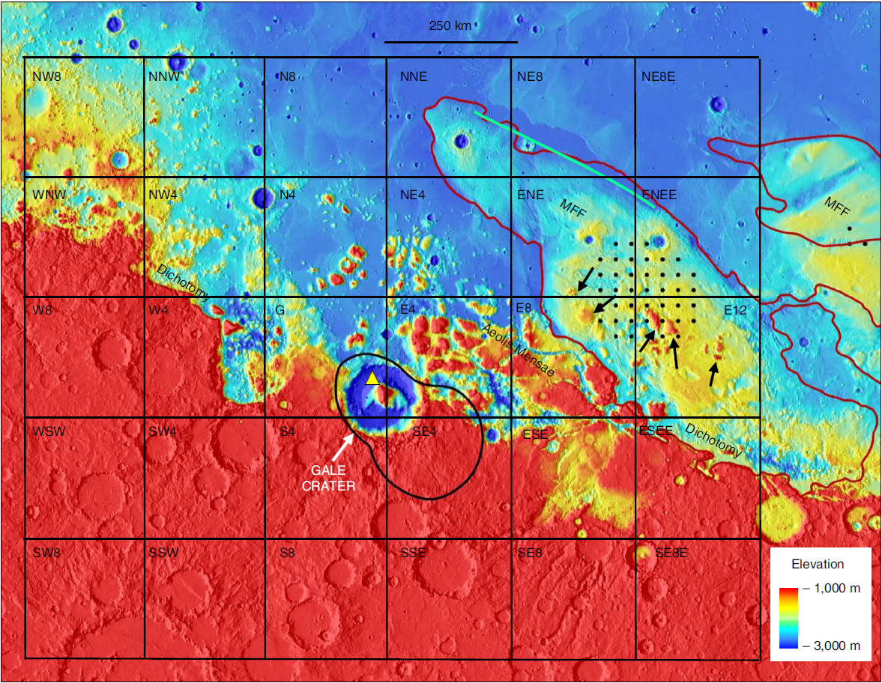
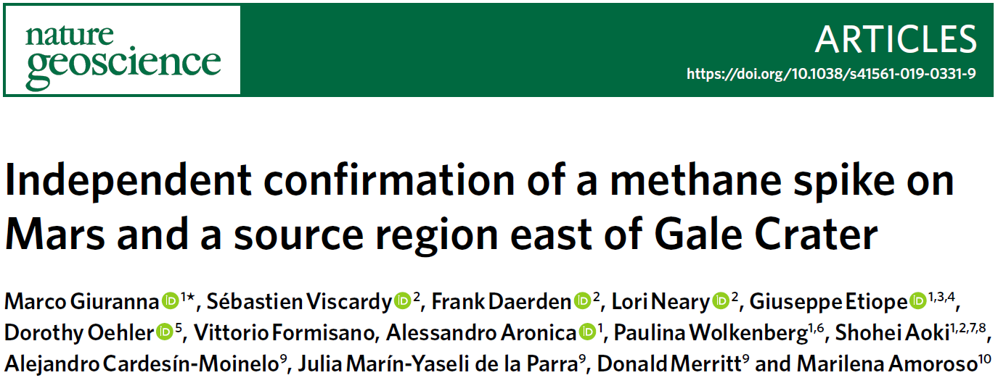
1969
1977
2004
2008
2012
2016
2019
2020
time
15.5 ppbv

Slide 41
1969
1977
2004
2008
2012
2016
2019
2020
time
End of the methane story?
For the first time ever:
Two contemporaneous CH₄ detections obtained in the same region
Identification of a potential source region

Slide 42
1969
1977
2004
2008
2012
2016
2019
2020
time
End of the methane story?
NO!
For the first time ever:
Two contemporaneous CH₄ detections obtained in the same region
Identification of a potential source region

Slide 43
1969
1977
2004
2008
2016
2019
2020
time
End of the methane story?
NO!
+ Earth-based telescopes
TGO = Trace Gas Orbiter
NOMAD
ACS
TES
PFS
+ Stratospheric observatory
Curiosity

Slide 44
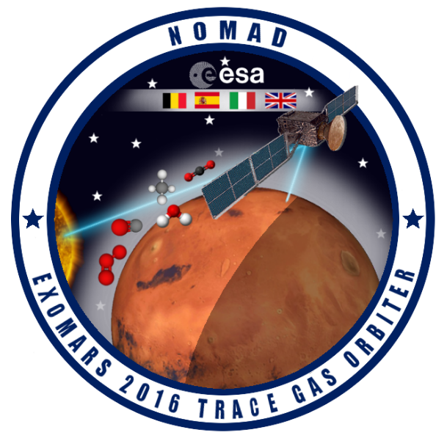
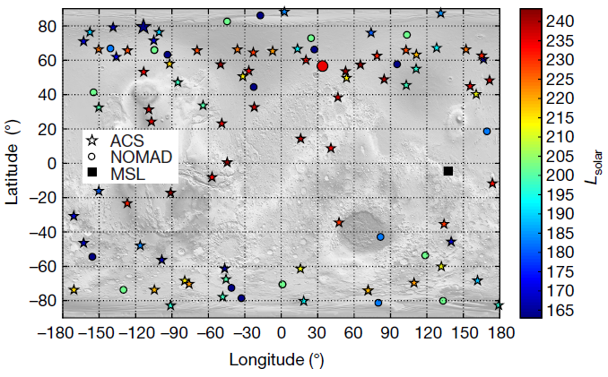
1969
1977
2004
2008
2016
2019
2020
time
Korablev et al., Nature (2019)
TGO detection limit: 0.05 ppbv = 50 pptv

Slide 45
1969
1977
2004
2008
2016
2019
2020
time
June 22, 2019
< 0.05 ppbv

Slide 46
1969
1977
2004
2008
2016
2020
time

Slide 47
1969
1977
2004
2008
2016
2020
time

Slide 48
1969
1977
2004
2008
2016
2020
time
The more we search for methane, the less we find it!

Slide 49
The CH₄ detections are real
Mumma et al., Science (2009)
Position supported by:
Earth-based telescopes
Need to exploit the Doppler effect
Possible contamination due to terrestrial ¹³CH₄…
sunlight

Slide 50
The CH₄ detections are real
Position supported by:
Earth-based telescopes
Need to exploit the Doppler effect
Possible contamination due to terrestrial ¹³CH₄…
Planetary Fourier Spectrometer (PFS)
Low spectral resolution
CH₄ observed in a single line of the spectrum
Giuranna et al., Nature Geoscience (2019)

Slide 51
The CH₄ detections are real
Position supported by:
Earth-based telescopes
Need to exploit the Doppler effect
Possible contamination due to terrestrial ¹³CH₄…
Planetary Fourier Spectrometer (PFS)
Low spectral resolution
CH₄ observed in a single line of the spectrum
TLS onboard Curiosity
Instrument initially expected to identify methane convincingly at the 1 pptv level!
But… TLS was the victim of a leak before launch

Slide 52
The CH₄ detections are real
Position supported by:
Earth-based telescopes
Need to exploit the Doppler effect
Possible contamination due to terrestrial ¹³CH₄…
Planetary Fourier Spectrometer (PFS)
Low spectral resolution
CH₄ observed in a single line of the spectrum
TLS onboard Curiosity
Instrument initially expected to identify methane convincingly at the 1 pptv level!
But… TLS was the victim of a leak before launch
Webster et al., Science (2013)

Slide 53
The CH₄ detections are real
Position supported by:
Earth-based telescopes
Need to exploit the Doppler effect
Possible contamination due to terrestrial ¹³CH₄…
Planetary Fourier Spectrometer (PFS)
Low spectral resolution
CH₄ observed in a single line of the spectrum
TLS onboard Curiosity
Instrument initially expected to identify methane convincingly at the 1 pptv level!
But… TLS was the victim of a leak before launch
A fast removal process to still be discovered
All mechanisms proposed so far are not convincing / efficient
Other key species must not be affected

Slide 54
The CH₄ detections are real
The CH₄ detections are NOT real
Position supported by:
Earth-based telescopes
Need to exploit the Doppler effect
Possible contamination due to terrestrial ¹³CH₄…
Planetary Fourier Spectrometer (PFS)
Low spectral resolution
CH₄ observed in a single line of the spectrum
TLS onboard Curiosity
Instrument initially expected to identify methane convincingly at the 1 pptv level!
But… TLS was the victim of a leak before launch
A fast removal process to still be discovered
All mechanisms proposed so far are not convincing / efficient
Other key species must not be affected
Position supported by:
NOMAD and ACS onboard TGO
Both are the most sensitive instruments and were specifically designed to search for trace gas species
The two instruments agree
No need to discover a mysterious removal process
No need to correct the photochemistry as currently understood

Slide 55
The CH₄ detections are real
The CH₄ detections are NOT real
MANY PROBLEMS
NO PROBLEM
I’m afraid there is no evidence for methane on Mars…
“Extraordinary claims require extraordinary evidence”
Carl Sagan (1934 – 1996)

Slide 56
4th Century B.C. – Renaissance:
Aristotelian doctrine
Cosmos divided into two words:
Sublunary part
Celestial part
➔ 2 distinct physics
Peter Apian, Cosmographia (1524)

Slide 57
17th century: Scientific Revolution
“From the Closed World to the Infinite Universe”
(Alexandre Koyré)
➔ same physics in the whole universe
Nicolaus Copernicus
De Revolutionibus Orbium Coelestium (1543)
If same physics everywhere, same things everywhere (e.g. life)

Slide 58
The idea of the plurality of (inhabited) worlds has become important since the 17th century
Giordano Bruno
“On the Infinite Universe and Worlds” (1584)
B. Fontenelle
“Conversations on the Plurality of Worlds” (1686)

Slide 59
Canals on Mars?
1877: Giovanni Schiaparelli announced that he discovered “canals”
➔ Built by intelligent beings

Slide 60
Canals on Mars?
Giovanni Schiaparelli (1877 – 1890)

Slide 61
Canals on Mars?
Percival Lowell (1896)

Slide 62
Canals on Mars?
E. W. Maunder and J. E. Evans (1903): test with 200 school boys
➔ Canals = Optical illusion!

Slide 63
Canals on Mars?
First photographs of Mars (1909)

Slide 64
“The vast bulk of classical canals […] appear to have no relation to the real Martian surface”

Slide 65
1950s
Vegetation on Mars?
Mars seen by the Hubble space telescope

Slide 66
Vegetation on Mars?
Global dust storm
Mars seen by the Hubble space telescope

Slide 67
Conclusions
Mars science has a long history of false claims about all matters connected to biology
The methane problem is most likely another such story…
The universality of the laws of physics same physical conditions
The exploration of the Solar system has revealed the extraordinary diversity of worlds
BUT…
We still don’t know what life requires to emerge on a planet
Space exploration is fundamental to better understand the mechanism underlying the emergence of life

