Slide 1

Temperature dependence of the CO₂-collisional broadening of chloromethane lines.
Sylvain Leonis, Nicolas Hespel, Olivier Browet, Bastien Vispoel and Muriel Lepère
ILEE Reasearch Day – 2020-02-11

Slide 3

2

Slide 4
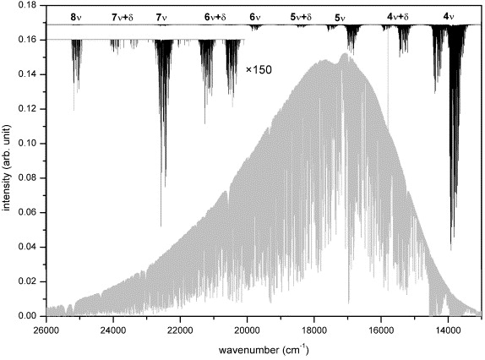
Physical
conditions
(P_{i}, T…)
Laboratory
measurements
Spectroscopic parameters
Atmospheric
conditions
(P_{i}, T…)
Atmospheric observations
Atmospheric models
Coheur et al. [JQSRT 82, 133-150 (2003)]
3

Slide 5
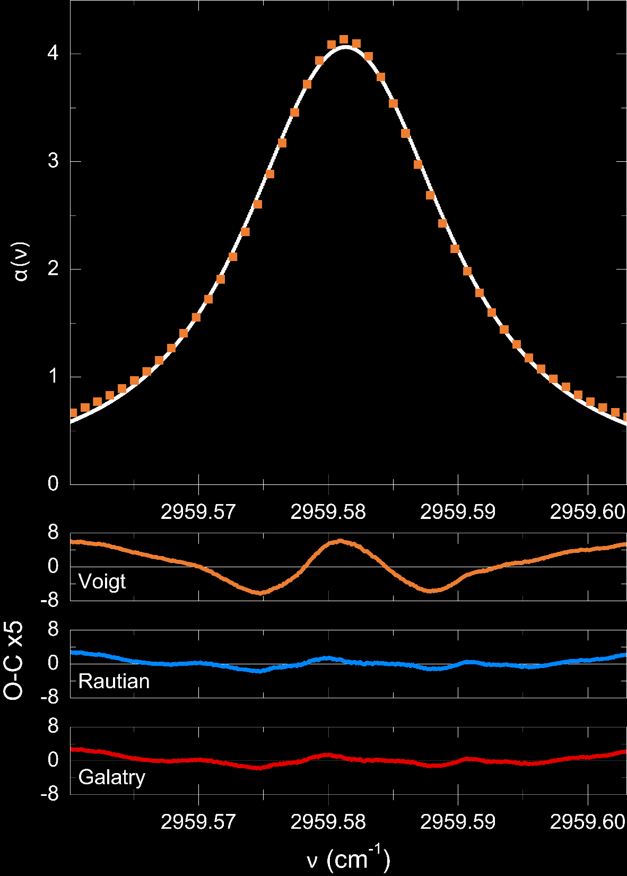
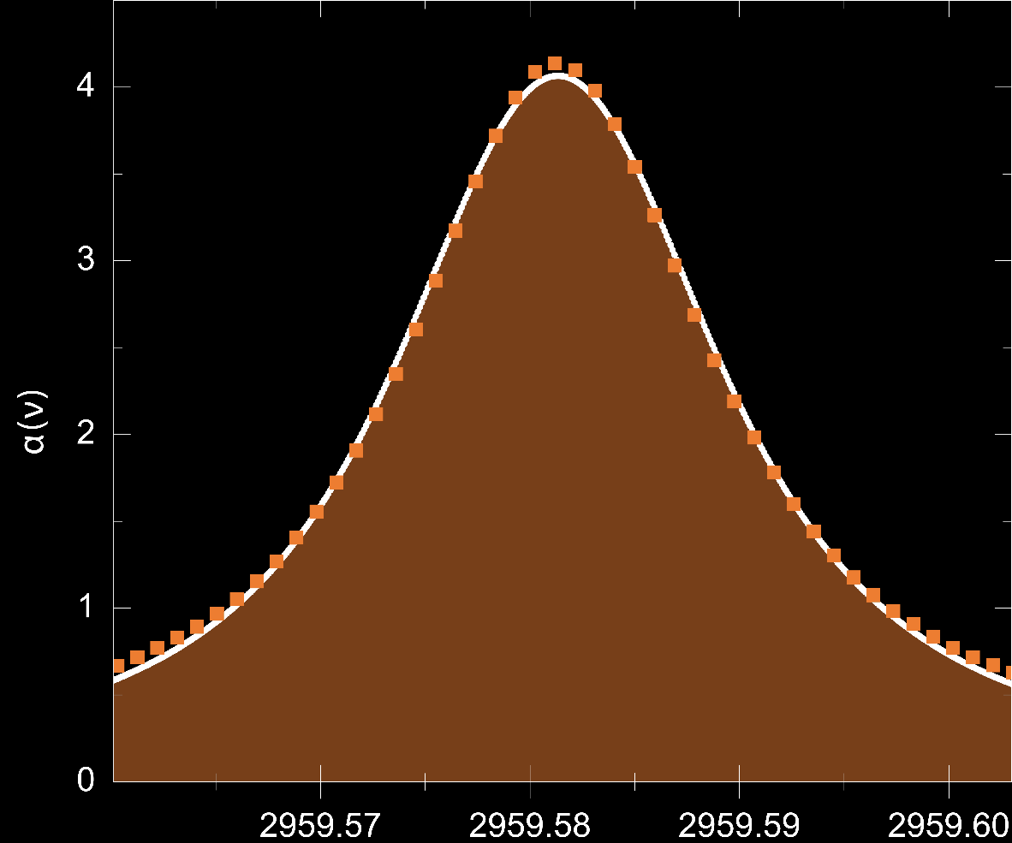
S
γ
ν
4
Notes:
Refaire sans les carrés et dans les bonnes couleurs

Slide 6
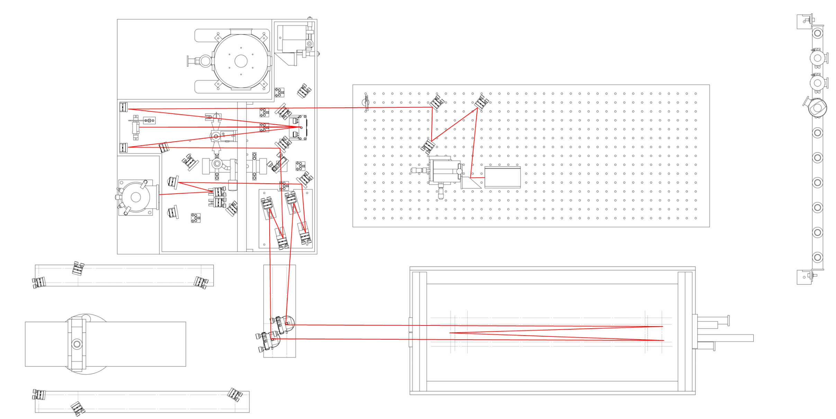
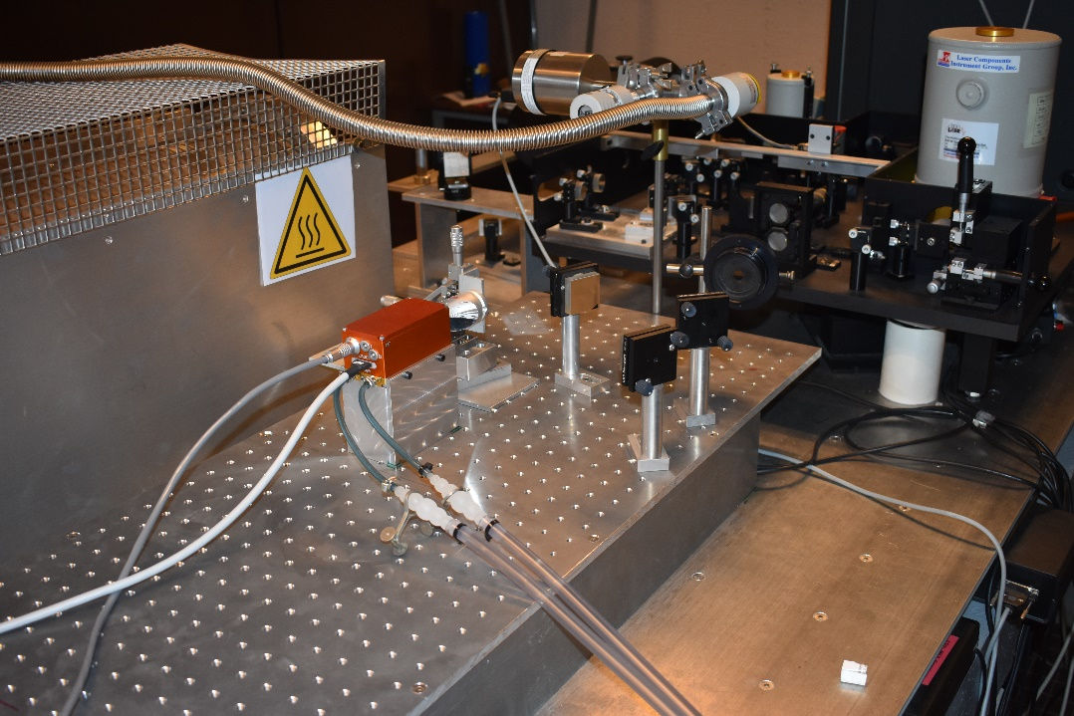
5

Slide 7
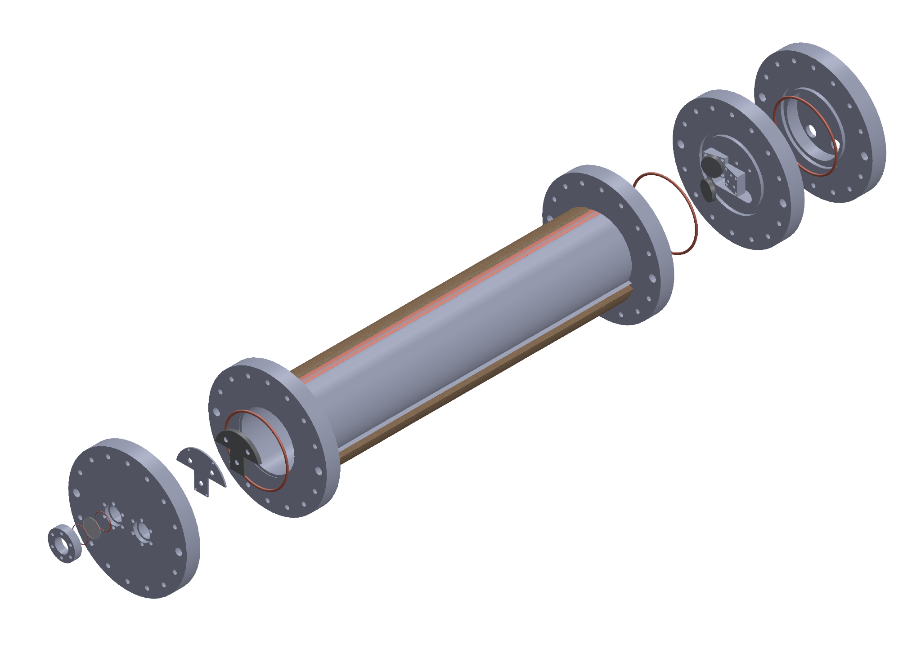
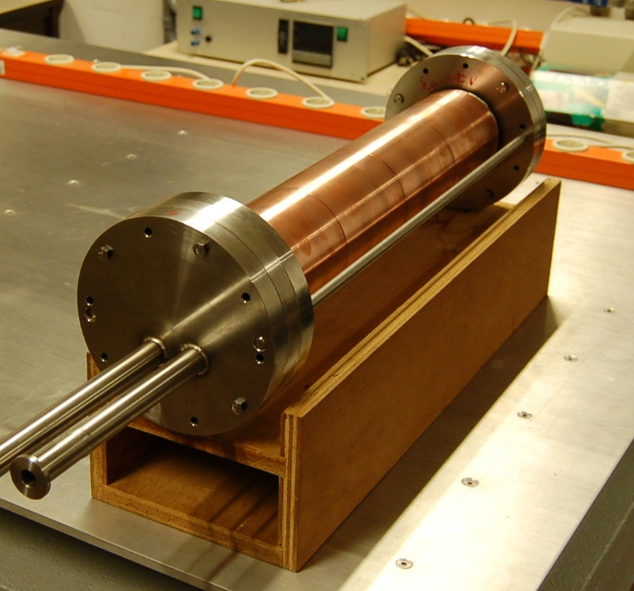
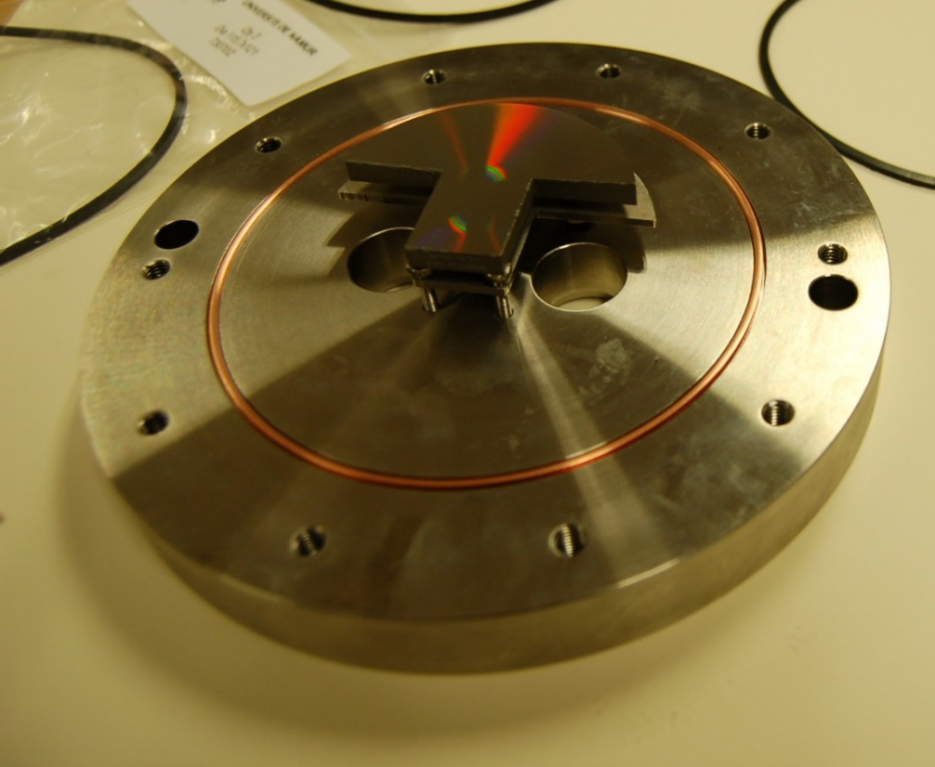
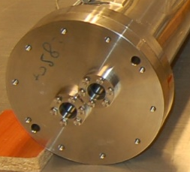
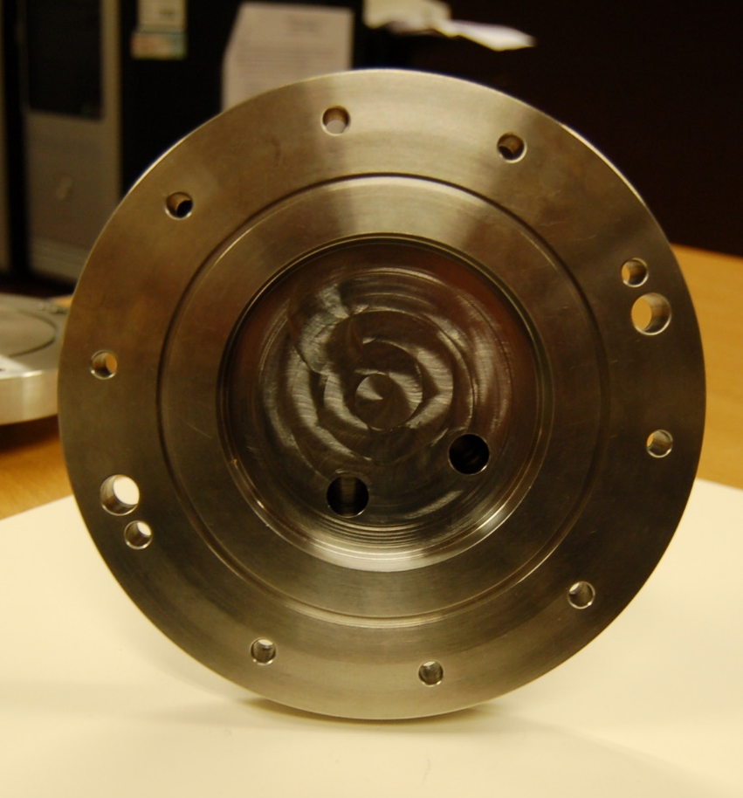
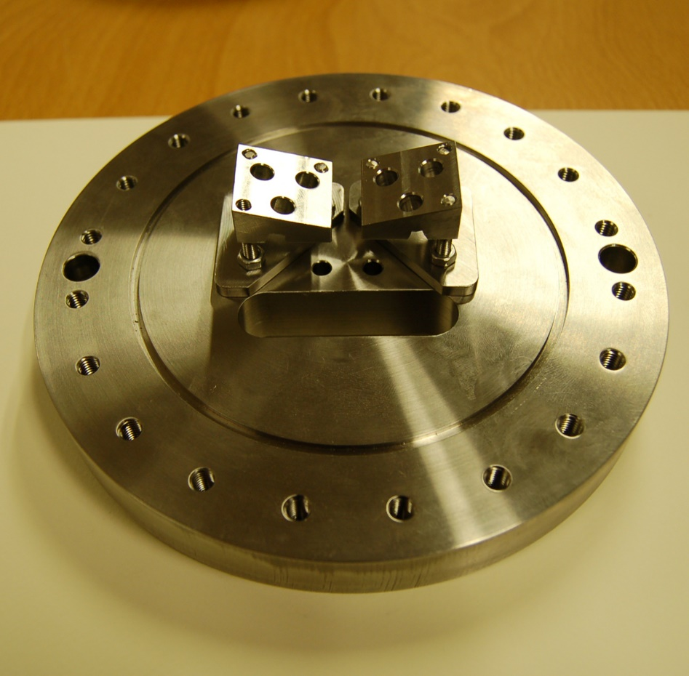
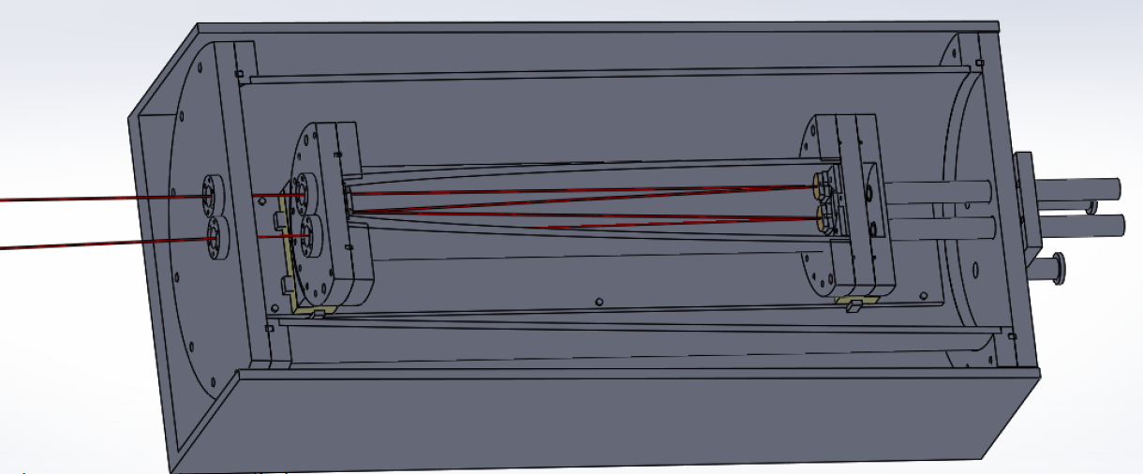
Gas In-Out
Temperature gauge access
Molybdenum mirrors
Ceramic heater
Copper mantel
Inconel cell
Metallic c-rings seals
Sapphire or diamond windows
6

Slide 8
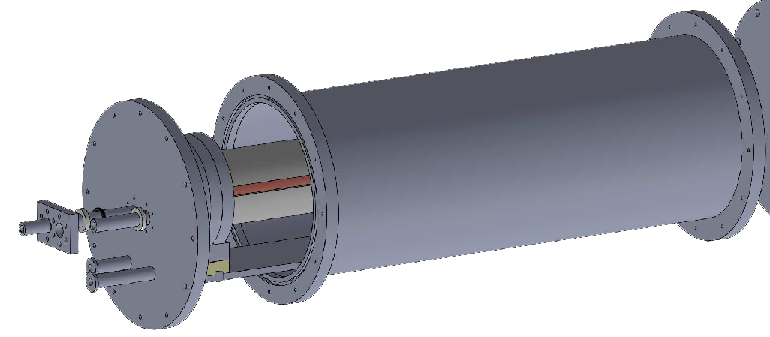
7

Slide 9
8

Slide 10
9
Notes:
Retirer valeurs
Couleurs !

Slide 11
296 K (20°C)
▲ This work
∆ Dudaryonok et al.
[JQSRT 145, 50-59 (2014)]
10

Slide 12
Line: ^{Q}P(8,2) (ν₂)
● Experimental
--- PL
11

Slide 13
Line: ^{Q}P(8,2) (ν₂)
● Experimental
--- PL
------ DPL
12

Slide 14
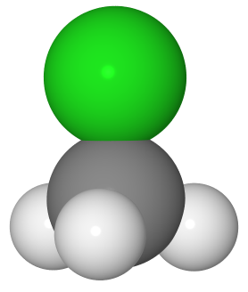
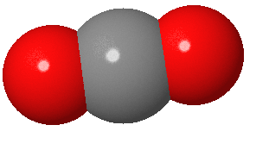

Slide 15


Thanks for your attention

