Slide 1
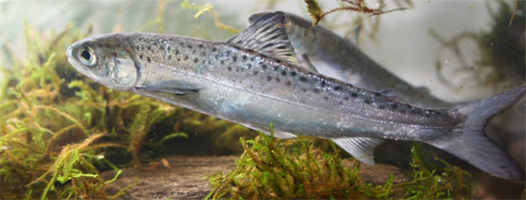


How the passage through a hydropower plant affects the physiological and health status of Atlantic salmon smolts?
Imen Ben Ammar, Sébastien Baekelandt, Valérie Cornet, Robert Mandiki, Patrick Kestemont

Slide 2
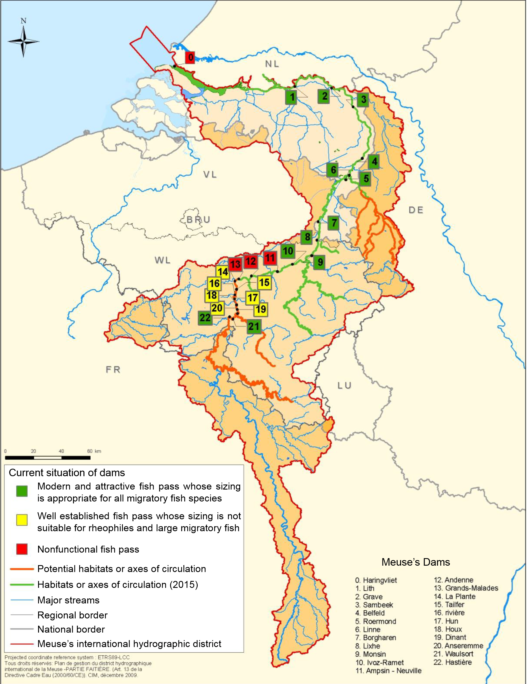
Context
Results
Discussion
Objectives
Methods
Heavily modified water body: Dam, Hydropower plant HPP
Home to 10 highly migratory diadromous fish species and ~ 30 non-diadromous species

Slide 3
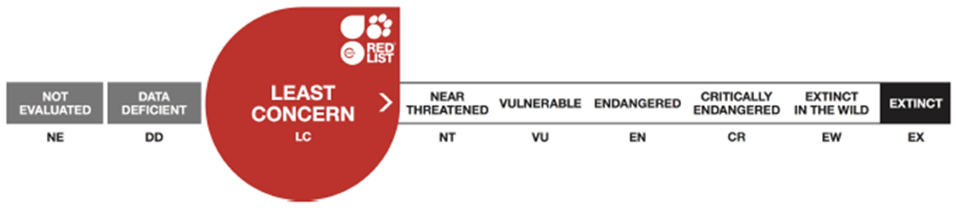
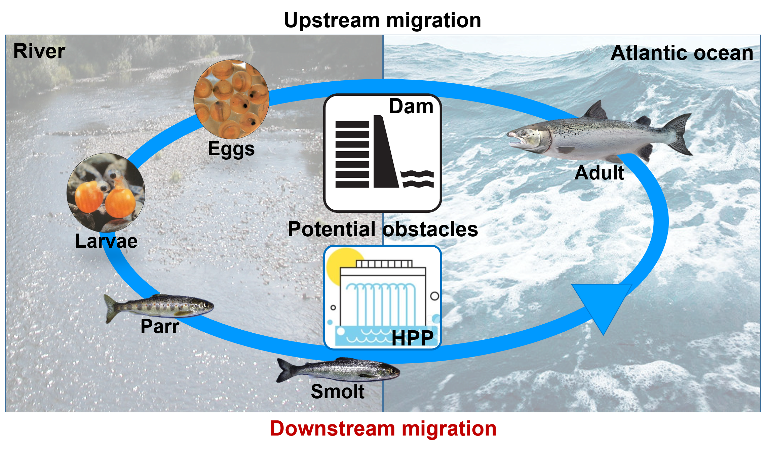
Context
Results
Discussion
Objectives
Methods
Atlantic salmon Salmo salar
Disruption of hydrological connectivity → severe reductions and/or extinction of some strains in Europe and America
(Freeman et al. 2003, Nehlsenet al. 1991, Parrish et al. 1998, Forseth et al. 2017).

Slide 4
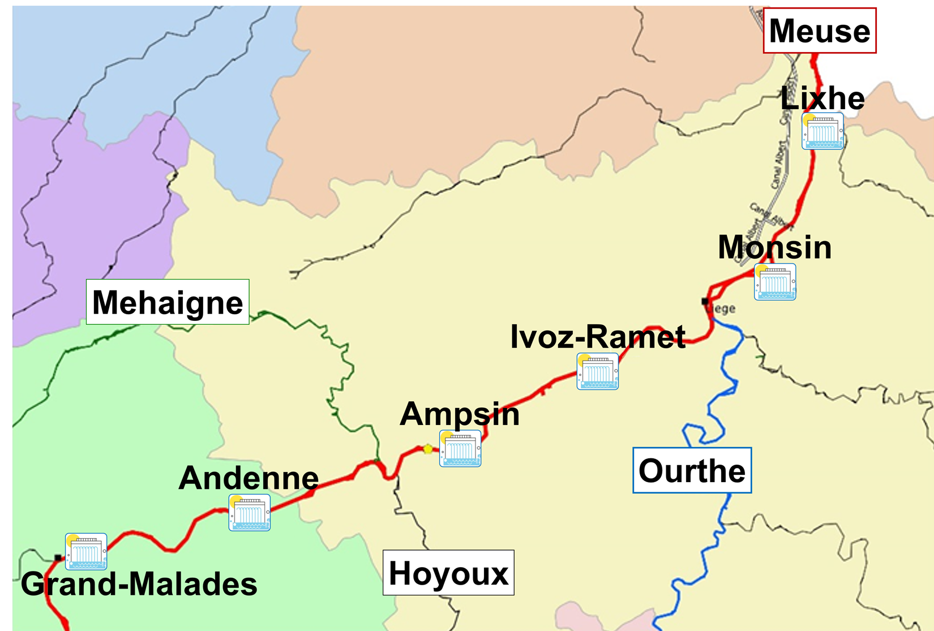

Context
Results
Discussion
Objectives
Methods
Impeding free movement
Preventing/limiting access to functional habitats
Mortalities directly and indirectly linked to the passages through hydropower plants (HPP) and over the spillways
(Freeman et al. 2003, Pringle et al., 2000; Katopodis and Williams, 2012; Larinier and Travade, 2002)
1940s: Disappearance of S. salar from the Belgian Meuse basin

Slide 5
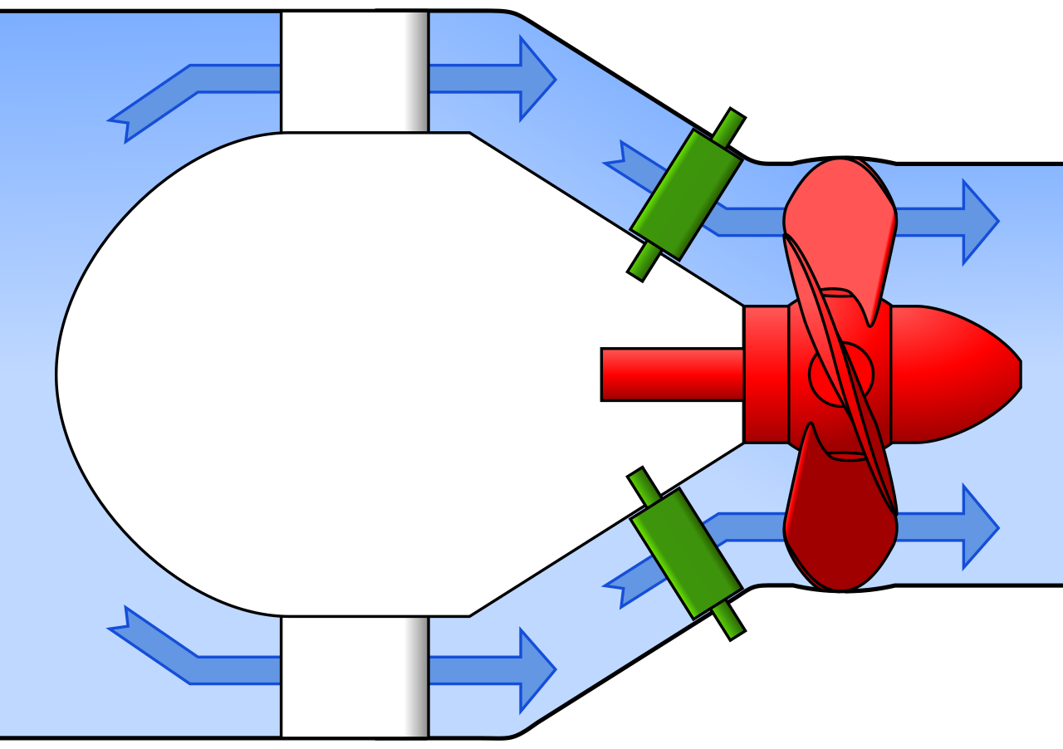

Context
Results
Discussion
Objectives
Methods
Direct mortality
Injuries
Strike from parts of the HPP
Sudden speed and pressure changes
Shear
Cavitation
(Larinier and Travade, 2002, Rivinoja 2005, Coutant and Whitney, 2000).
How surviving and uninjuried fish are affected

Slide 6
Context
Results
Discussion
Objectives
Methods
How surviving and uninjuried fish are affected
How the passage through HPP affect
Physiological condition
Health and immune status
Stress status
Metabolism
Hormone regulation
Immune system
Oxidative stress defence

Slide 7

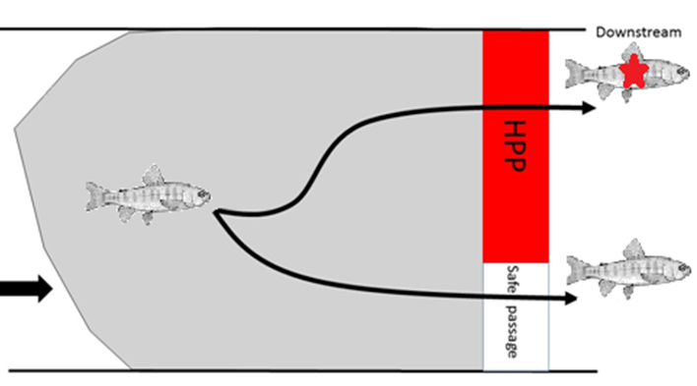
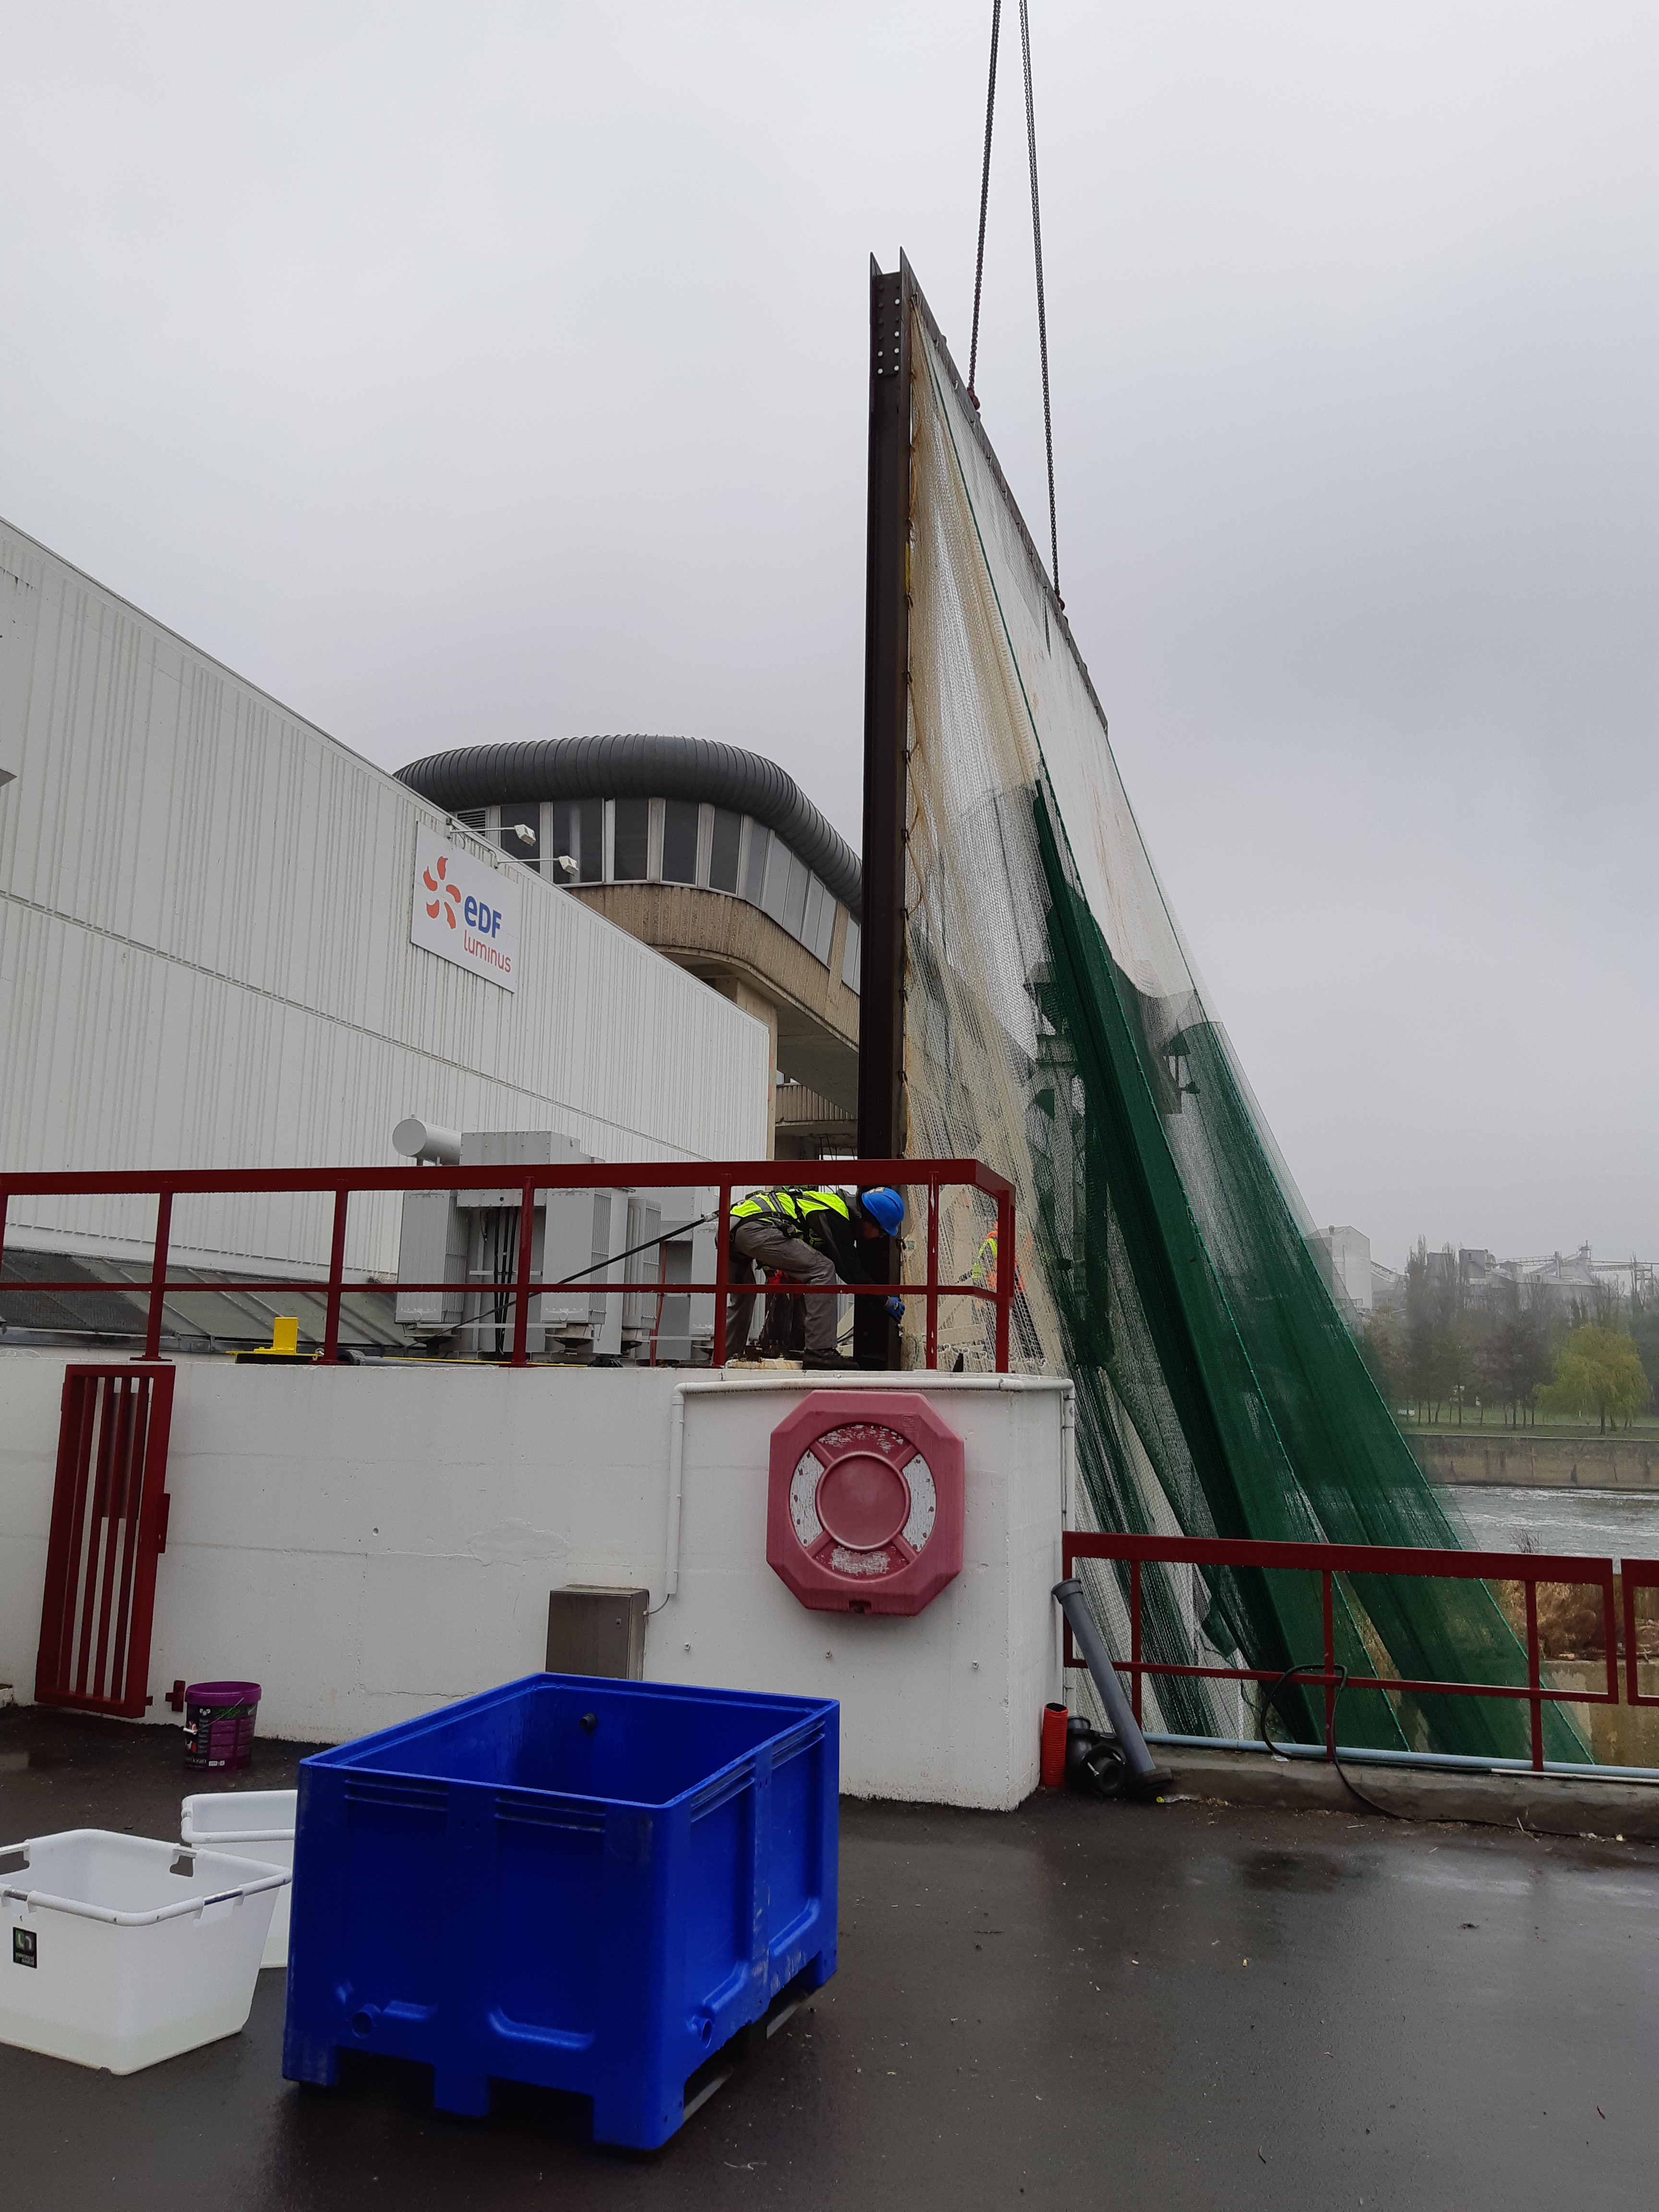
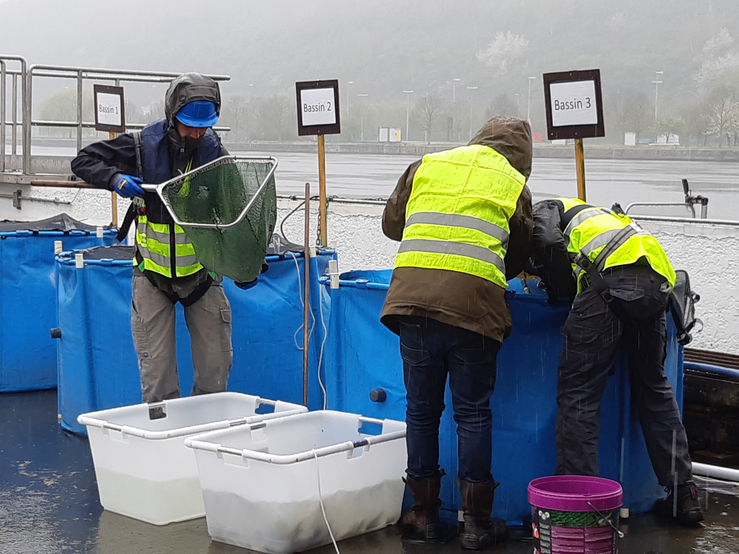
Context
Results
Discussion
Objectives
Methods
Andenne 2019
Atlantic salmon smolts

Slide 8

Context
Results
Discussion
Objectives
Methods
2 x 180
HPP group
180
Control group
72h pi
120h pi
24h pi
Physiological condition
Health and immune status
Plasma cortisol
Plasma glucose
Brain serotonine, dopamine and metabolites
Stress related genes expression
Plasma peroxidase activity
Plasma ACH50 activity
Immune system related genes expression

Slide 9
Context
Results
Discussion
Objectives
Methods
Survival and health status
2 x 180
Recovery: 71%
Survival: 97%
External damages: 7%
Recovery: 94%
Survival: 100%
180
Better survival rate in control group
No external damages in control group while some surviving fish present minor injuries in HPP group

Slide 10
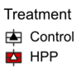
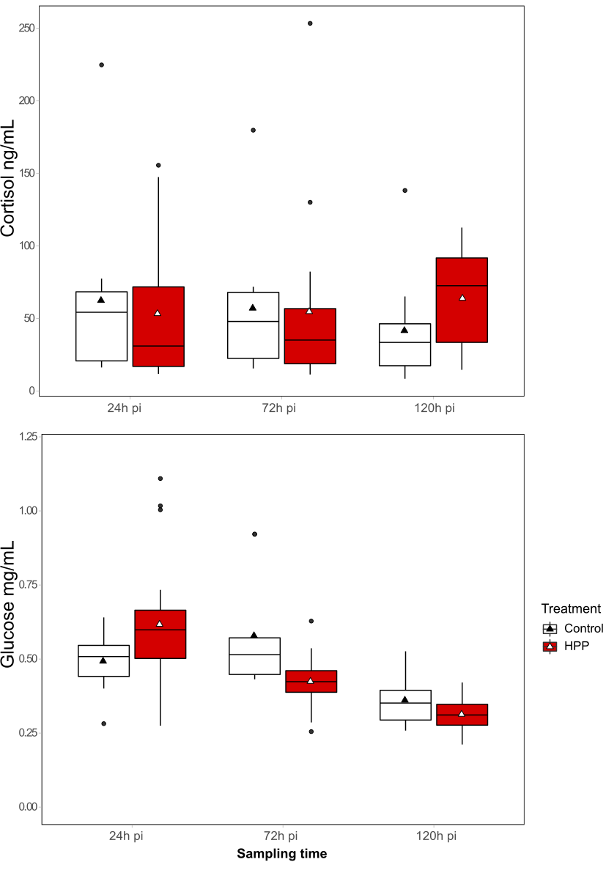
Context
Results
Discussion
Objectives
Methods
Physiological condition
A
AB
ABC
BC
CD
D
Cortisol remained stable
Glucose decreased depending on the treatment and the sampling time

Slide 11
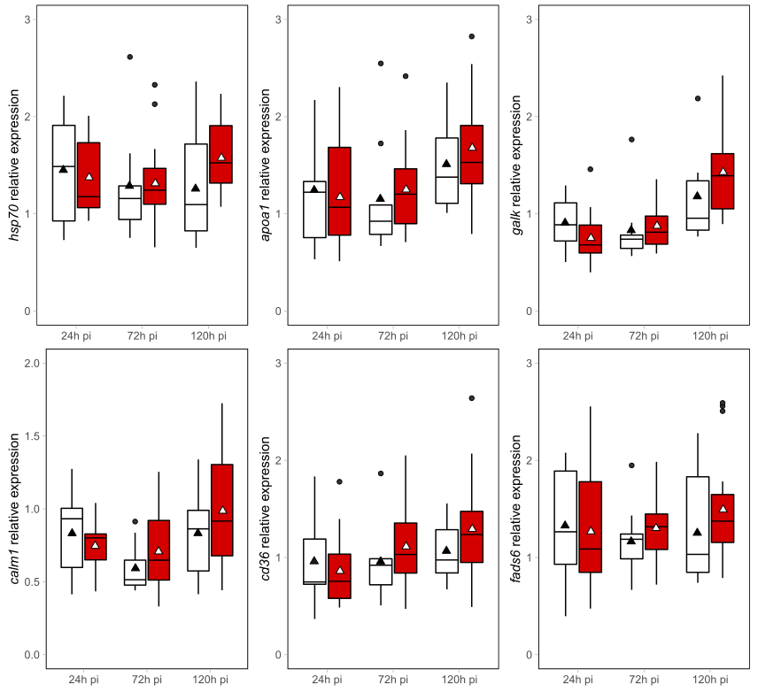
Context
Results
Discussion
Objectives
Methods
Physiological condition
Variations depending on the sampling time only with general increase at 120h pi

Slide 12
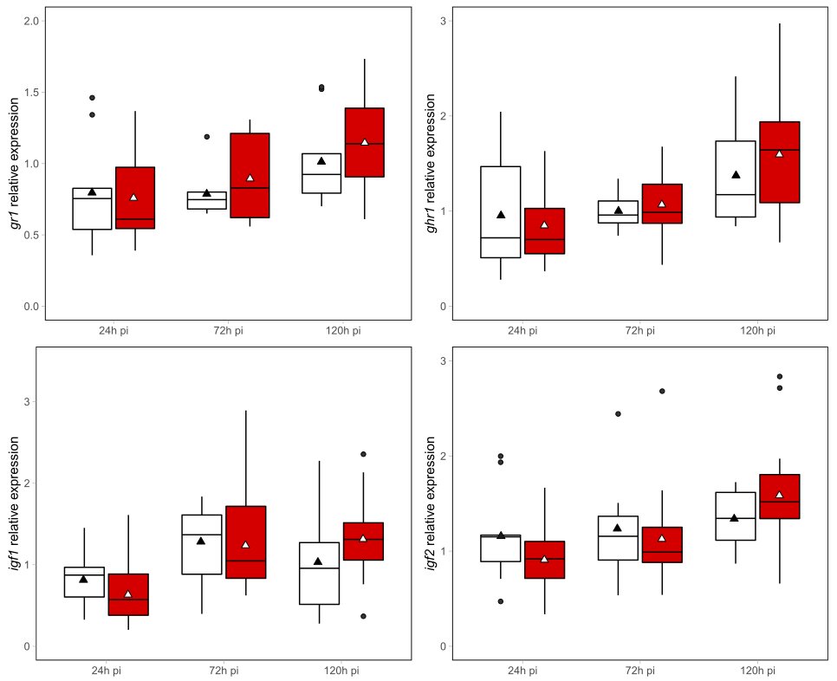
Context
Results
Discussion
Objectives
Methods
Physiological condition
Variations depending on the sampling time only with general increase at 120h pi

Slide 13
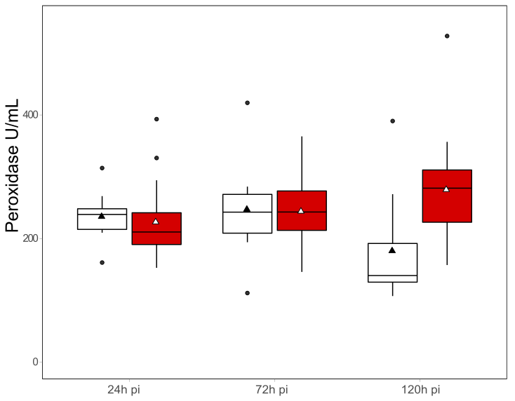

Context
Results
Discussion
Objectives
Methods
Immune system status
A
A
A
B
AB
AB
BC
AB
B
B
BC
C
Peroxidase higher in HPP than control at 120h pi
ACH50  between 24h and 72h pi for control group and 72h and 120h pi for HPP

Slide 14
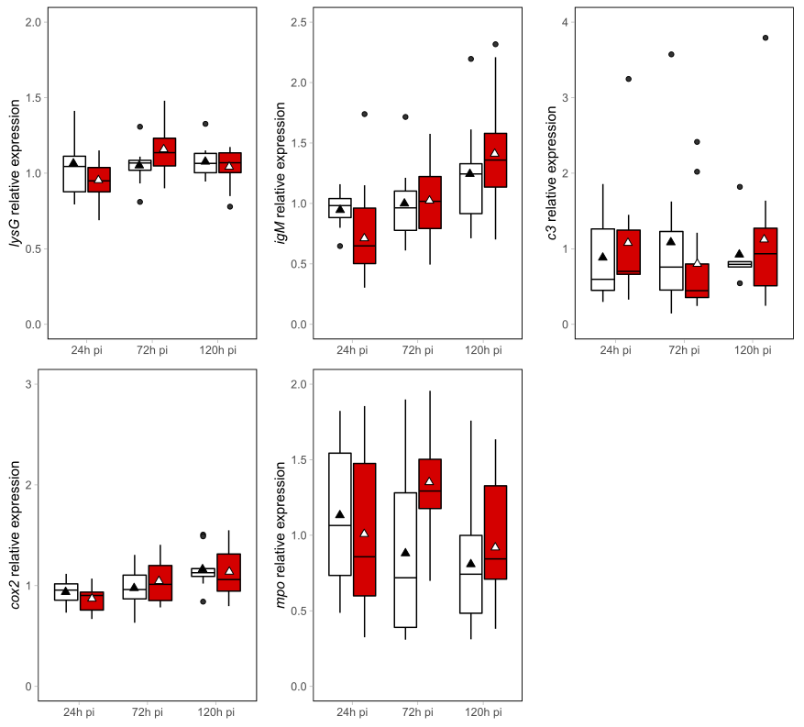
Context
Results
Discussion
Objectives
Methods
Immune system status
A
igM and cox2 varied depending on the sampling time
AB
AB
AB
B
AB
AB
A
AB
B
AB
AB
lysG and mpo varied depending on the interaction between treatment and sampling time

Slide 15
Context
Results
Discussion
Objectives
Methods
Cortisol levels remained stable: Fish enhanced sensitivity to the stress + the stress due to the injection itself overshadow the stress due to the turbine?
More abrupt ⬇ of glucose levels in HPP fish→ ⬆ in energy expenditure due to the stress and confrontation with the turbine: possible exhaustation?
Variations over the time for metabolism and hormone regulation related genes

Slide 16
Context
Results
Discussion
Objectives
Methods
Peroxidase activity higher in HPP group (at 120h pi): native immune response linked to oxidative stress response
Similar pattern for mpo gene expression (at 24h pi) linked to oxidtive stress response
ACH50 higher at 24h pi in control group and ⬇ earlier than in HPP group + lysG gene expression higher at 72h pi in HPP group → disruption of the native immune system: transient immunostimulation due to the stress?

Slide 17

Context
Results
Discussion
Objectives
Methods
Take-home message :
Passage throurgh the turbine disrupted stress and native immune system
This disruption seems to lead to a possible exhaustation and a transient immunostimulation
What about the cumulative impact of many passages

