Slide 1
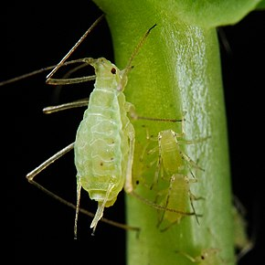
Design of biocontrolled pesticides based on detrimental insects trehalase inhibition
Virgile Neyman
Promoteur : Dr. Catherine Michaux Co-promoteur : Pr. Frédéric Francis
11/02/2020

Slide 2
Context
Project
Biochemical function
Work plan
Context
Insecticids market in EU
Up to € 1,3 billion /year
Most commonly fought against with neonicotinoids and pyrethrinoids
However these compounds have a huge damaging impact on :
Acyrthosiphon pisum
Or « Pea aphid »
Environment
Human health
Cases of resistances
Hayo M. G. Van der Werf, 1996. Agriculture, Ecosystems and Environment n°60.
I. Baldi, et al, 2013. Inserm : Editions EDP Sciences (ISSN: 1264-1782)
S.P. Foster, et al, 2013. SCI.
1

Slide 3
Context
Project
Biochemical function
Work plan
Project
Formulation of new insecticides targeting and disrupting the insects biochemical functions.
Now
Aim of the project
Action mode
Central nervous system
Targeting a specific biochemical function
Insects (useful), vertebrates, mammals
(Human being)
Affected species
A.pisum
Silva, M. C. P., Terra, W. R., & Ferreira, C, 2004. Insect Biochemistry and Molecular Biology, 34(10).
Sparks, T.C., & Nauen, R., 2015. Pesticide Biochemistry and Physiology.
2

Slide 4
Context
Project
Biochemical function
Work plan
Biochemical function studied
Inhibition of the trehalase activity leading to a dysfunction in the life-sustaining biological systems of the target insects
For the human being : trehalase is only required for the degradation of ingested trehalose
Investigations on trehalase inhibitors are limited but show various results
Shukla, E., Thorat, L. J., Nath, B. B., & Gaikwad, S. M, 2014. Glycobiology, 25(4).
Thompson, S.N., 2003. Advances in Insect Physiology.
3

Slide 5
Context
Project
Biochemical function
Work plan
Work plan
4 steps - WP
Purification of Trehs from A.pisum (WP1)
Inhibition tests on Trehs from A.pisum (WP3)
Characterization of Trehs from A.pisum (WP2)
Inhibition tests on Trehs from useful insects (WP4)
4

