Slide 1
Do engineered nanoparticles present ecotoxicological risks for aquatic organisms ?
Mahaut Beghin
February 2020
Supervisor : Pr. Patrick Kestemont

Slide 2
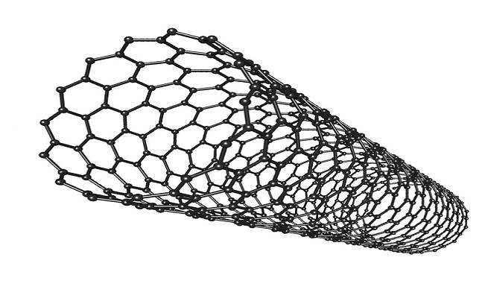
What is an engineered nanoparticle?
>12000 different nanoparticles
Size ≤100 nm
carbon
metal
dendrimer
polymer
®WishLab
®WishLab
(Keller et al., 2017)
1

Slide 3
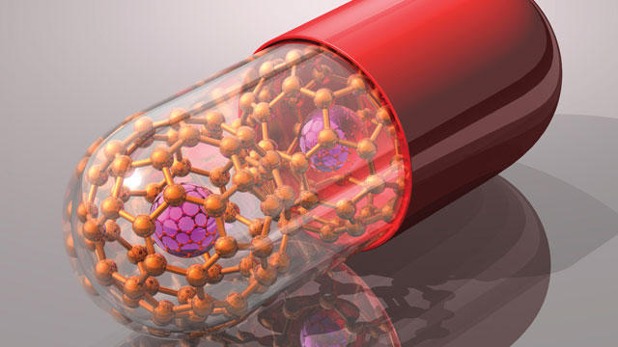
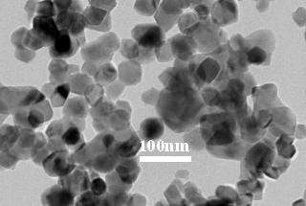
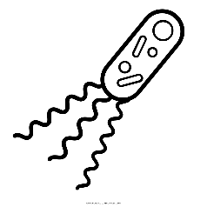
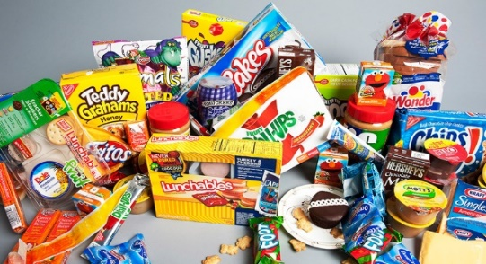
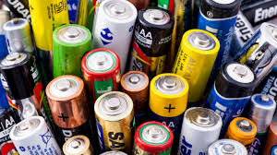
What are they used for?
(Heinz et al., 2017)
2

Slide 4
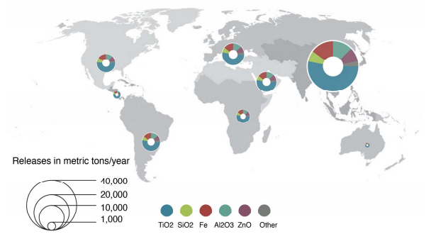
What consequences for aquatic ecosystems?
4
69000 tons/year in aquatic ecosystems
Average concentrations: 50 – 500 ng L⁻¹
(Keller et al., 2013; Sun et al., 2014)
3

Slide 5
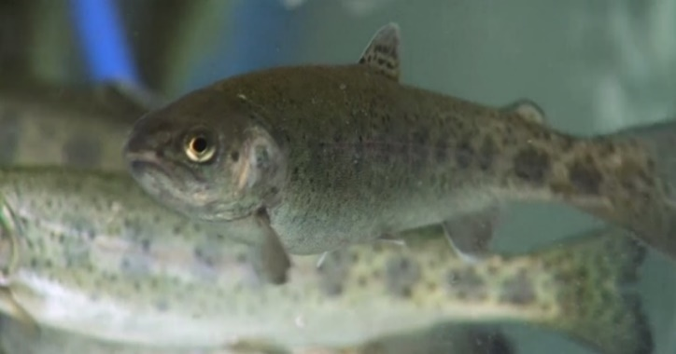
Objectives
Comparative study of titanium and zinc nanoparticles toxicity individually and in mixture and their impact on rainbow trout immune system
Oncorhynchus mykiss
Ti
Zn
4

Slide 6
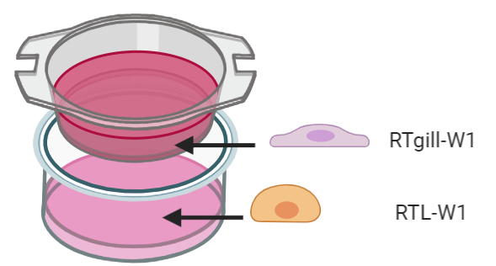
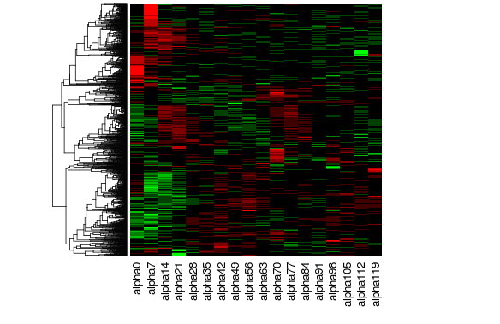
Experimental design
WP1: In vitro approach
RNA Seq
Affected physiological functions ?
5

Slide 7
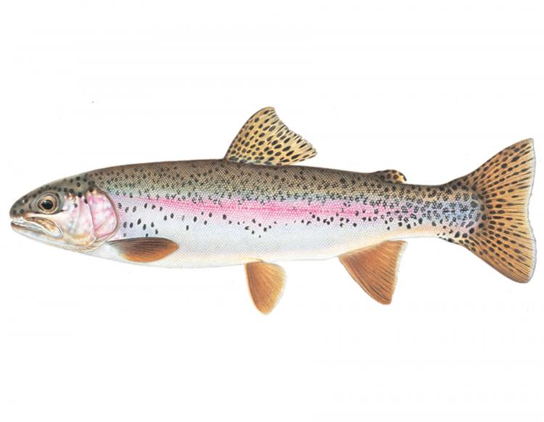
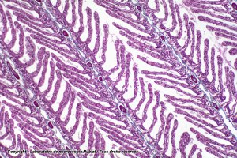
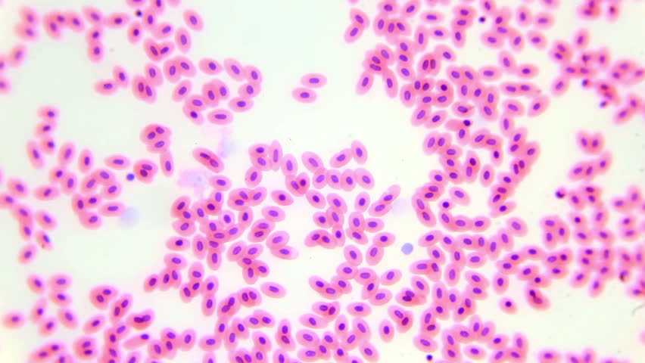
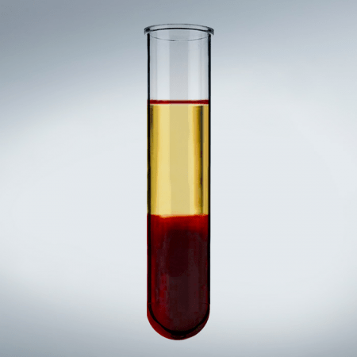
Experimental design
WP2: In vivo approach
Ti
Zn
Anterior kidney
Oxydative stress
gills
spleen
Immune functions
liver
30 days exposure
Effects on imunity ?
6

Slide 8
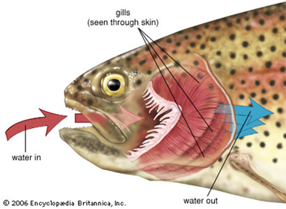
Experimental design
WP3: Mucosal approch
mucosal immunity
comensal microbiota
Impact on gills mucosal immunity and comensal microbiota ?
7

Slide 9
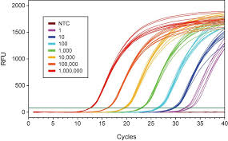
Experimental design
Anterior kidney
gills
spleen
liver
Ti
Zn
7

Slide 10
Thank you for your attention !
8

Slide 11
Bibliography
Song R, Qin Y, Suh S, Keller AA. Dynamic Model for the Stocks and Release Flows of Engineered Nanomaterials. Environ Sci Technol. 2017;51(21)
Heinz H, Pramanik C, Heinz O, et al. Nanoparticle decoration with surfactants: Molecular interactions, assembly, and applications. Surf Sci Rep. 2017;72(1):1-58
Lange S, Magnadóttir B. Spontaneous haemolytic activity of Atlantic halibut (Hippoglossus hippoglossus L.) and sea bass (Dicentrarchus labrax) serum. Comp Biochem Physiol Part B Biochem Mol Biol. 2003;136(1):99-106. 4.
Keller AA, Lazareva A. Predicted Releases of Engineered Nanomaterials: From Global to Regional to Local. Environ Sci Technol Lett. 2013;1(1):65-70.
Sun TY, Gottschalk F, Hungerbühler K, Nowack B. Comprehensive probabilistic modelling of environmental emissions of engineered nanomaterials. Environ Pollut. 2014;185:69-76.
Liu J, Cai Y, Lu G, Dan X, Wu D, Yan Z. Interaction of erythromycin and ketoconazole on the neurological, biochemical and behavioral responses in crucian carp. Environ Toxicol Pharmacol. 2017;55:14-19.
Dubey A, Goswami M, Yadav K, Chaudhary D. Oxidative Stress and Nano-Toxicity Induced by TiO2 and ZnO on WAG Cell Line. PLoS One. 2015;10(5):1-26.
Tang T, Zhang Z, Zhu X. Toxic effects of TiO 2 NPs on Zebrafish. Int J Environ Res Public Health. 2019;16(4).
Chupani L, Niksirat H, Velíšek J, et al. Chronic dietary toxicity of zinc oxide nanoparticles in common carp (Cyprinus carpio L.): Tissue accumulation and physiological responses. Ecotoxicol Environ Saf. 2018;147:110-116.
Lison D, Huaux F. In vitro studies: Ups and downs of cellular uptake. Nat Nanotechnol. 2011;6(6):332-333. Hassellöv M, Kaegi R. Analysis and Characterization of Manufactured Nanoparticles in Aquatic Environments.; 2009.
Roux F. Fish cell lines and their potential uses in ecotoxicology: from cytotoxicity studies and mixture assessment to a co-culture model and mechanistic analyses. 2015.
Lammel T, Thit A, Mouneyrac C, Baun A, Sturve J, Selck H. Trophic transfer of CuO NPs and dissolved Cu from sediment to worms to fish-a proof-of-concept study. Environ Sci Nano. 2019;6(4):1140-1155.
Correia AT, Rebelo D, Marques J, Nunes B. Effects of the chronic exposure to cerium dioxide nanoparticles in Oncorhynchus mykiss: Assessment of oxidative stress, neurotoxicity and histological alterations. Environ Toxicol Pharmacol. 2019;68:27-36.

Slide 12
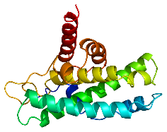
Toxicity mechanisms
Reactive oxygen species production (O₂^{.-} , .OH, H₂O₂)
ROS
Nanoparticles
ROS generation
ions
ROS
Cytoskeleton disruption
ROS
ROS
Protein denaturation
ROS
DNA damage
Cell death
(adapted fromLiu et al., 2017)
5

Slide 13
Nanoparticules métalliques
TiO₂
SiO₂
ZnO
FeO
CuO
AlO₃
CeO₂
Ag

