Slide 1
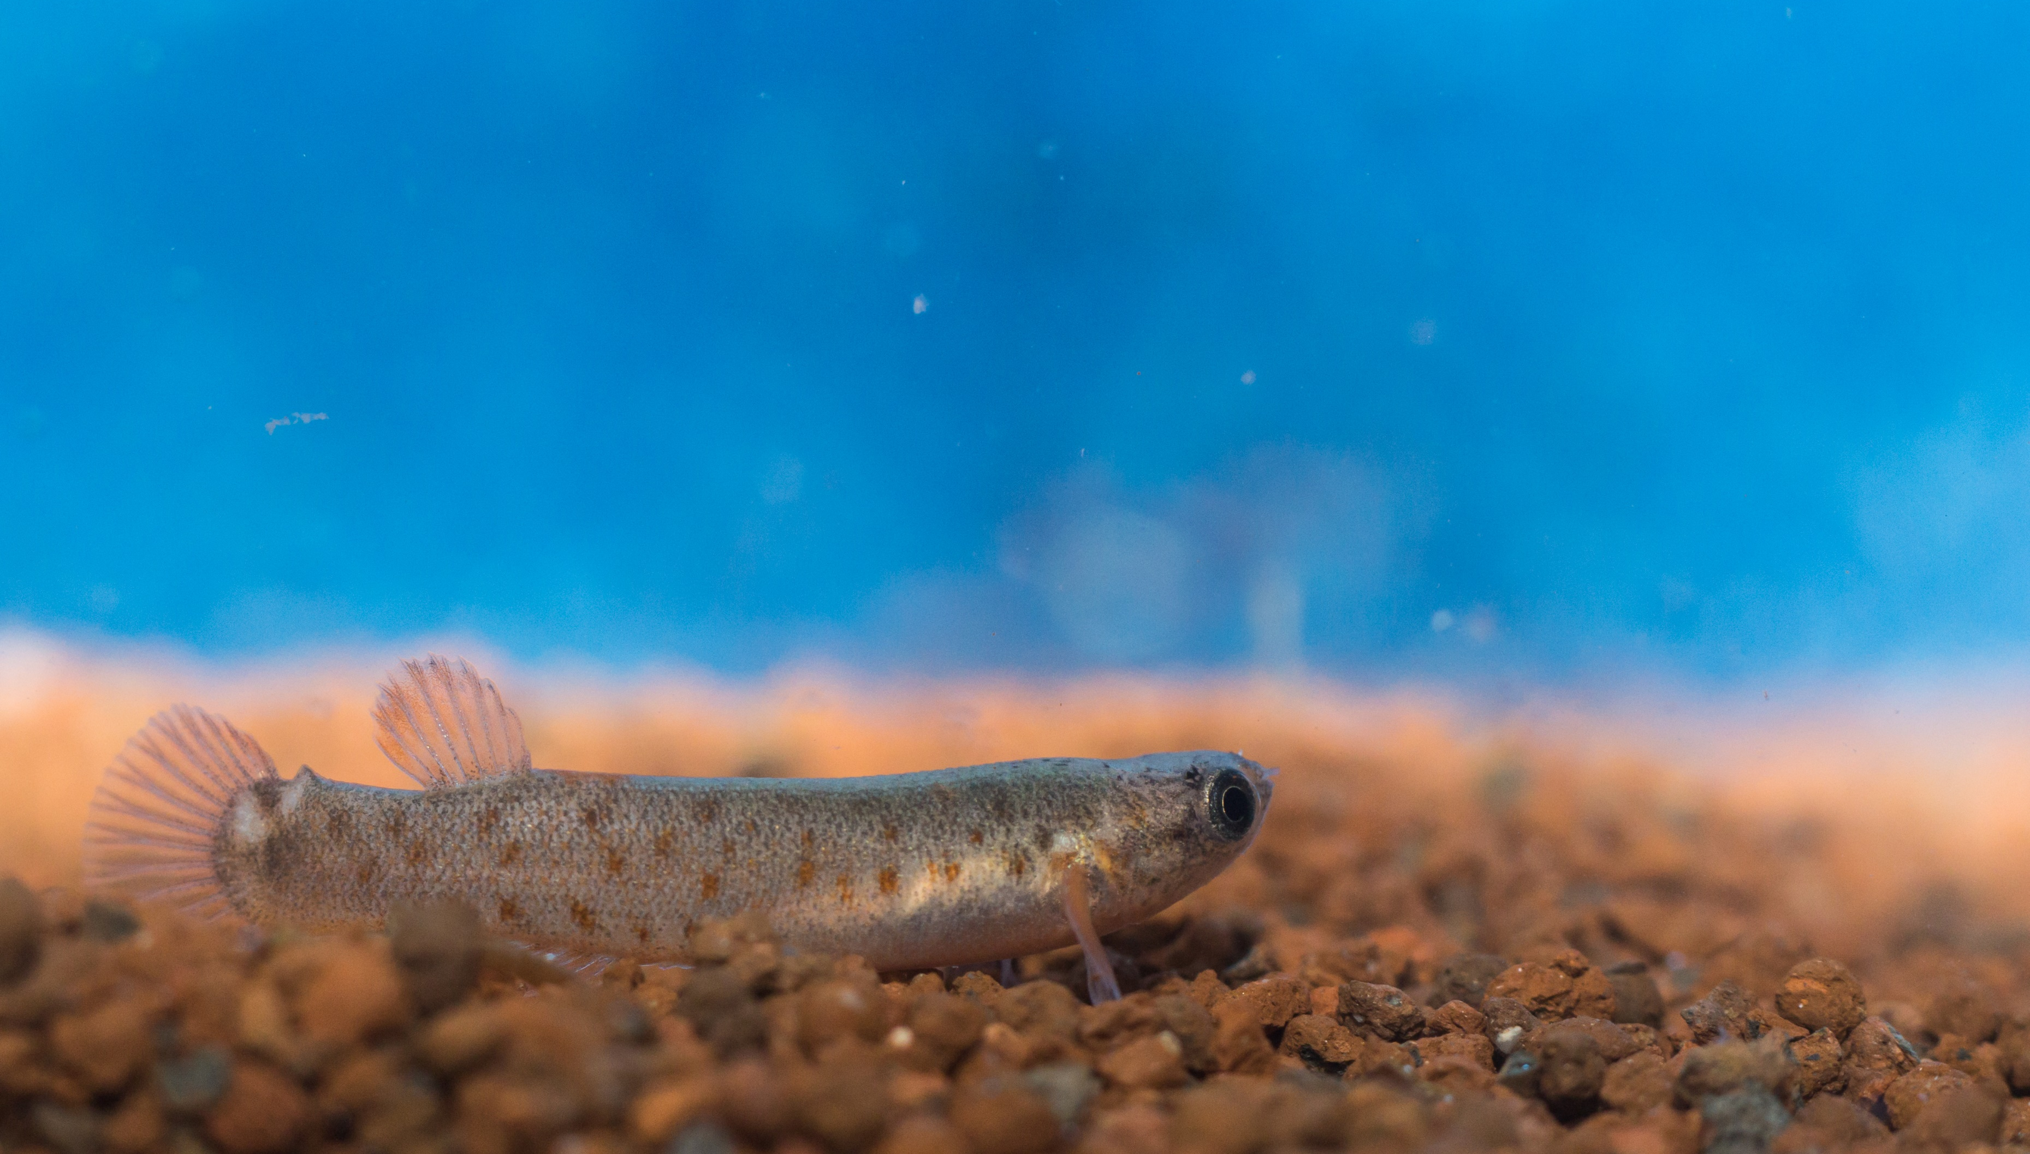
Insight into the complex sexuality of the only
self-fertilizing vertebrate, the mangrove rivulus
Y. Blanco Alvarez*, A. Fellous*, R. Earley**, F. Silvestre*
* Laboratory of Evolutionary and Adaptive Physiology, University of Namur, Belgium
** Department of Biological Sciences, University of Alabama, USA

Slide 2
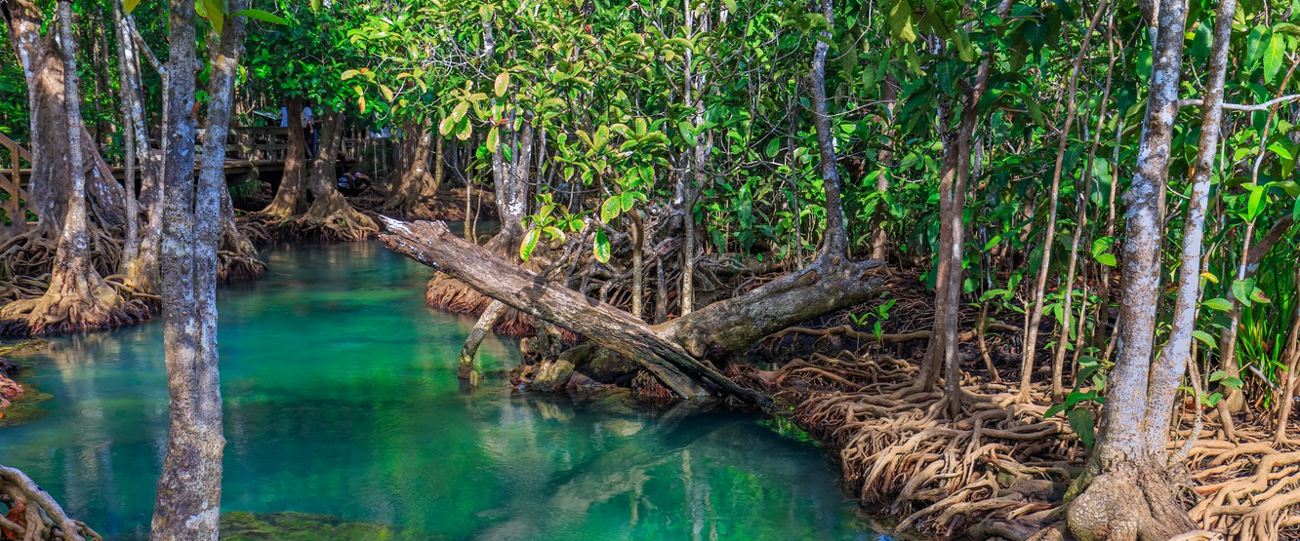
K. marmoratus in the wild

Slide 3
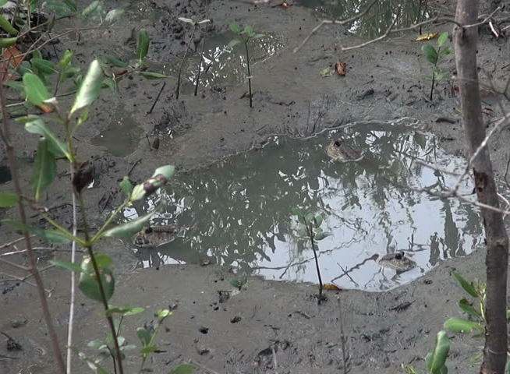
K. marmoratus in the wild

Slide 4
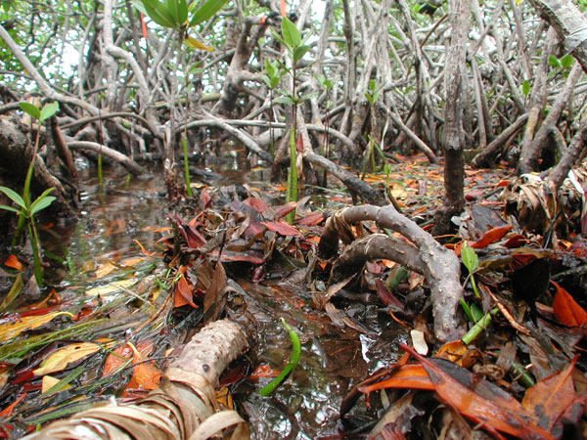
K. marmoratus in the wild

Slide 5
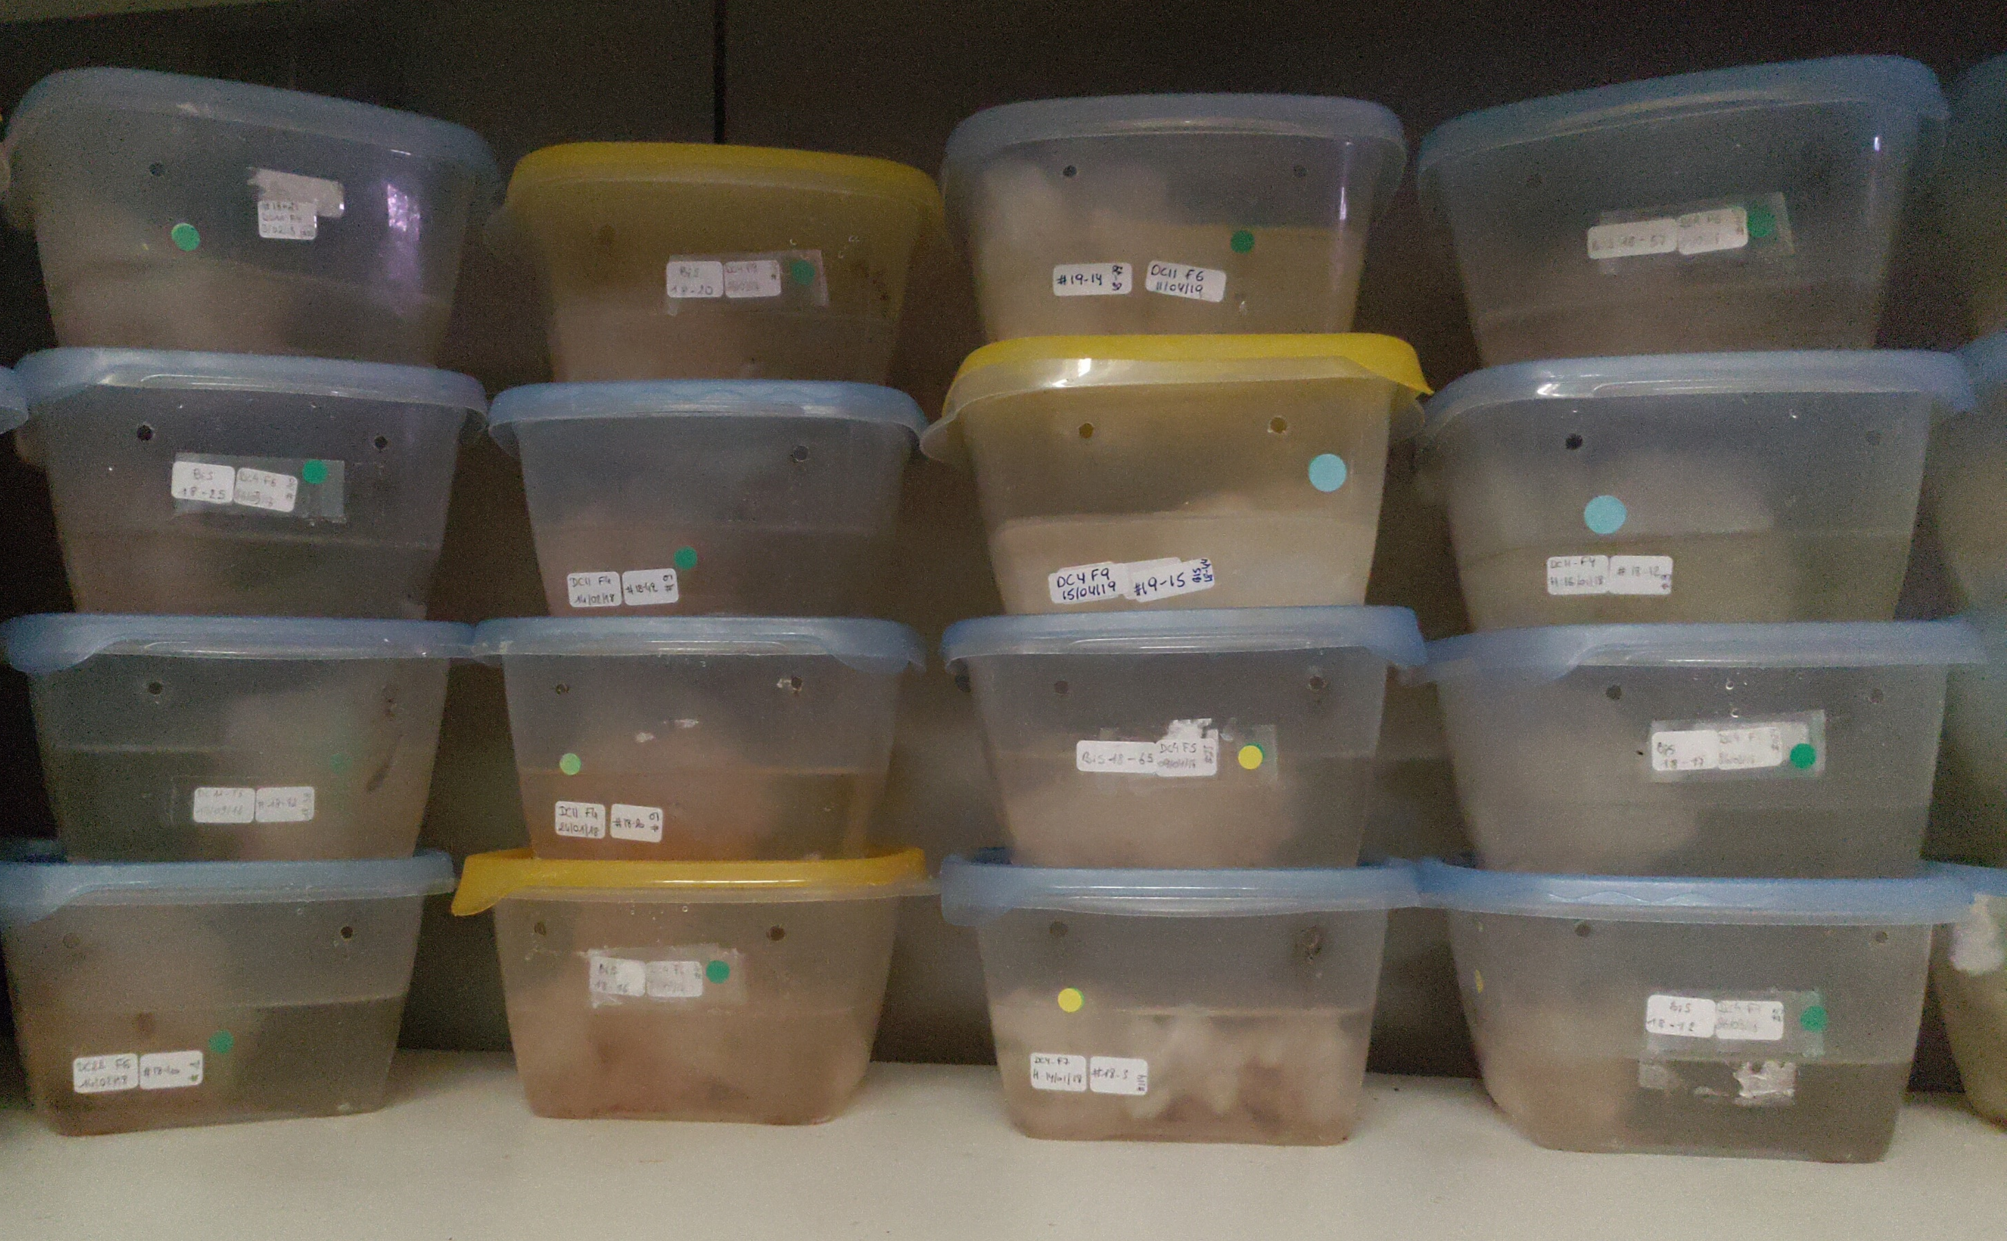
A promising model vertebrate
Tatarenkov et al. 2010
All it needs is a Tupperware
100s of naturally homozygote and isogenic lineages already exist

Slide 6
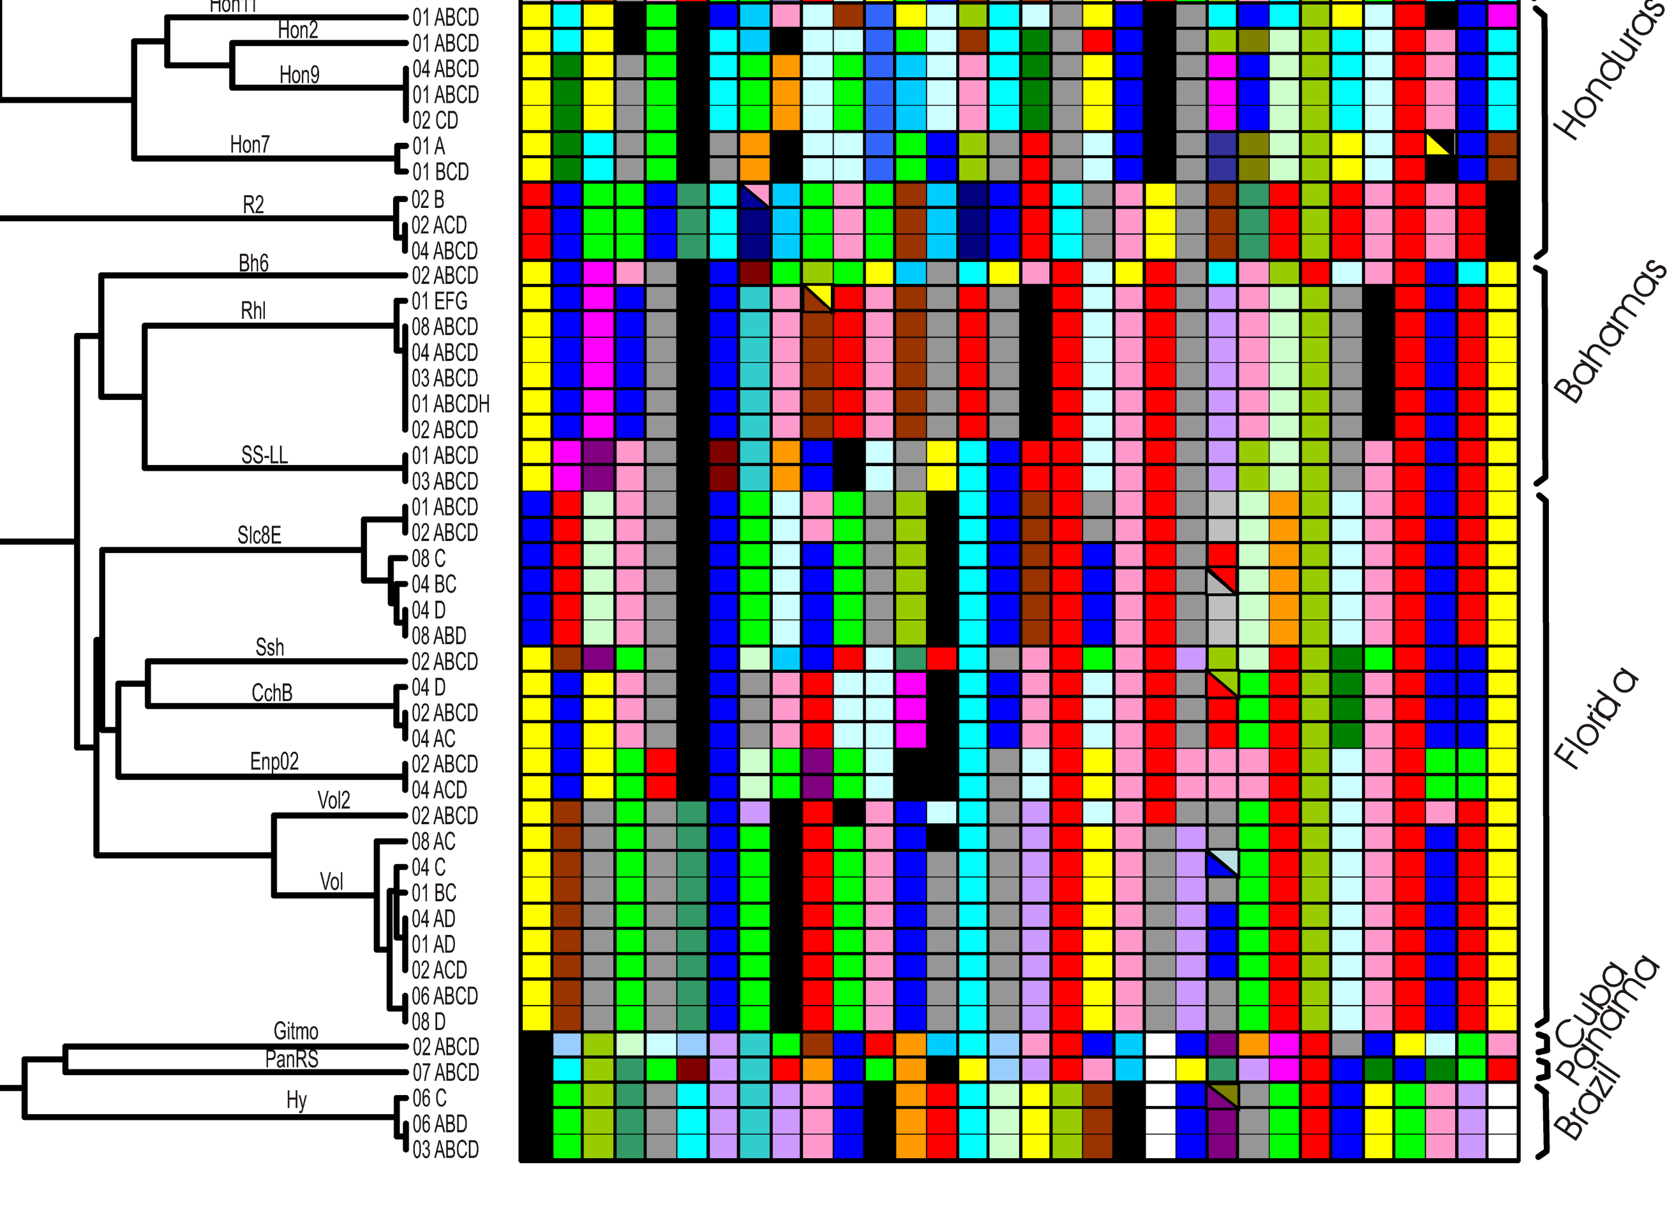
Tatarenkov et al. 2010
A promising model vertebrate
All it needs is a Tupperware
100s of naturally homozygote and isogenic lineages already exist

Slide 7
A complex sexuality
Environmental sex determination
Is dnmt3av2 the link between sex and environment?
Marson et al. 2019

Slide 8
A complex sexuality
Environmental sex determination
Is dnmt3av2 the link between sex and environment?
Marson et al. 2019

Slide 9
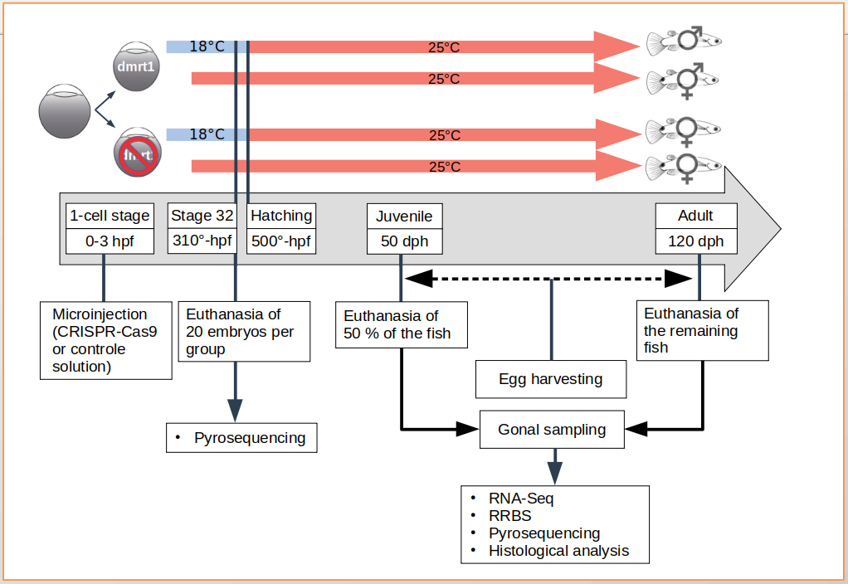
Experimental design
Knockout of dmrt1
Incubation at low or high temperature

Slide 10
Experimental design
Knockout of dmrt1
Incubation at low or high temperature

Slide 11
Experimental design
Knockout of dmrt1
Incubation at low or high temperature

Slide 12
Questions
Any questions ?

