Slide 1
Architecture and stability
of ecosystems
Camille CARPENTIER
ILEE Research day
11.02.2020

Slide 2
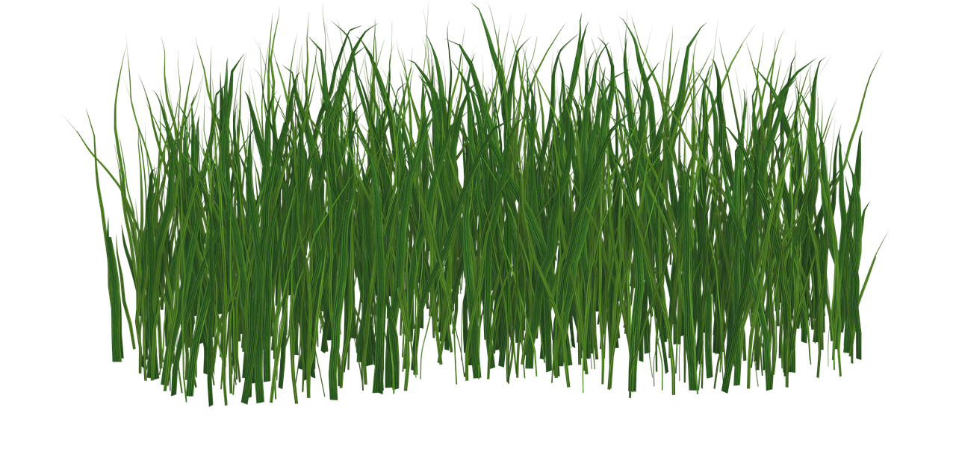
2 prey
50% community
2 prey
33% community
3 prey
50% community

Slide 3
Linkage-density law
2 prey
2 prey
Fixed number of species
Cohen and Briand, 1984
Constant connectance hypothesis
50%
50%
Fixed fraction of species
Martinez, 1992

Slide 4
Linkage-density law
Constant connectance hypothesis
Fixed number
of species
Fixed fraction
of species
$$\frac{L}{S^{2}}=a$$
$$L=a ⋅S$$
$$L$$
Why do we care?
Number of links
$$S$$
Number of species
$$b=1$$
$$L=a⋅S^{b}$$
$$b=2$$

Slide 5
$$b=1$$
Ecosystem response to species removals
$$b=2$$

Slide 6
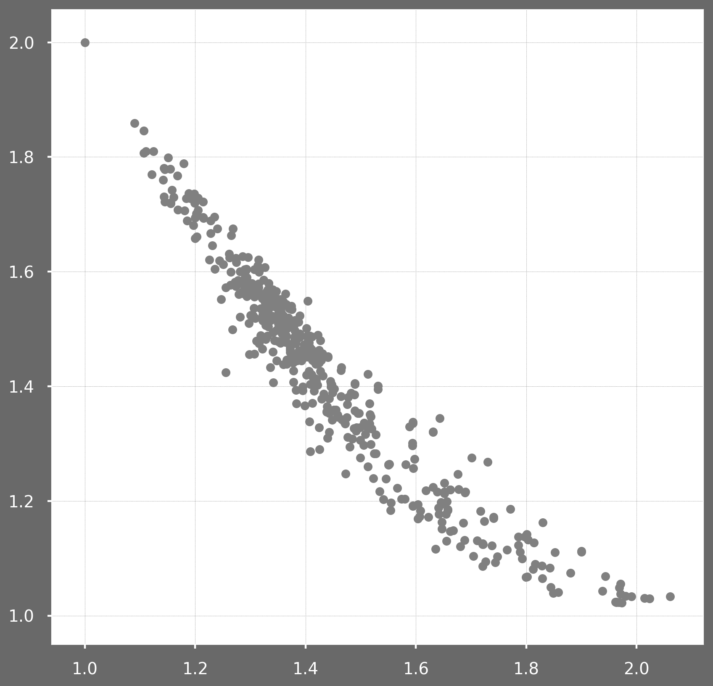
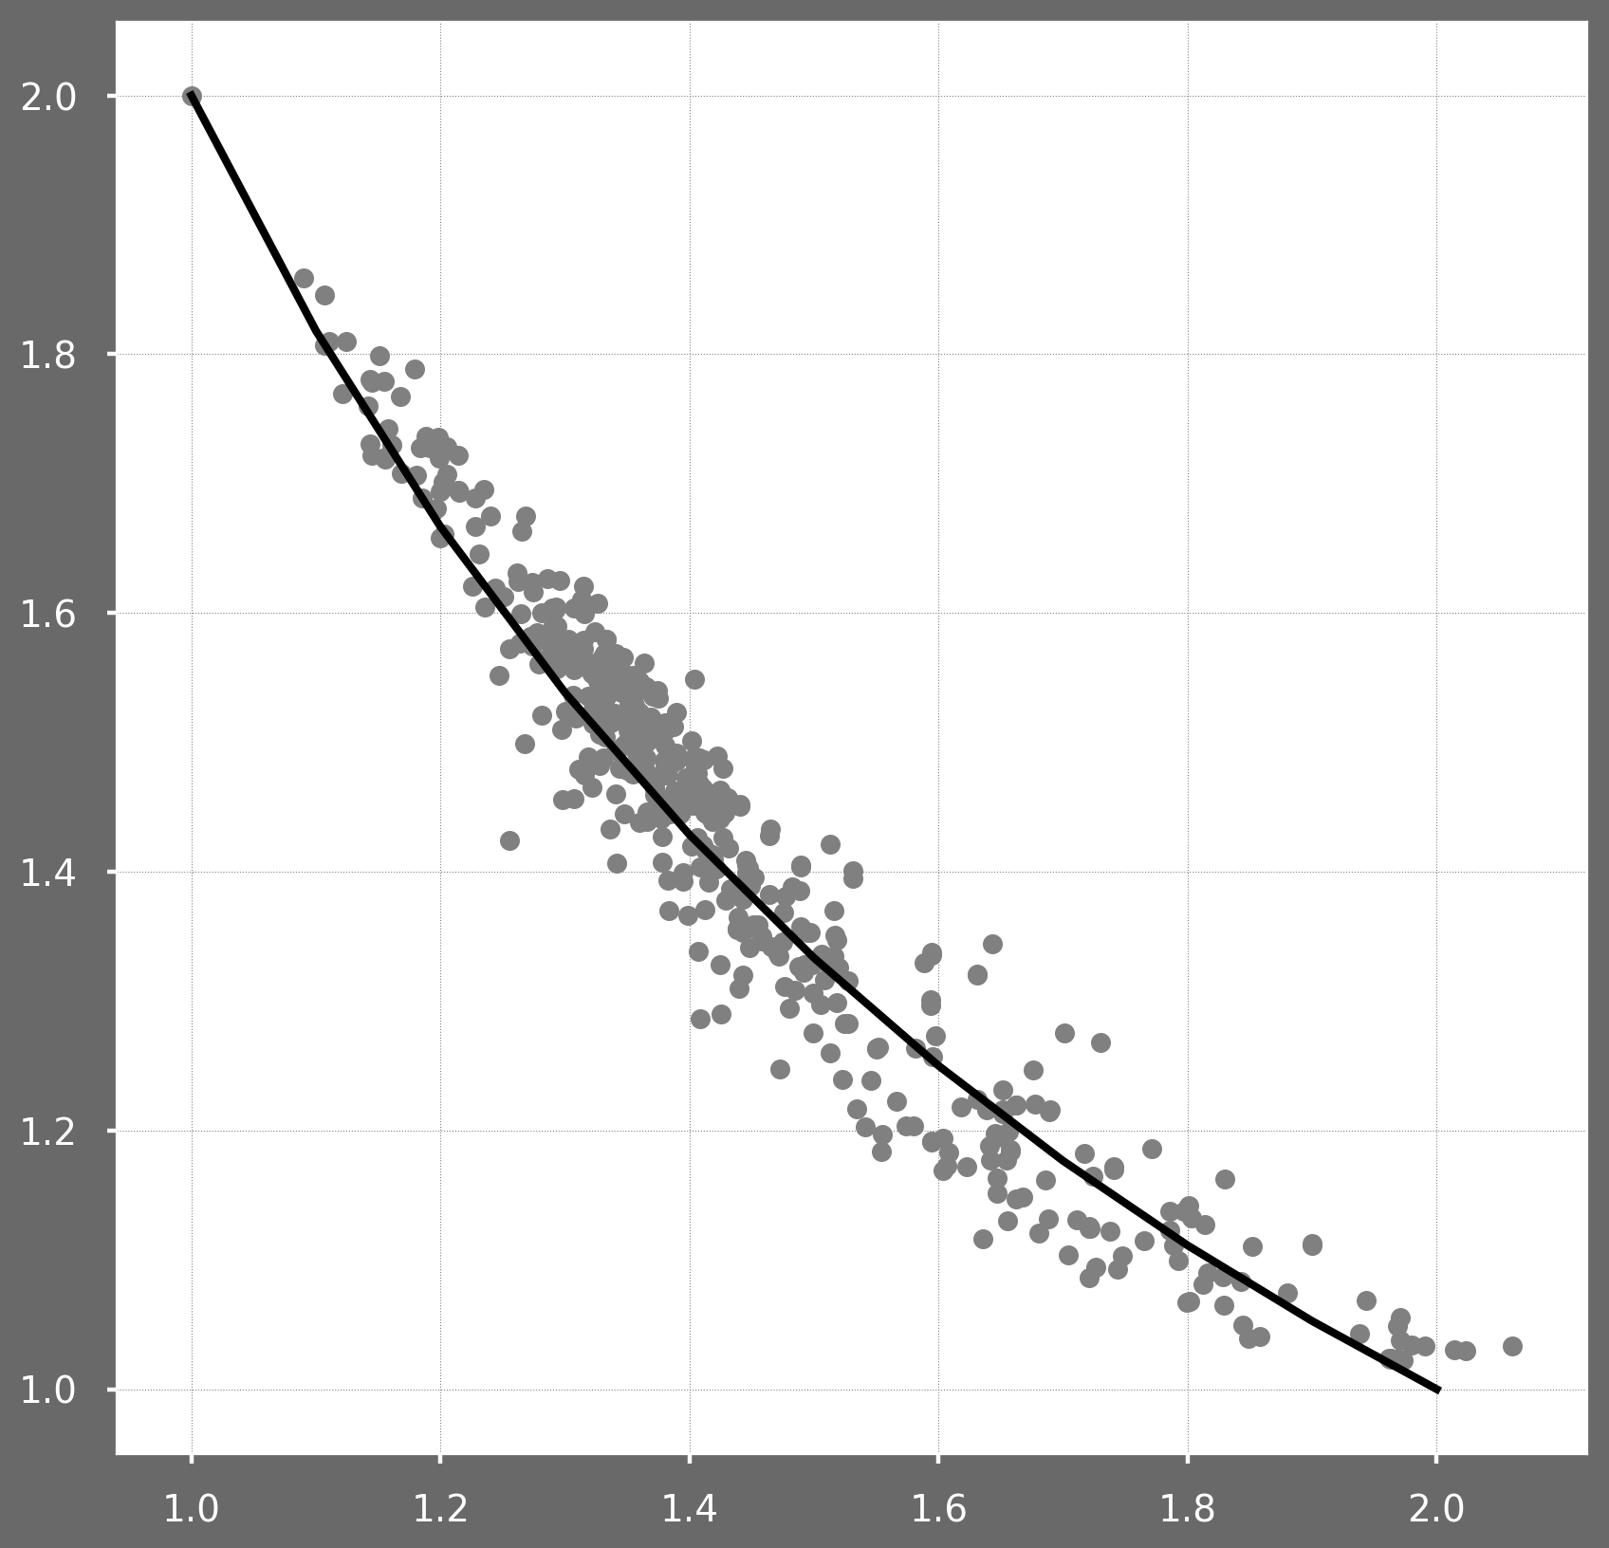
$$b=1$$
$$b=2$$
$$L=a⋅S^{b}$$
486 real networks
$$R^{2}=\text{0.93}$$
$$\frac{dL}{dS}=a⋅b⋅S^{b−1}$$
$$=b⋅\frac{{a ⋅S}^{b}}{S}$$
$$=b⋅\frac{L}{S}=b⋅\left\langle k\right\rangle$$
Mean number of extinctions
On average, $\hat{ΔL}=$ $2⋅\left\langle k\right\rangle$
$$\hat{ΔS}=\frac{2}{b}$$
$$b$$

Slide 7
$$\hat{ΔS}=\frac{2}{b}$$
Mean number of extinction = slope of lost ~removed
# species lost
$$b=1$$
$$b=2$$
50%
# species removed
Robustness
Fraction of species to remove such that 50% of species disappear

Slide 8
Robustness = resistance to species removal
What about less drastic changes?
Resilience to small changes
Ability of ecosystem to return to equilibrium
$$b=1$$
$$b=2$$
Perturbations spread faster when $b=2$
Increasing $b$ decreases Resilience

Slide 9
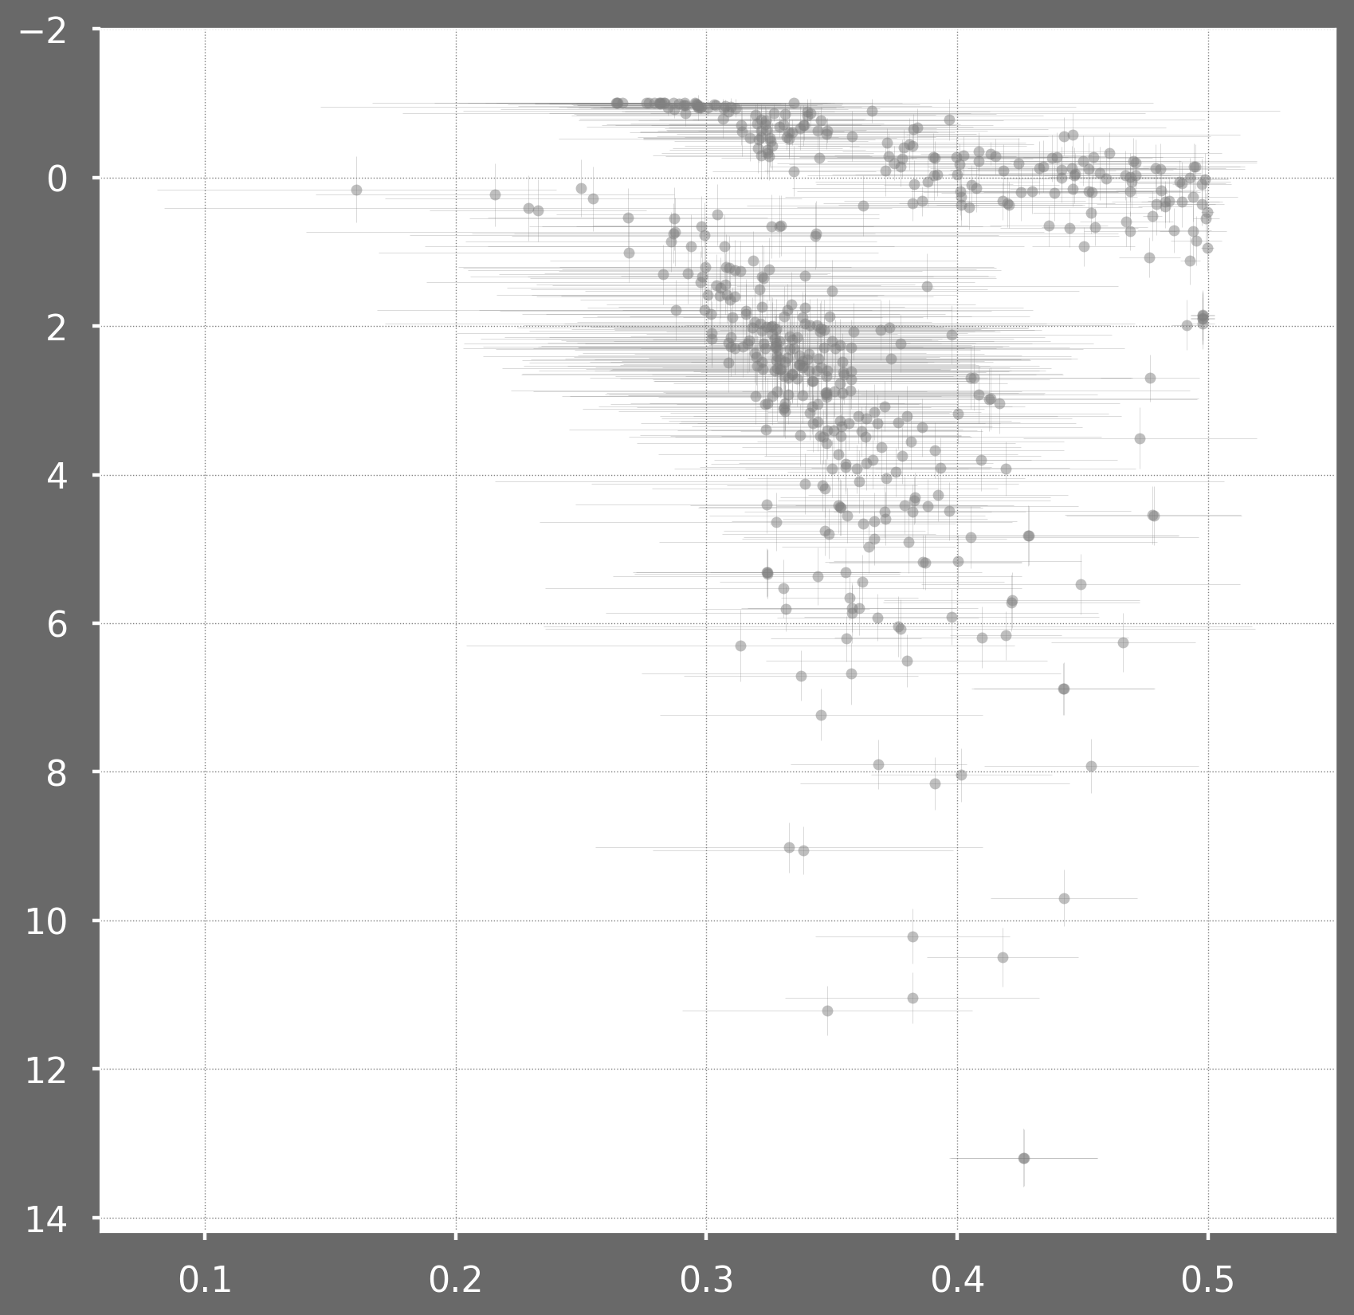
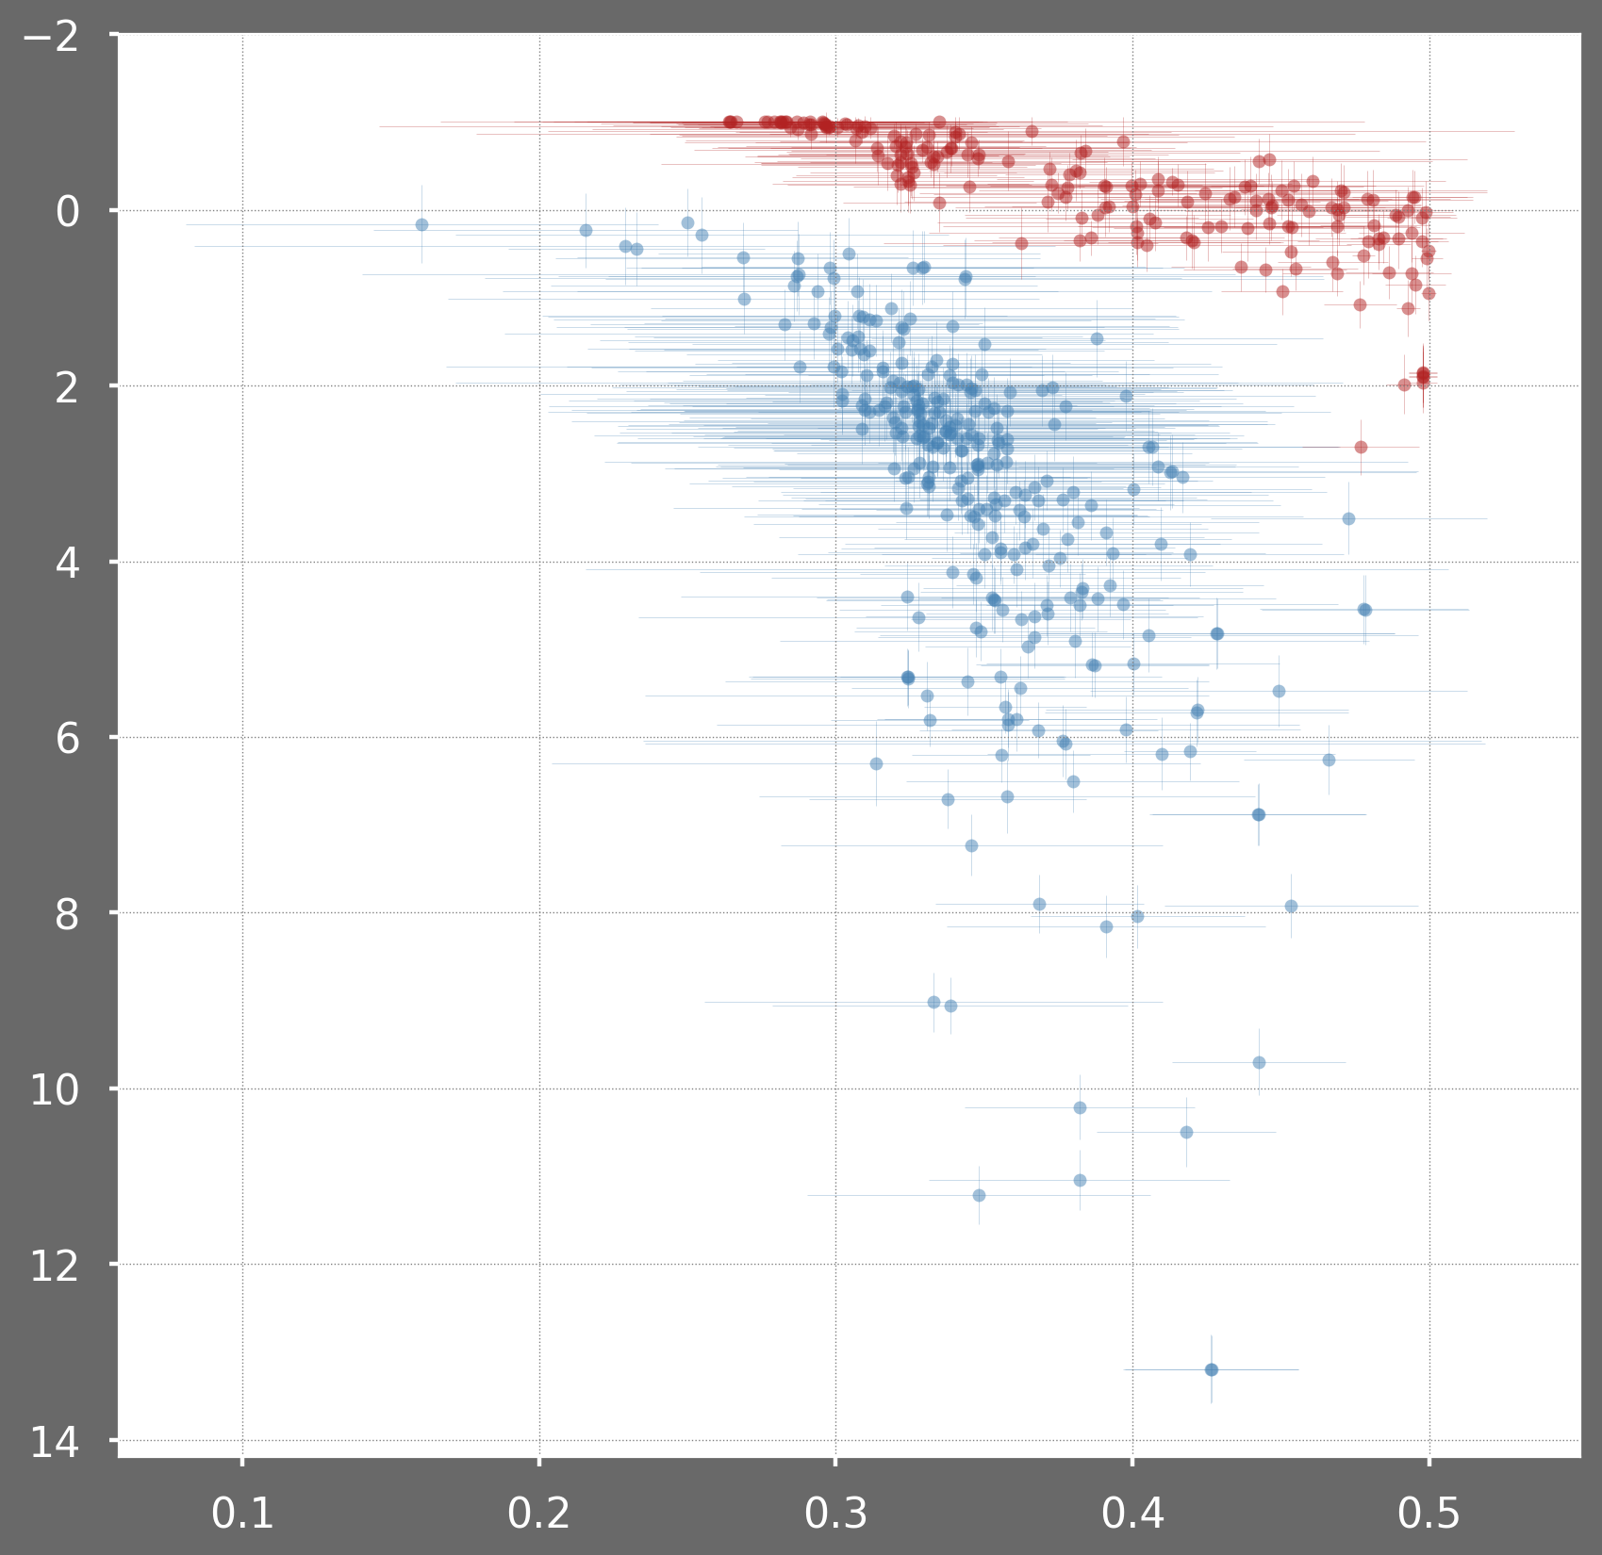
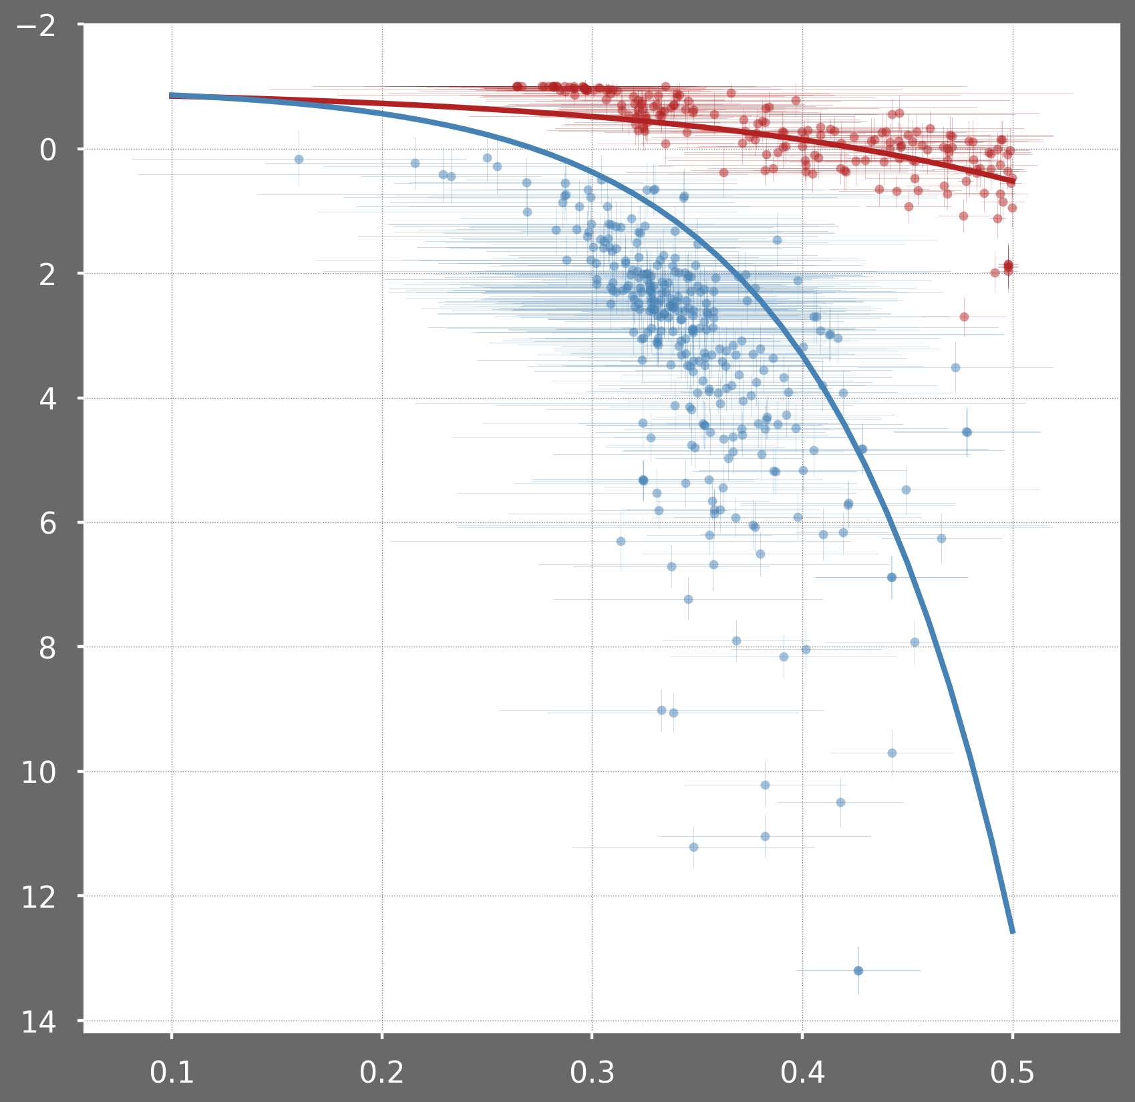
Trade-off between Resilience and Robustness
$$𝕽\left(λ_{max}\right)=−d+\sqrt{σ^{2}∙2^{1−b}∙S^{b−1}}∙\left(1−\frac{𝔼^{2}\left(\left|X\right|\right)}{σ^{2}}\right)$$
Resilience
$ℜ\left(λ_{max}\right)=−d+\left(S−1\right)∙2^{1−b}∙S^{b−2}∙𝔼\left(\left|X\right| \right)$
Resilience constrain is higher in mutualistic case
Robustness

Slide 10
$$b=1$$
$$b=2$$
Number of links
# species lost
Resilience
Number of species
# species removed
Robustness
Architecture and stability
of ecosystems

Slide 11
Architecture and stability
of ecosystems
Camille CARPENTIER
ILEE Research day
11.02.2020

Slide 12
Annexes

Slide 13
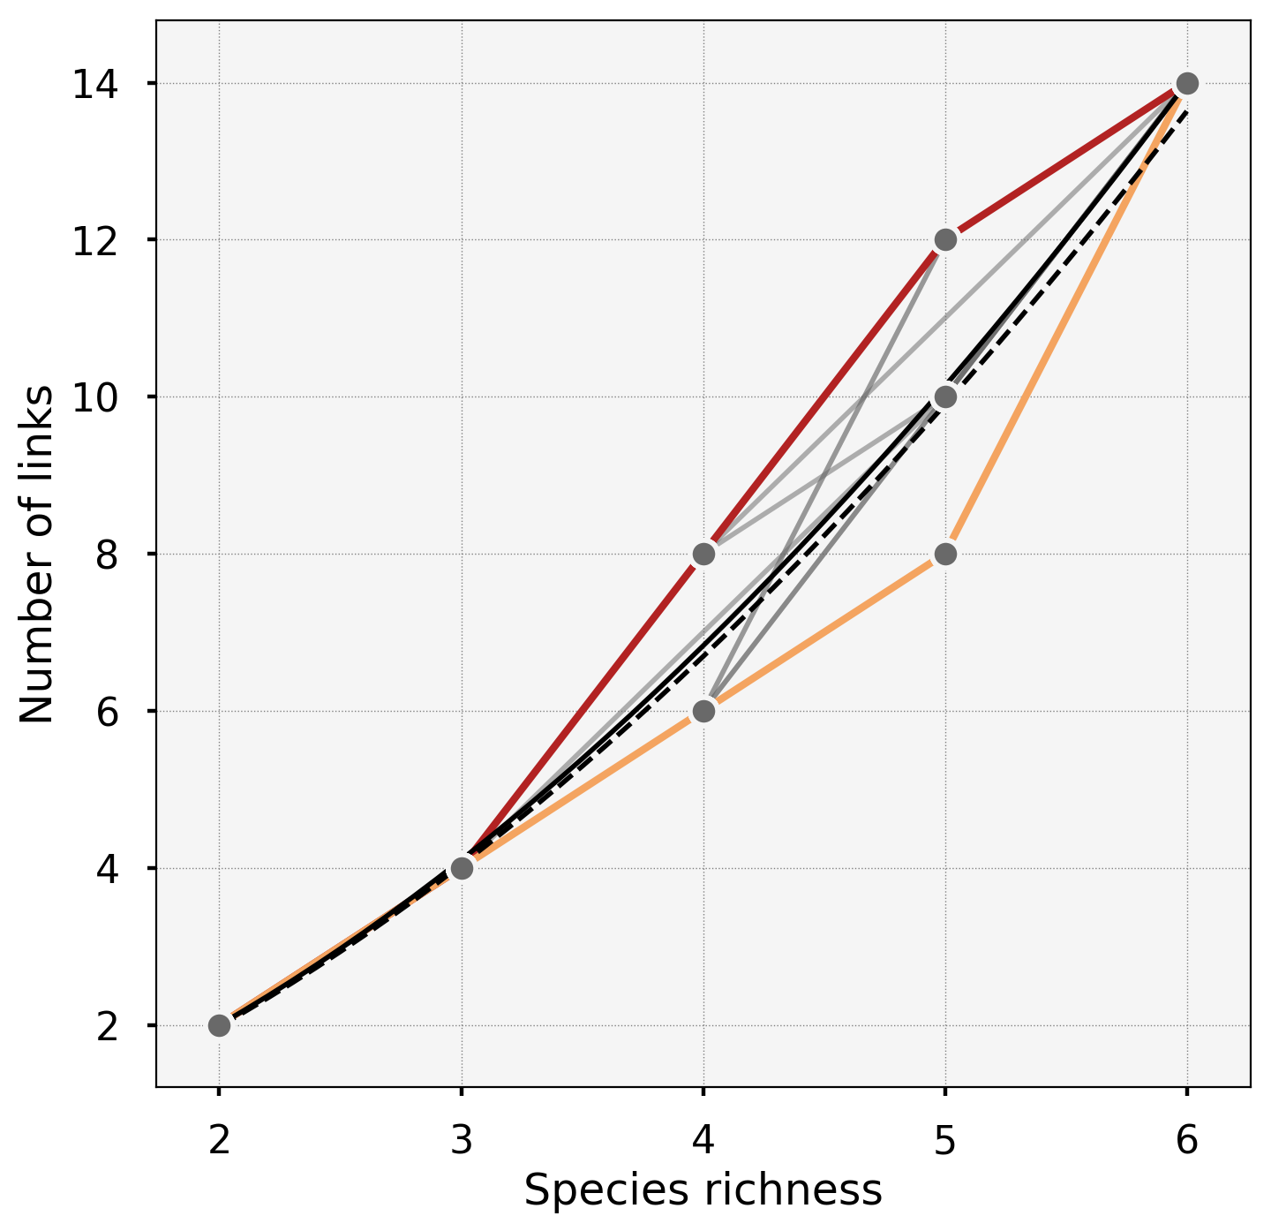
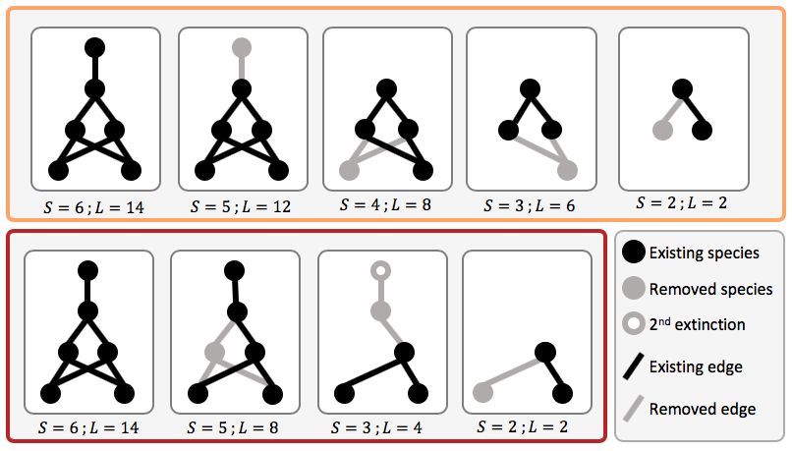

Slide 14
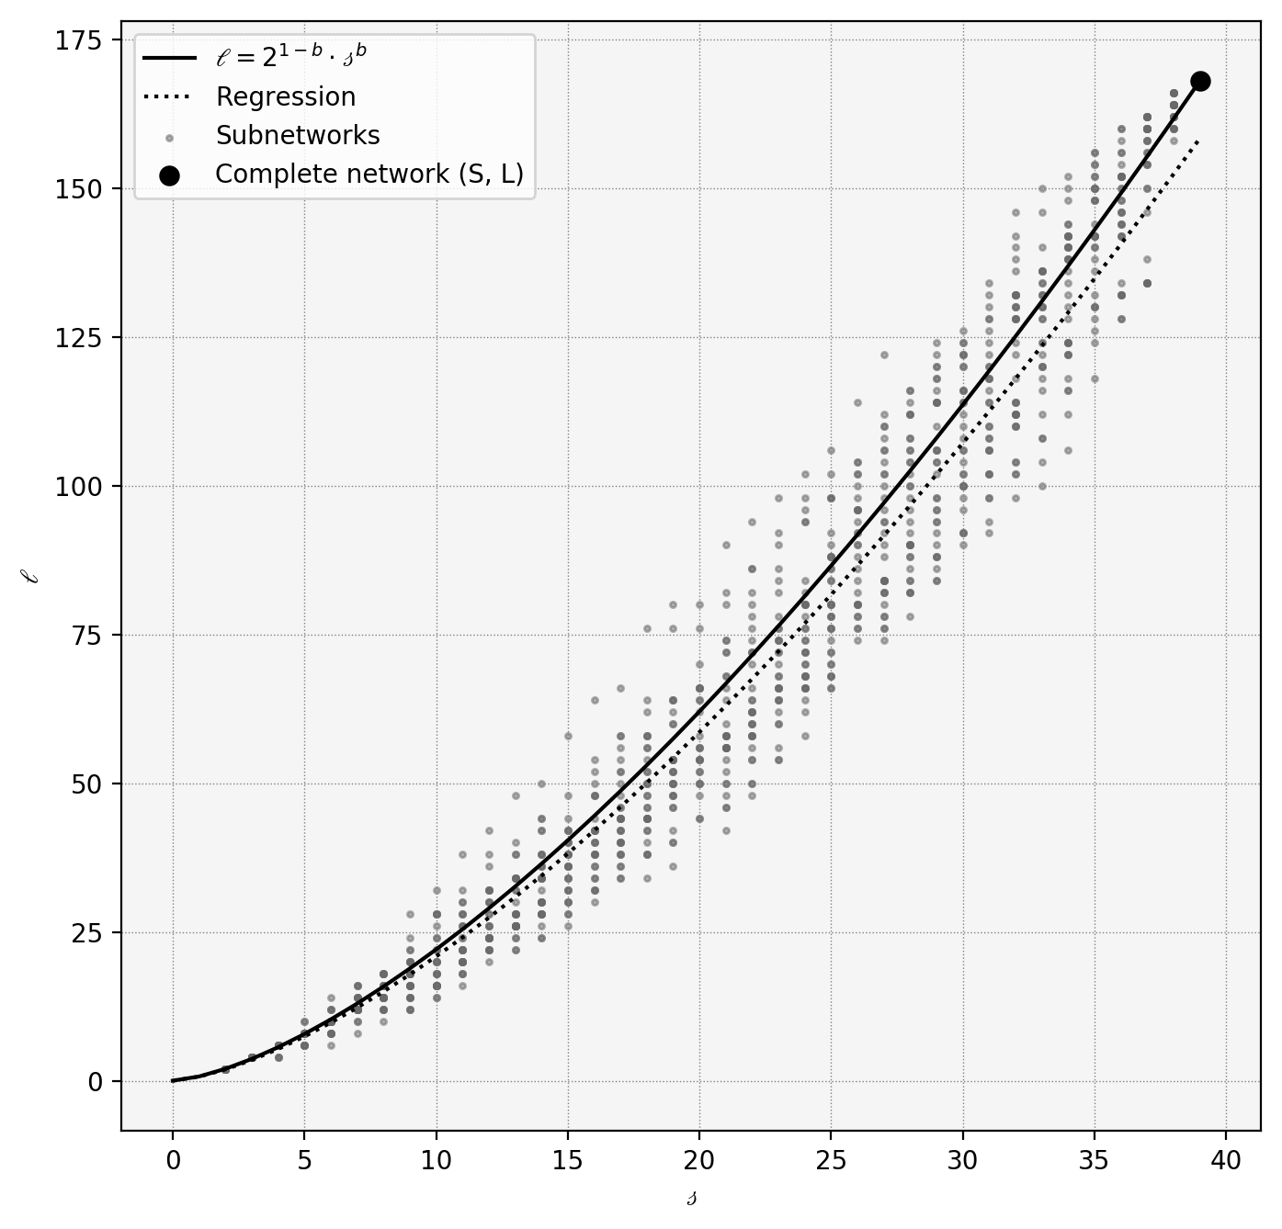

Slide 15
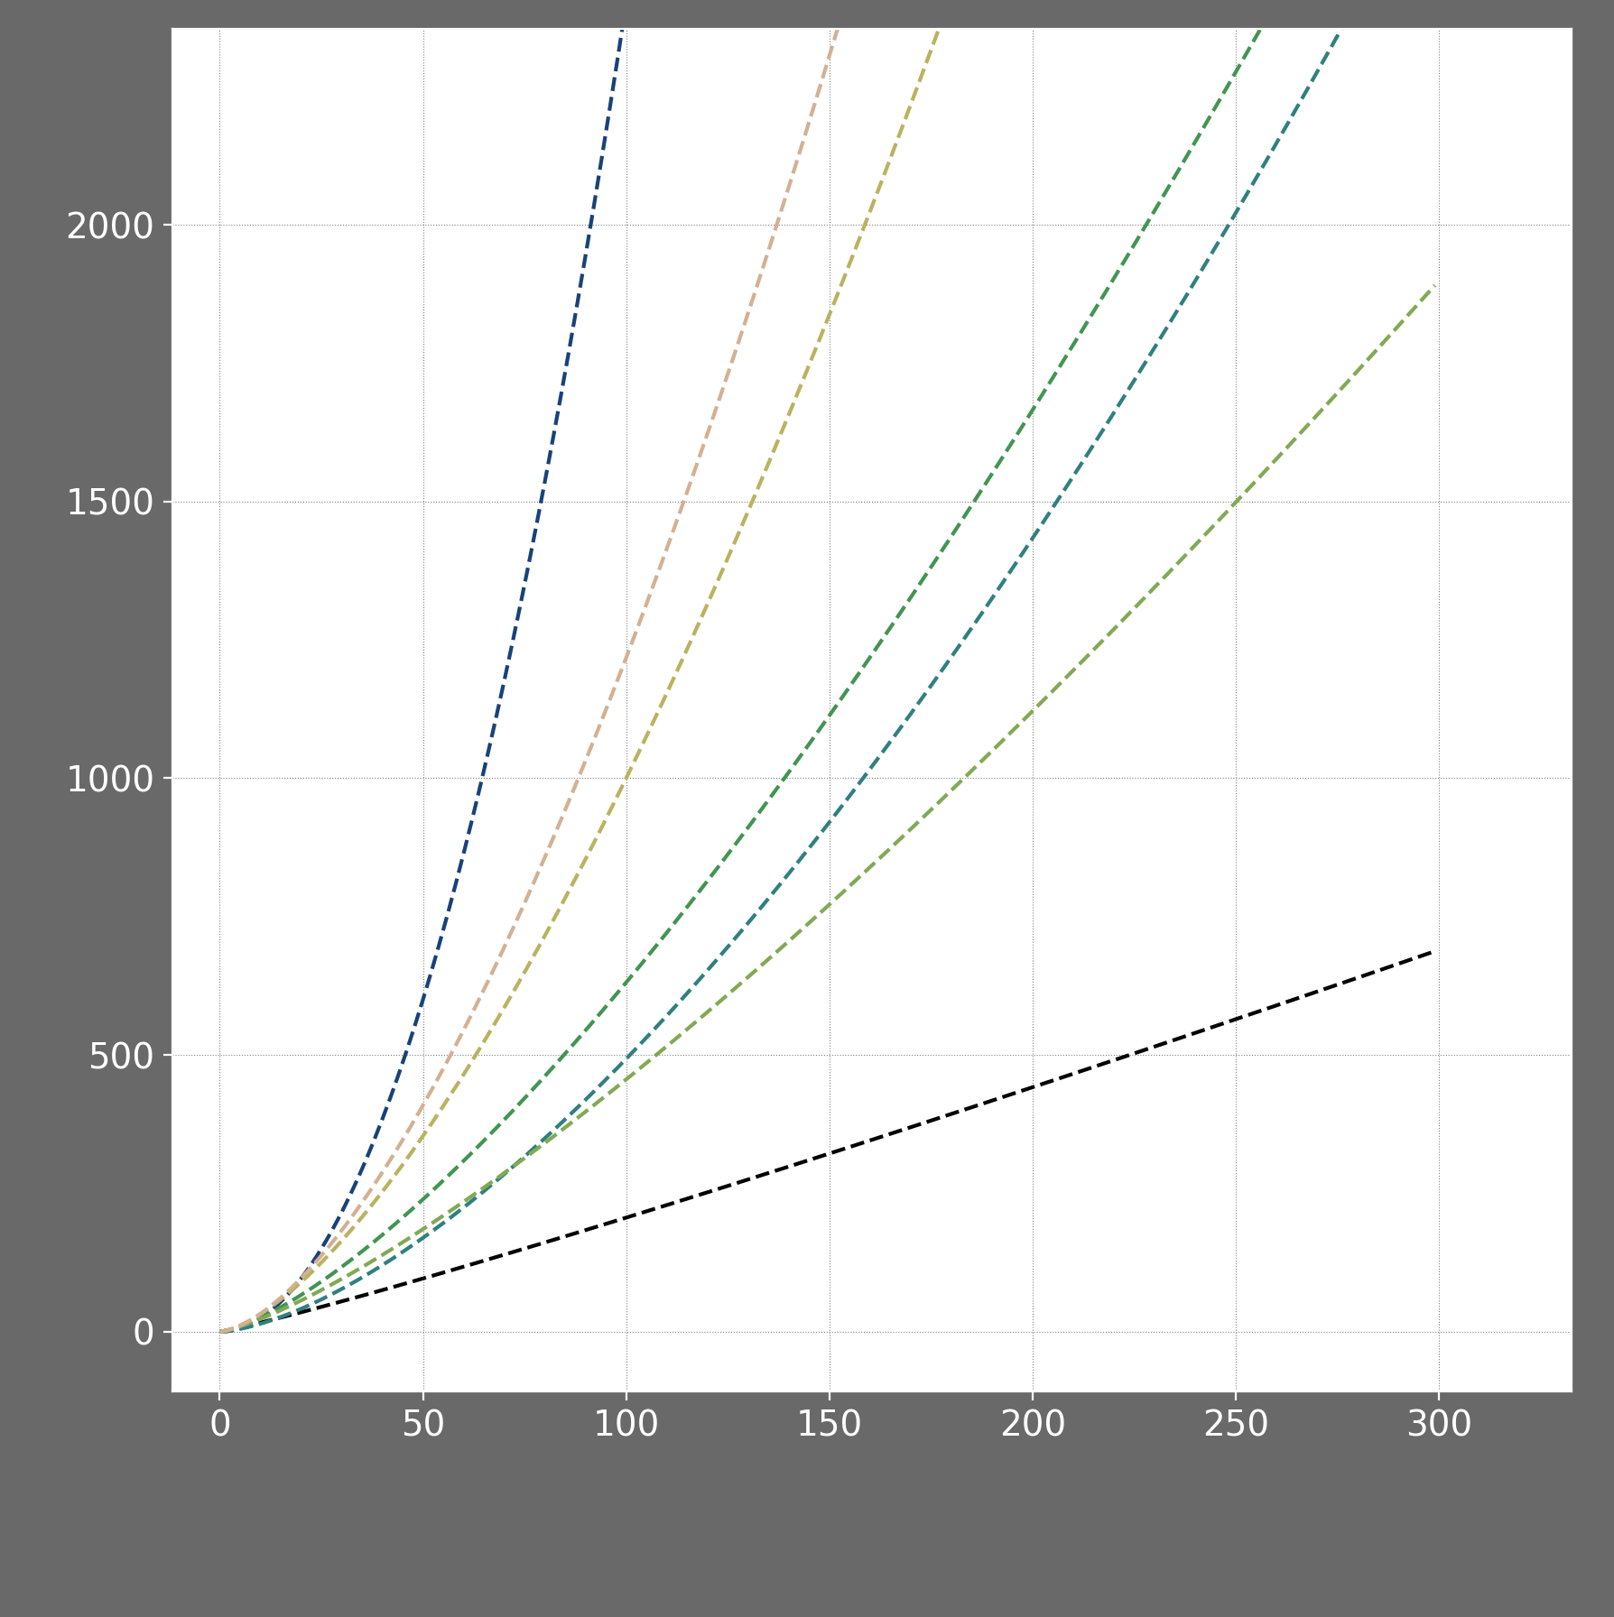
Briand et al., 1983
Warren et al., 1990
Martinez et al., 1992
Havens et al., 1992
Schmid et al., 2002
Dunne et al., 2006
Riede et al., 2010
$$L=a∙S^{b}$$
One value of $a$ and $b$ for all systems
$a$ and $b$ are universal
$$L$$
$a$ and $b$ are network specific
$$L=2^{1−b}∙S^{b}$$
$$S$$

Slide 16
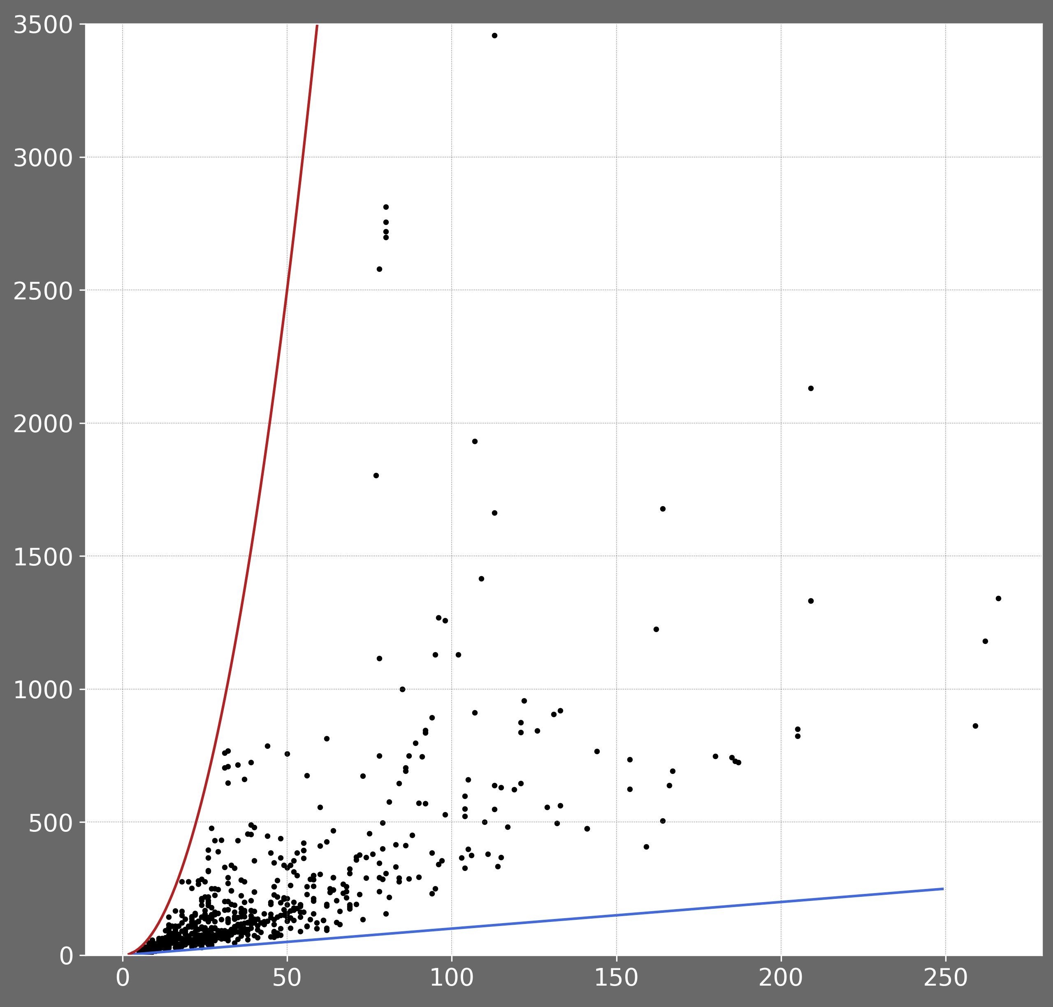
$$L=1∙S^{2}$$
$$L=a∙S^{b}$$
Ecosystem 1
One value of $a$ and $b$ for all systems
$$L$$
Ecosystem 2
$a$ and $b$ are universal
$$L=1∙S^{1}$$
$$S$$

Slide 17
Allesina and Tang, 2012
$ℜ\left(λ_{max}\right)=−d+\sqrt{σ^{2}∙S∙C}∙\left(1−\frac{𝔼^{2}\left(\left|X\right|\right)}{σ^{2}}\right)$
$$ℜ\left(λ_{max}\right)=−d+\left(S−1\right)∙C∙E\left(\left|X\right| \right)$$
${C= 2}^{1−b}∙S^{b−2}$
$−d+\sqrt{σ^{2}∙2^{1−b}∙S^{b−1}}$ $∙\left(1−\frac{𝔼^{2}\left(\left|X\right|\right)}{σ^{2}}\right)$
$$−d+\left(S−1\right)∙2^{1−b}∙S^{b−2}∙𝔼\left(\left|X\right| \right)$$
$$ℜ\left(λ_{max}\right) \sim S^{ \frac{b−1}{2}}$$
$$ℜ\left(λ_{max}\right)\sim S^{b−1}$$
$ℜ\left(λ_{max}\right)$ have to be $<0$
$$b<1+\frac{2}{log\left(\frac{S}{2}\right)}∙\left(log\left(\frac{d}{σ}\right)−log\left(1−\frac{2}{π }\right)\right)$$
$$b<\frac{1}{\log\left(\frac{S}{2}\right)}∙\left(\log\left(\frac{d}{σ}\right)+ log\left(\frac{\sqrt{π}}{2∙\sqrt{2}}\right)+\log\left(S\right)\right)$$

Slide 18
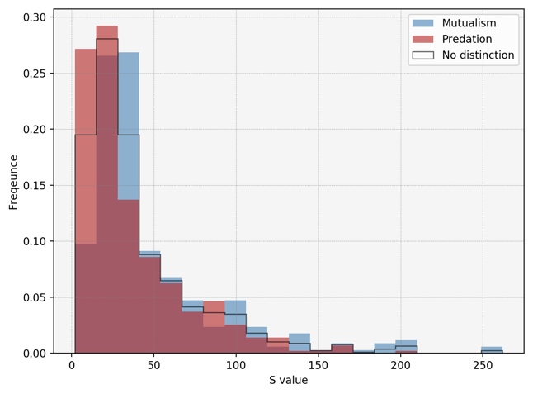
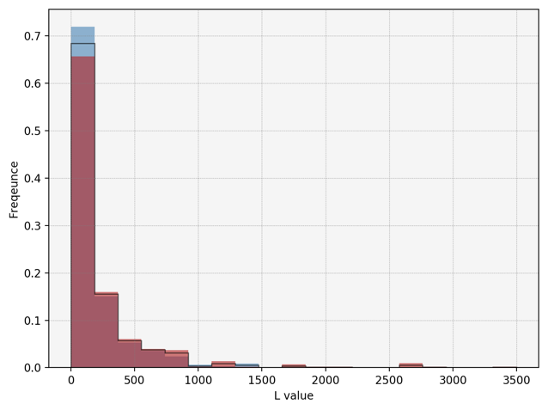
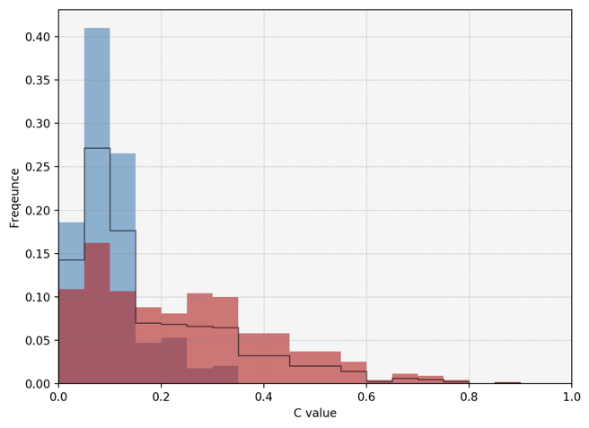
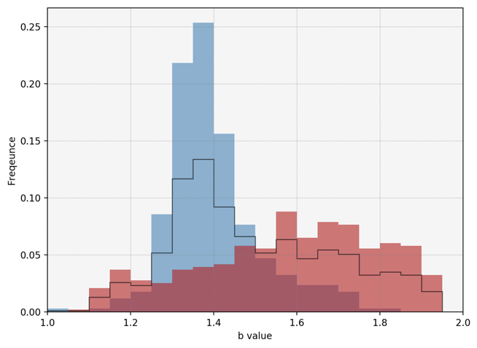

Slide 19
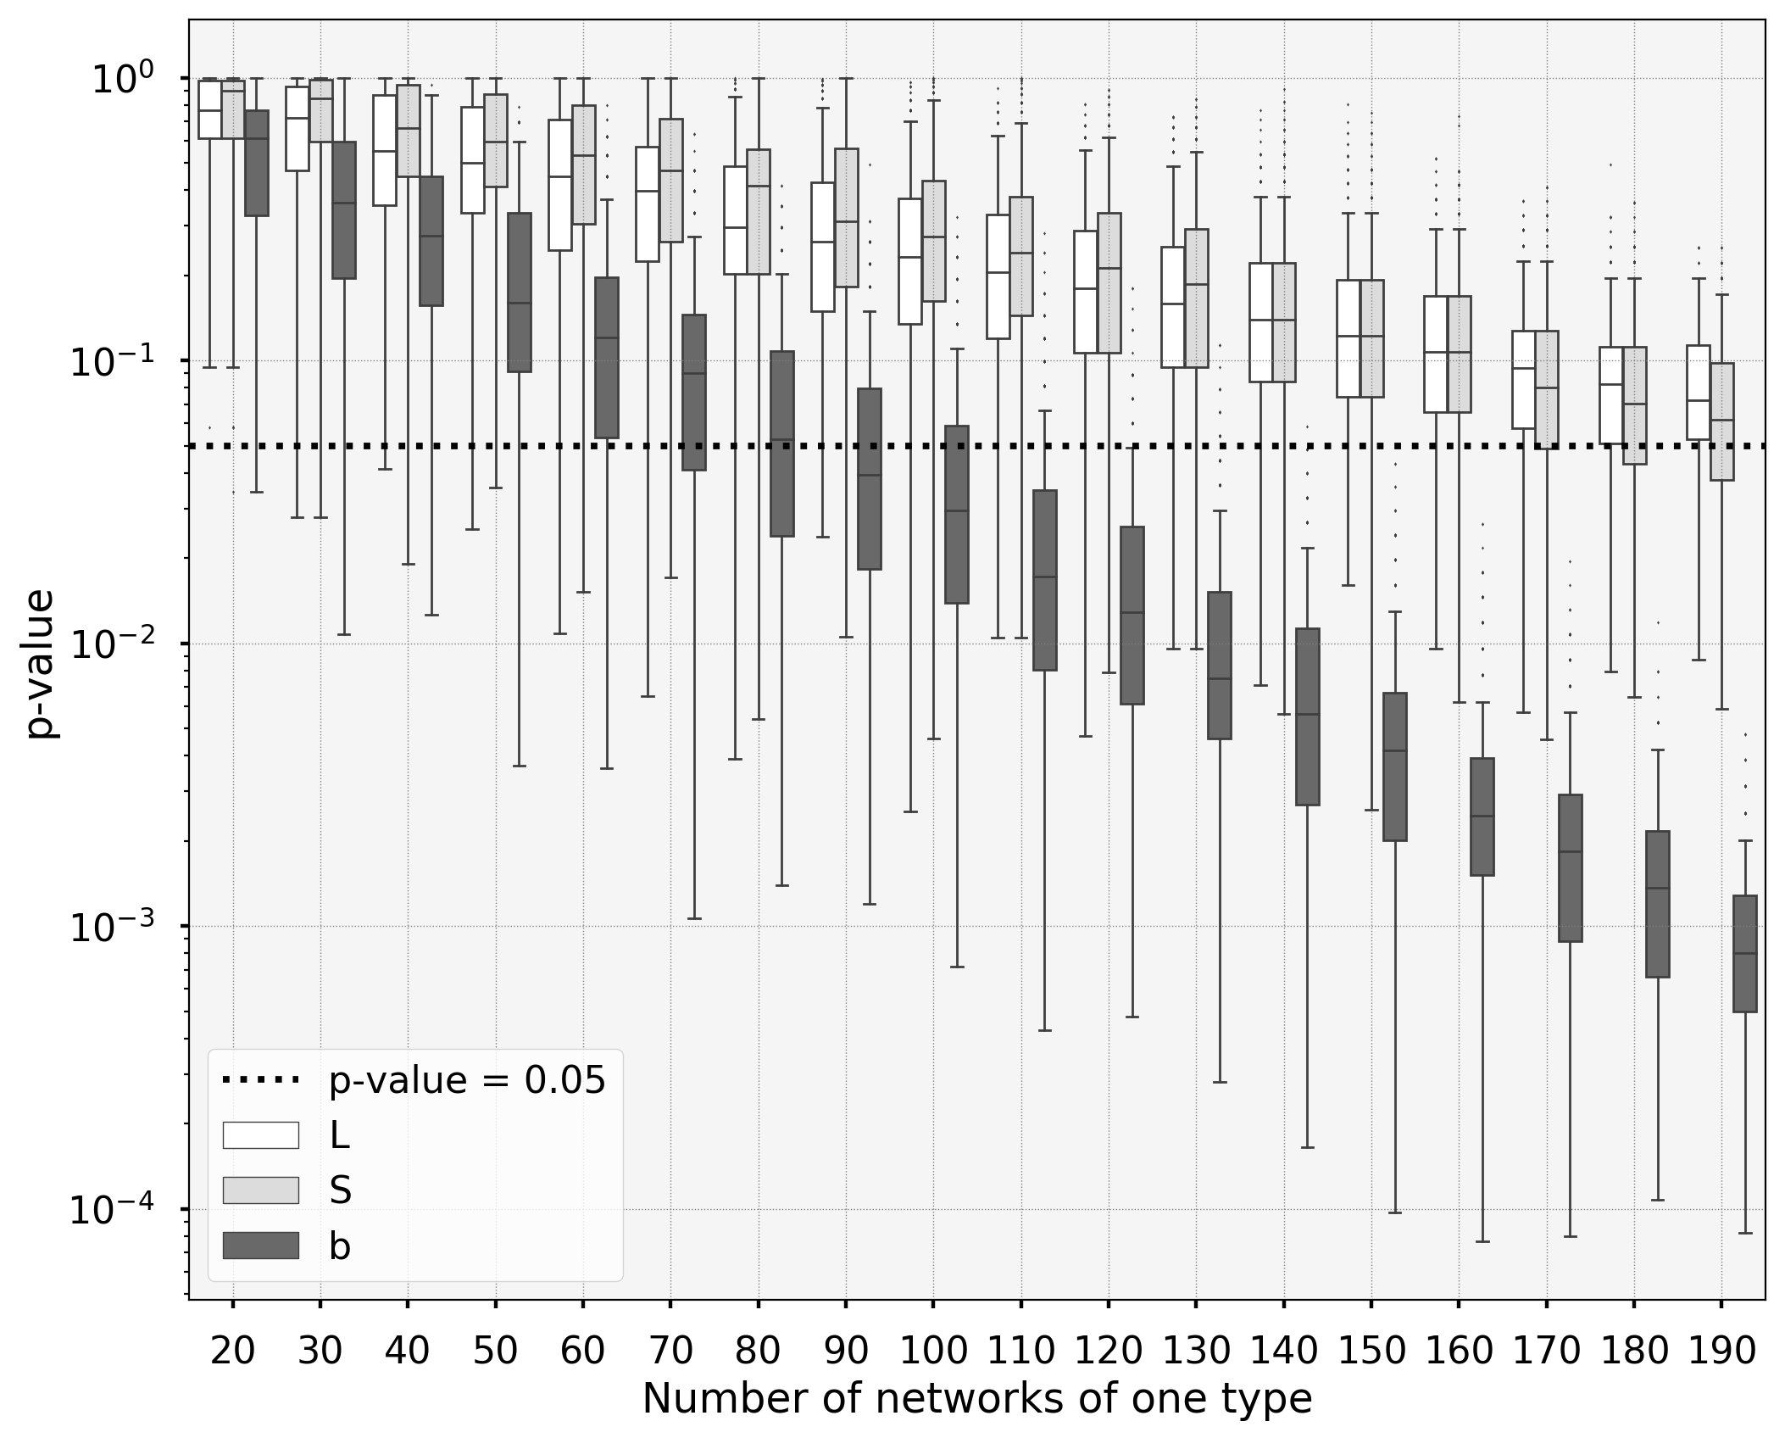

Slide 20
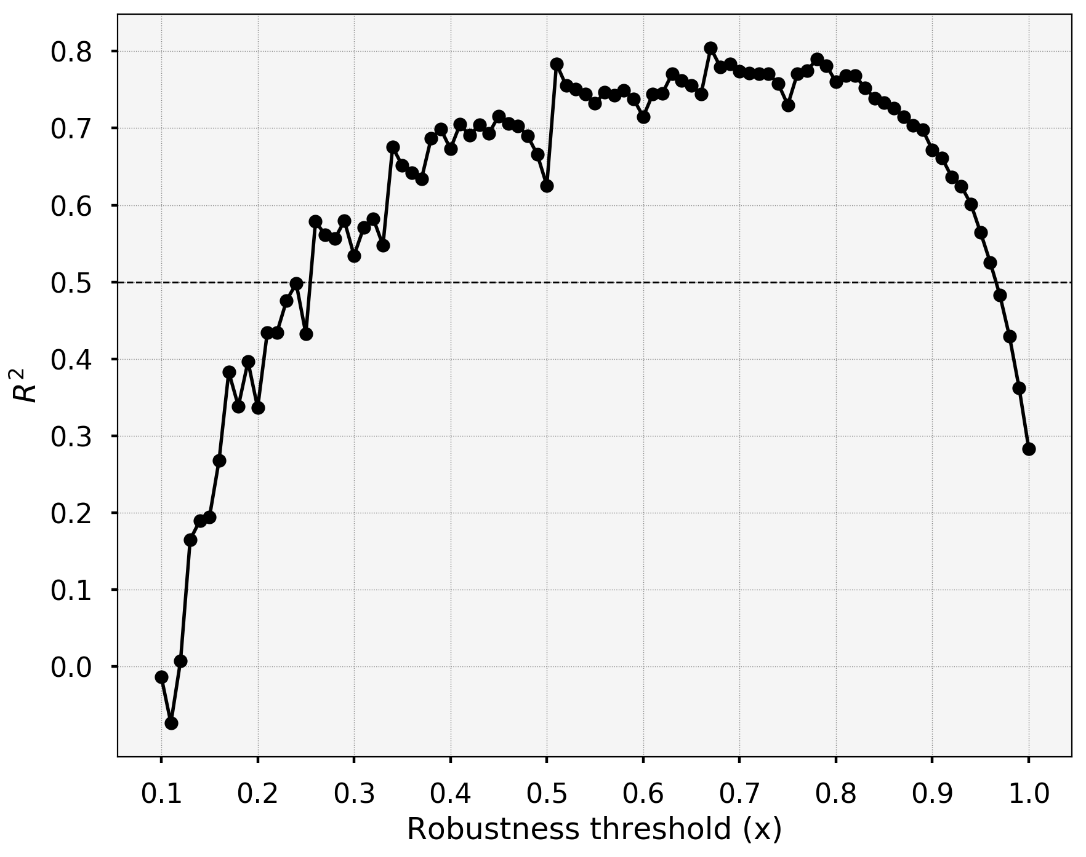

Slide 23
$$b=1$$
$$b=2$$
$$L=a⋅S^{b}$$
# species lost
$$b=1$$
$$\frac{dL}{dS}=a⋅b⋅S^{b−1}$$
$$=b⋅\frac{{a ⋅S}^{b}}{S}$$
$$=b⋅\frac{L}{S}=b⋅\left\langle k\right\rangle$$
$$b=2$$
On average, $\hat{ΔL}=$ $2⋅\left\langle k\right\rangle$
$$\hat{ΔS}=\frac{2}{b}$$
# species removed

Slide 24
How many people do you talk to at conferences?
Does the size of the community matters ?

