Slide 1
A multi-biomarker approach highlights the physiological functions affected by chronic exposure of African catfish to the binary insecticide Acer 35EC
A. Houndji1,2, I. Imorou Toko2, A. Godonou2,
I. Ben Ammar1, P. Kestemont1
1. URBE, University of Namur & 2. LaRAEAq, University of Parakou

Slide 2


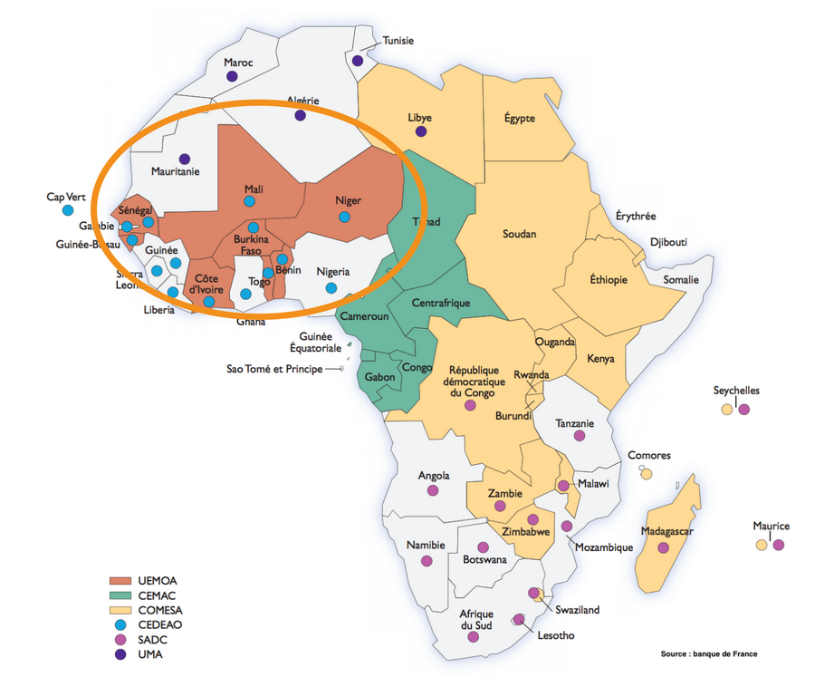
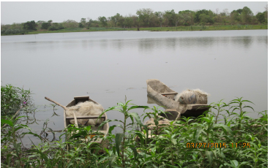

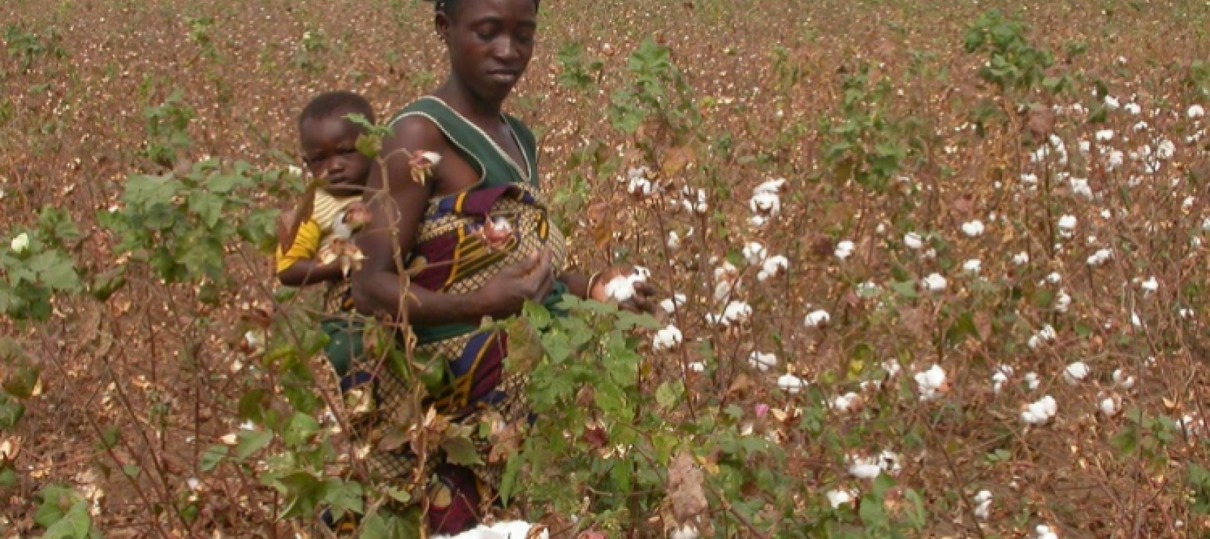
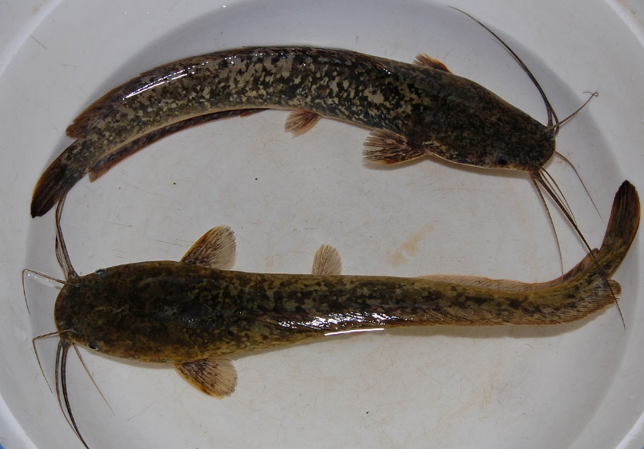
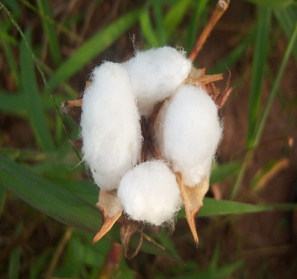
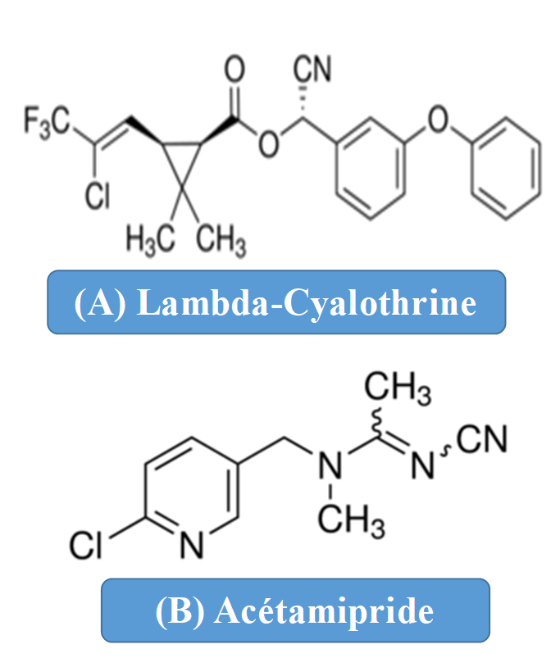
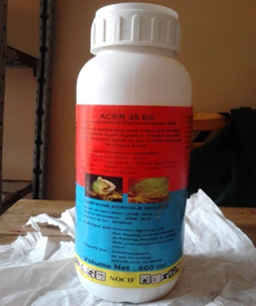
Introduction

Slide 3

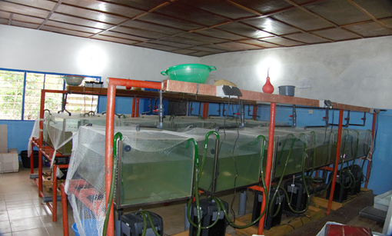
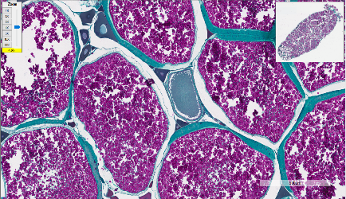
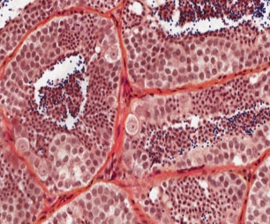
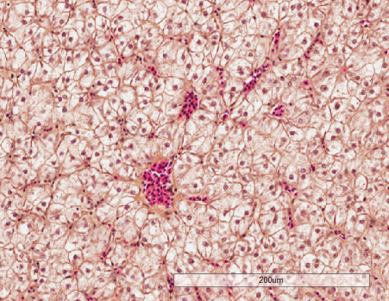
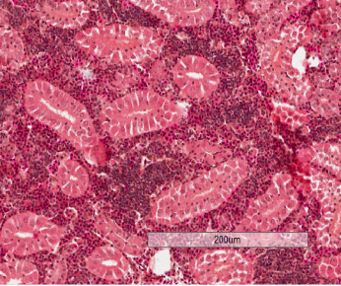
Materials and Methods
Biometric indices (HSI, GSI, SSI)
Detoxification & oxidative stress markers in liver (GST, CAT, SOD, GSH, GPx)
Neurotoxicity marker in brain & muscle (CHE)
Immune markers (ACH50, Peroxidase, NBT, Total Ig, Leucocytes proportions (C))
Reproductive markers (T, E2, 11-KT)
Histological alterations in the ovaries (D), testes (E), liver (F) & kidney (G)
Doses: 0, 0.0022 & 0.022 µL/L of Acer
20 ♂ 20 ♀;± 13 g / Tank
Renewal of solutions : 75% each 72 h
3 ♂ and 3 ♀ were sampled / tank / time
C
D
E
F
G

Slide 4
Results (1/2)
Exposition
Recovery

Slide 5
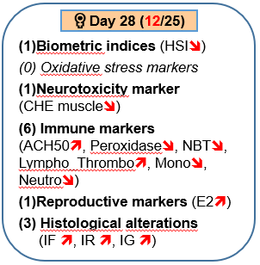
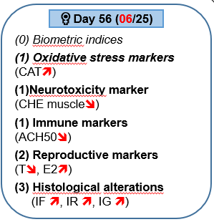
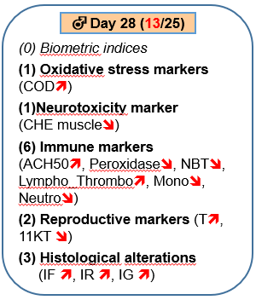
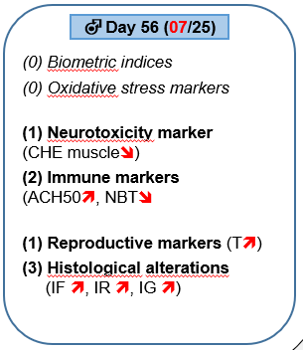
Results (2/2)

Slide 6
Conclusions
Chronic exposure to cotton insecticide Acer 35 EC impacts all the physiological functions considered in this study depending on the concentration, duration of exposure and sex.
Decontamination process can help restoring the homeostasis.

