Slide 1
GISELE
Guidance for socio-economic impact of ecosystem restoration
Contact : antoinelimpens@gmail.com

Slide 2
GISELE
Guidance for socio-economic impact of ecosystem restoration
Objectives & description
How to achieve the objective?
My recent implication
Gisele objectives & description
Help future Belgian restoration project managers to prepare and carry out the socio-economic impact analysis (SEIA) of their restoration projects
SEIA evaluate the impact of restoration projects on ES+stakeholders and determine fluctuations in services before and after restoration;
Request from Belgian LIFE holders (CE deliverable);
Part of the LIFE BNIP = Integrated Life Project with many different actions (pure restoration ➔NK2 objectives and more➔GISELE).

Slide 3
GISELE
Guidance for socio-economic impact of ecosystem restoration
Objectives & description
How to achieve the objective?
My recent implication
How achieve the objective?
Development of a « Manual » = Website/Book/Software/…
By the year 2023
Iterative method
MANUAL
= Website/ book /software/?
CS 3
Case Study 2
CS 5
CS 4
Manual first version (users needs and literature review);
CS1 = carry out SEIA1;
Update manual;
Test manual on CS2;
Update again;
Test updated version on next CSs;
Etc. ➔ final version.

Slide 4
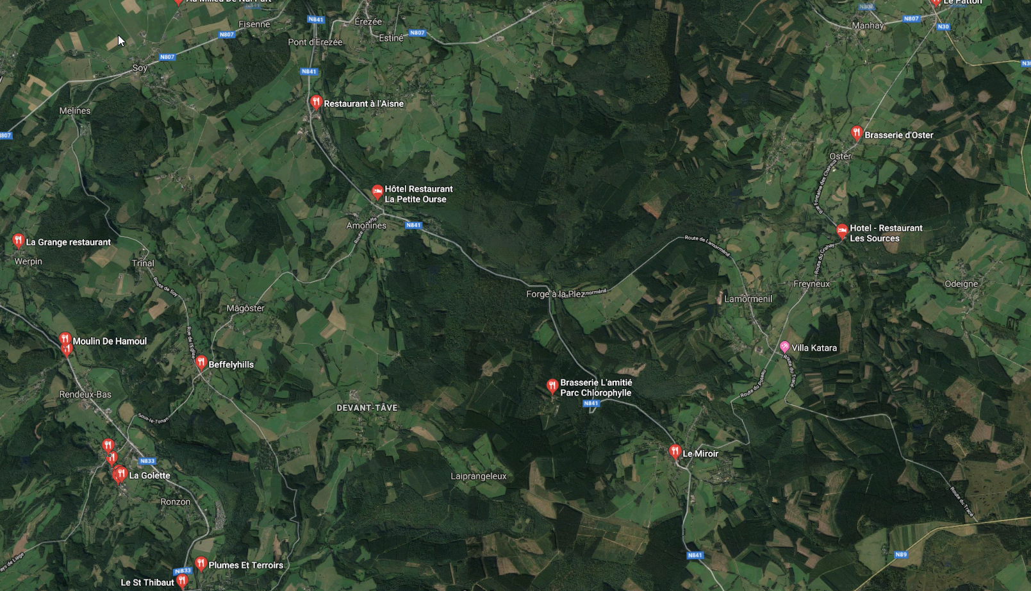
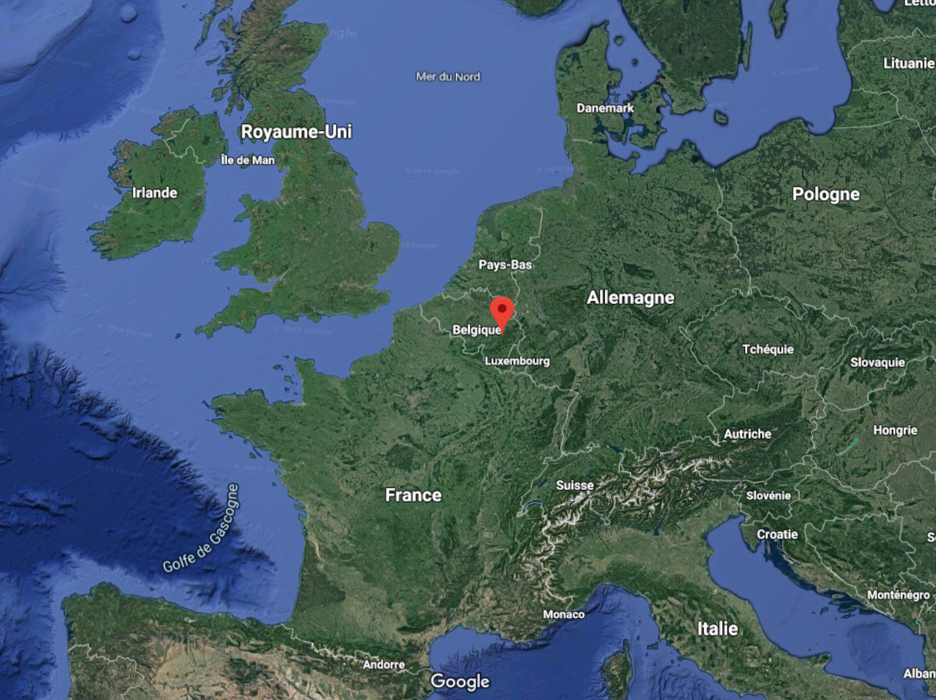
GISELE
Guidance for socio-economic impact of ecosystem restoration
Objectives & description
How to achieve the objective?
My recent implication
My recent implication – Practical application on CS1
BNIP action C.5.12
Convincing forest owners to stop softwood planting on 100 ha alluvial terraces <-> 2000€/ha ecological compensation.
100ha dispersed Walloon territory
Highest surface restored parcels
Softwood forest on alluvial terraces restored in alluvial forests, Aisne valley; Source : Antoine Limpens.
1km
« Aisne Valley », Manhay, Wallonia, Belgium.

Slide 5
GISELE
Guidance for socio-economic impact of ecosystem restoration
Objectives & description
How to achieve the objective?
My recent implication
My recent implication – Practical application on CS1
SEIA itself of the case
*Small spatial scale (< 3 ha)
*Low expected impact
➔Interviews with local stakeholders
9 stakeholders
1,5h individual interviews
2 qualitative exercises
1 perception analysis
Resulted in :
1 summary report of the qualitative impact
Some exploratory descriptive statistics

Slide 6
Thank you and come talk to me, I’m nice ;)
Contact : antoinelimpens@gmail.com

