Slide 1
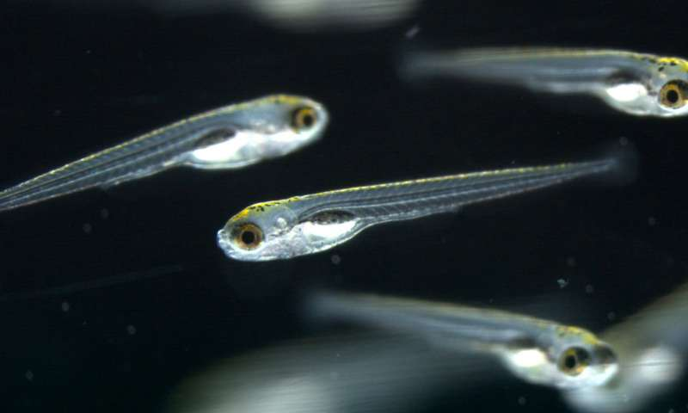
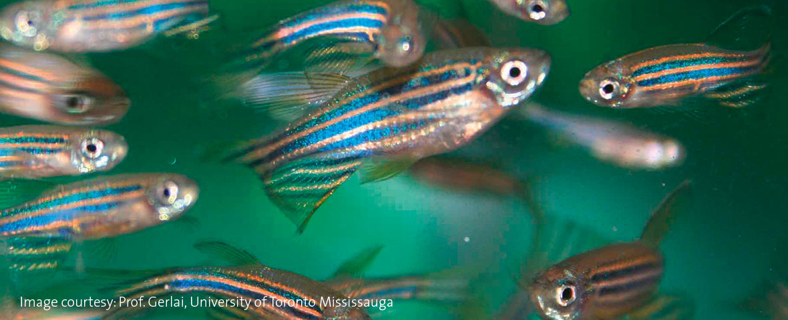
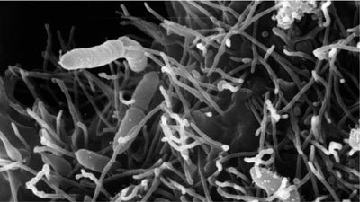
COULD AN EARLY-LIFE INFECTION WITH BACTERIAL PATHOGEN TRIGGER IMMUNE MEMORY IN ZEBRAFISH ADULT?
University of Zurich
Oregon State University
Oregon State University
Valérie Cornet, Jessica Douxfils, S.N.M. Mandiki, Patrick Kestemont
Research Unit in Environmental and Evolutionary Biology, University of Namur, Belgium
ILEE research day

Slide 2
In mammals…
Early-life social environment
Perinatal period of life
Later-life immune function: Prevalence and frequency of diseases increased
Adult rats:
Reactivity to stress, disease suceptibility
Conti et al. 2012
Bilbo et al. 2009
1
Notes:
It is now well recognized that early-life adversity has an important impact on the responses later in life

Slide 3
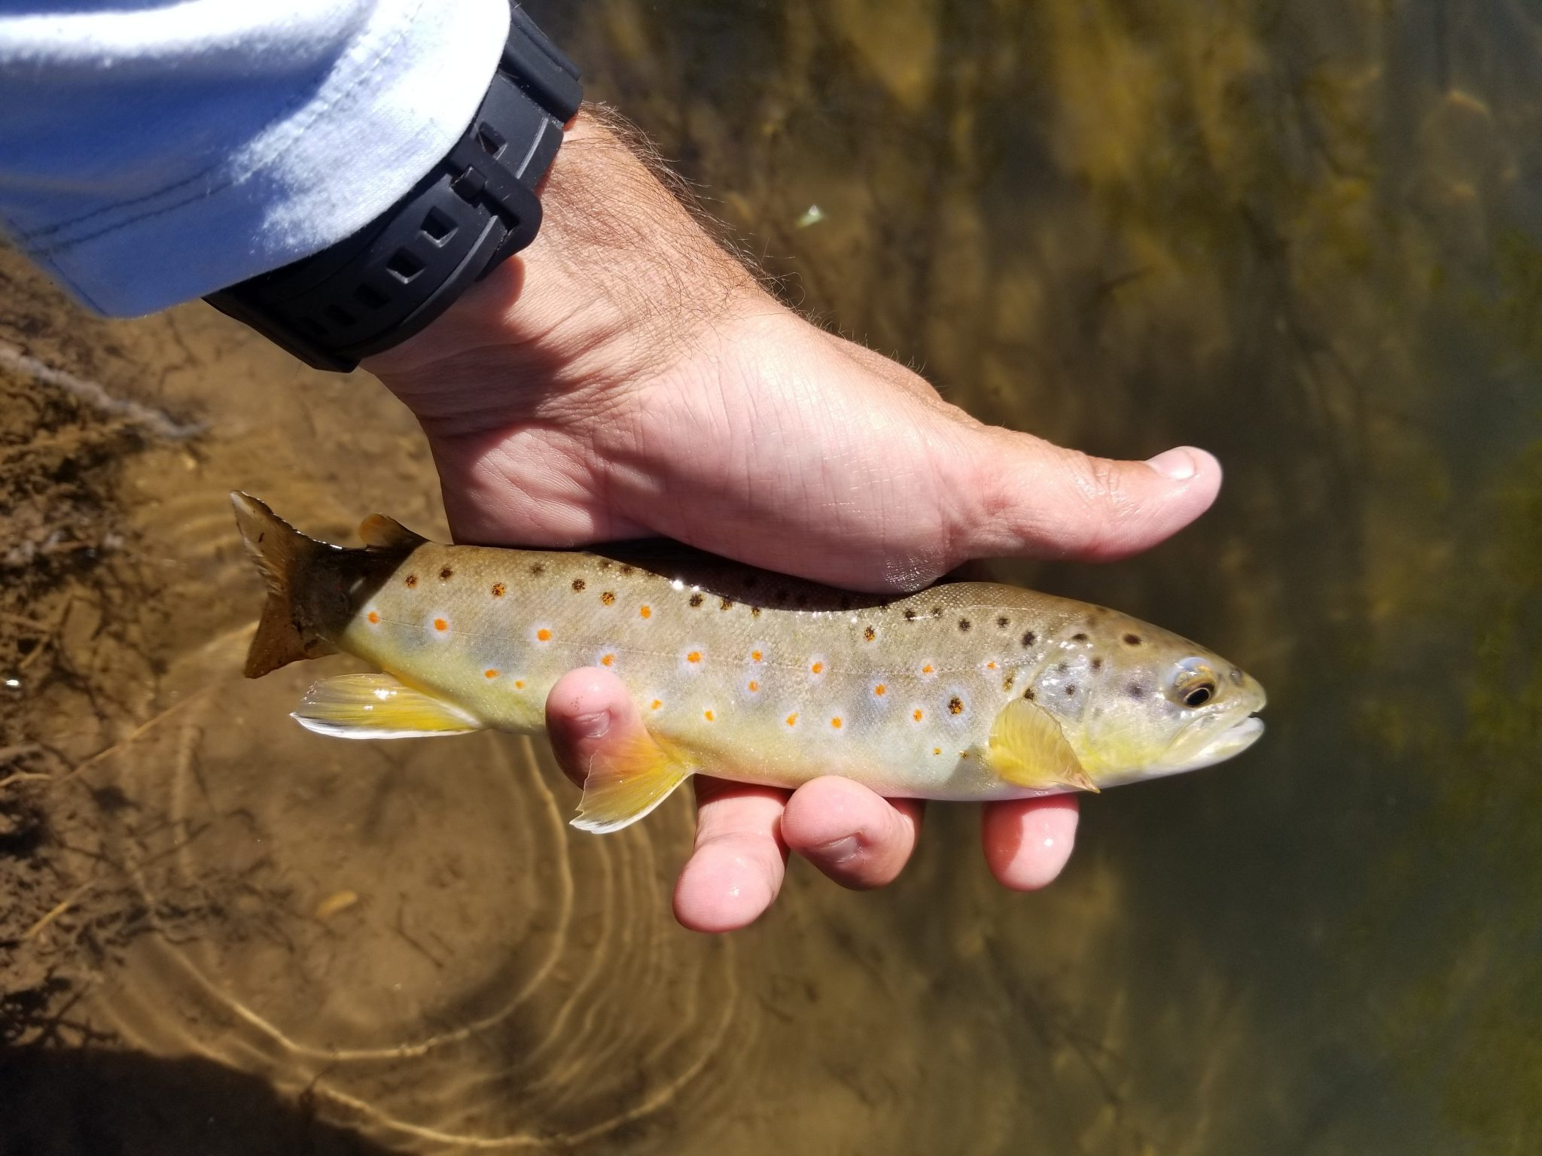
And in Fish…?
Handling stressor
Stress sensitivity
Auperin et al. (2008)
Embryo/Larval stage
Adult stage
Temperature
Pollution
Fish activity
Responses to metal exposure
Immune functions
Cornet et al. (unpublished data)
Milston et al. (2003)
2

Slide 4
And here comes the question…
What effects early-life infection histories have on Health trajectories and immune capabilities in fully-developed adult zebrafish?
3

Slide 5
A brief reminder…
Innate immunity
Pathogens
Adaptive immunity
Major in fish
Fast and efficient
Lazy in fish
Slow and less efficient
PAMP
Recognition by Innate immune effectors
T cell
Activation
TLR
Cytokines release
LT
LTc
LB
G
M
NK
LBi
Pathogen uptake and elimination
Inflammatory reaction
Attack on pathogen
Attack by antibody release
4
Innate immunity
Adaptive immunity

Slide 6
Sooner or later: a developping immunity
Innate immunity
Pathogens
Adaptive immunity
Major in fish
Fast and efficient
Lazy in fish
Slow and less efficient
PAMP
Recognition by Innate immune effectors
T cell
Activation
TLR
Cytokines release
LT
LTc
LB
G
M
NK
LBi
Innate immunity
Adaptive immunity
5

Slide 7
How did we process?
Control
1
2
3
Early infection
1
2
3
1
2
3
Chronic infection
0
1
2
3
1
2
3
Late infection
1
2
3
1
2
3
18
19
35
36
61
62
dpf
0
First infection
2
6h post-infection
6h bath infection at
10⁶ CFU/ml
1
Before infection
3
24h post-infection
6

Slide 8
Surrounded by microorganism from D1
Innate immunity
Pathogens
Adaptive immunity
Major in fish
Fast and efficient
Lazy in fish
Slow and less efficient
PAMP
Rag1
Tcra
Cd4
Recognition by Innate immune effectors
T cell
Activation
TLR
Cytokines release
LT
LTc
LB
TLR4
NF-κB
G
M
NK
LBi
Pathogen uptake and elimination
Inflammatory reaction
Attack on pathogen
Attack by antibody release
Lysozyme
C3 component
Transferrin
IgM
MPO
Il-6
Tgf-β
6

Slide 9
Influence of different bacterial infection histories on fish immune responses
7

Slide 10
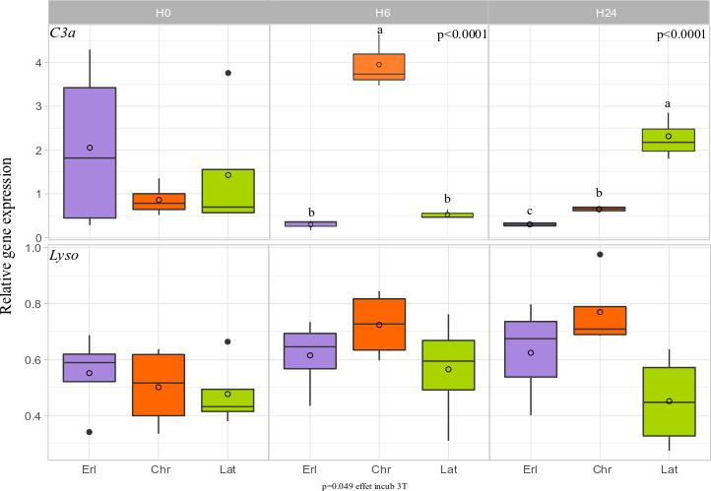
Chronic infection induces fast C3a expression
Innate immunity
G
M
Pathogen uptake and elimination
8

Slide 11
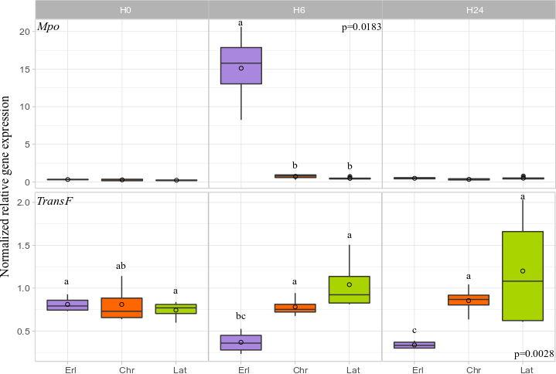
Signs of inflammation with Early infection
Innate immunity
G
M
Pathogen uptake and elimination
Myeloperoxidase highly expressed in Erl: high production of HOCl
Better capacity to kill fish but oxidative stress could damage tissues
Transferrin lowered in Early infected fish: sign of inflammation
9
Notes:
MPO is a peroxidases that produces hypochlorous acid during the neutrophil's respiratory burst. It requires heme as a cofactor. Hypochlorous acid and tyrosyl radical are cytotoxic, so they are used by the neutrophil to kill bacteria and other pathogens. Transferrin: thus creating an environment low in free iron that impedes bacterial survival in a process called iron withholding. The level of transferrin decreases in inflammation

Slide 12
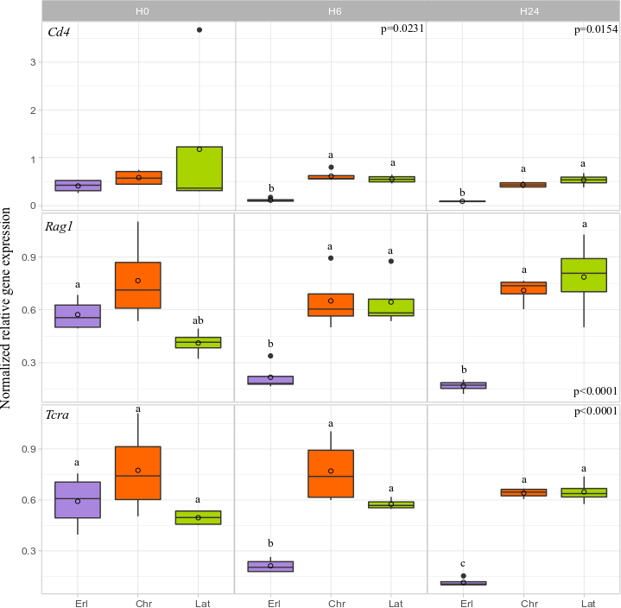
Adaptive immunity increased in chr and lat fish
Adaptive immunity
LTc
LB
Attack on pathogen
Attack by antibody release
12

Slide 13
Response of immune system in later life according to different bacterial infection histories
Oregon State University
13

Slide 14
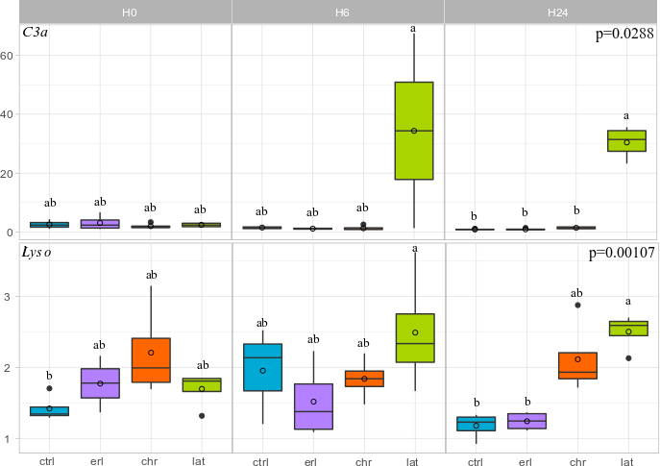
Antimicrobial components increased in Late infection
Innate immunity
G
M
Pathogen uptake and elimination
Relative gene expression
14

Slide 15
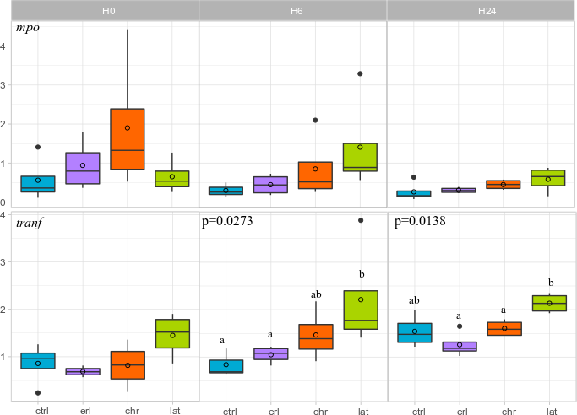
Antimicrobial components increased in Late infection
Innate immunity
G
M
Pathogen uptake and elimination
Relative gene expression
15

Slide 16
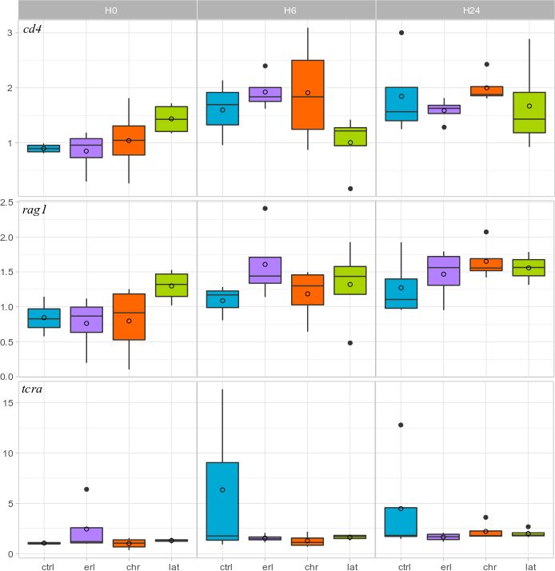
No differences for adaptive immunity
Adaptive immunity
LTc
LB
Attack on pathogen
Attack by antibody release
Relative gene expression
18

Slide 17
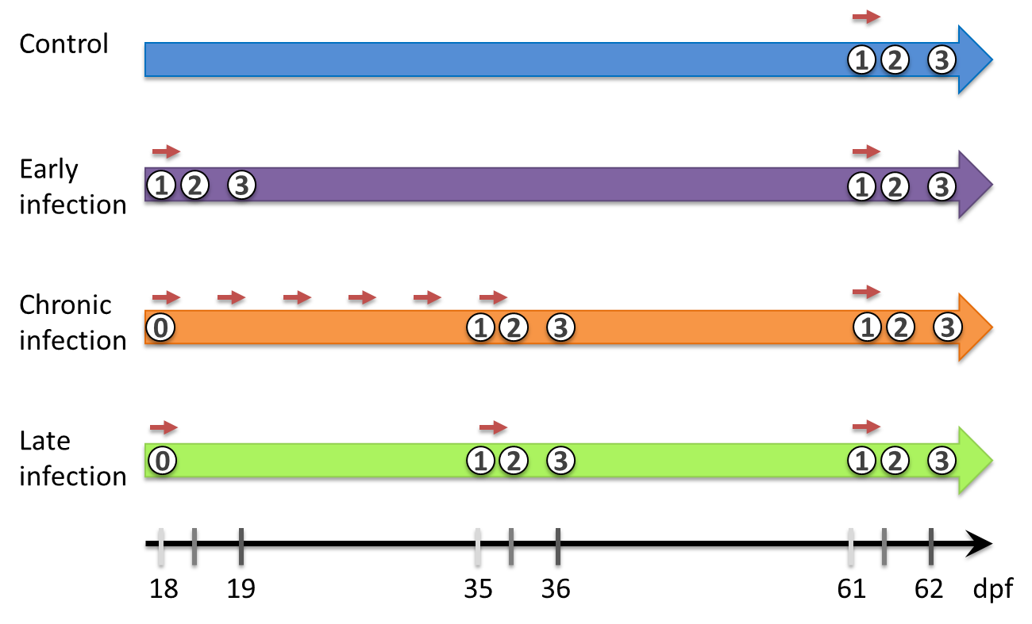
Take-home message
Innate immunity
Pathogens
A. salmonicida achromongenes
Recognition by Innate immune effectors
G
M
NK
LBi
Pathogen uptake and elimination
Inflammatory reaction
In early infected larvae: Strong innate immune responses with signs of inflammation
Lysozyme
C3 component
Transferrin
MPO
Il-6
Tgf-β
19

Slide 18
Take-home message
Innate immunity
Pathogens
A. salmonicida achromongenes
Recognition by Innate immune effectors
G
M
NK
LBi
Late infected fish: concept of “trained” innate immunity
But a series of bacterial infections lowered the beneficial effect provided by the primary infection on innate immune responses weakening of organism?
Pathogen uptake and elimination
Inflammatory reaction
Lysozyme
C3 component
Transferrin
MPO
Il-6
Tgf-β
20

Slide 19
To conclude…
Pathogens
Adaptive immunity
PAMP
Rag1
Tcra
Cd4
T cell
Activation
TLR
LT
LTc
LB
Stimulation at primary infection but not in later-life after 24hpi :
=> No adaptive memory or delayed responses (10 days later) ?
Could an early-life infection trigger immune memory in adult zebrafish?
Yes, but not the one we expected
21

Slide 20
Thank you for your attention
Drawing from Dan Gorodezky

Slide 21
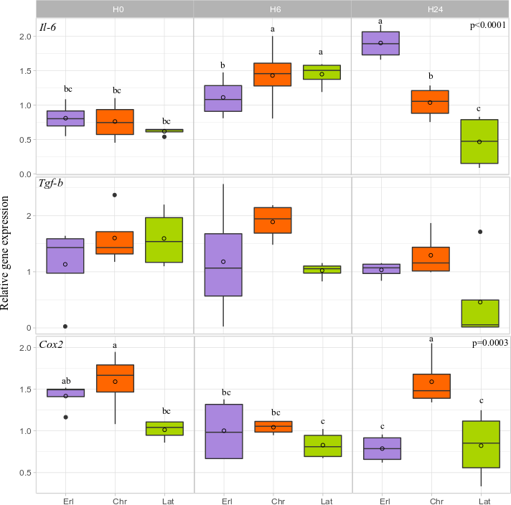
Signs of inflammation in Erl larvae
10

Slide 22
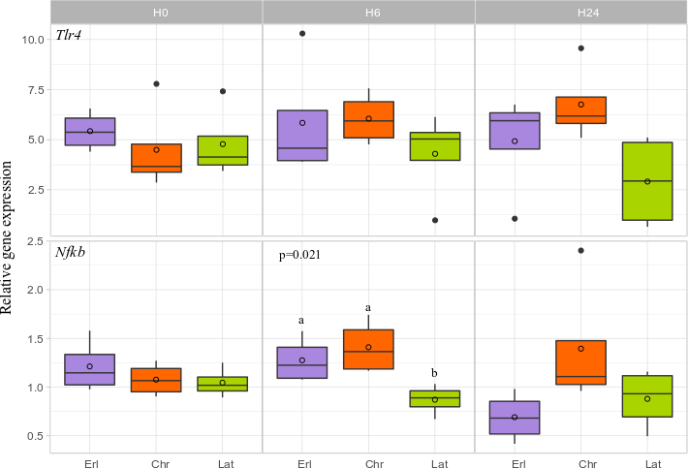
NF-κB lower in Late infected fish
11

Slide 23
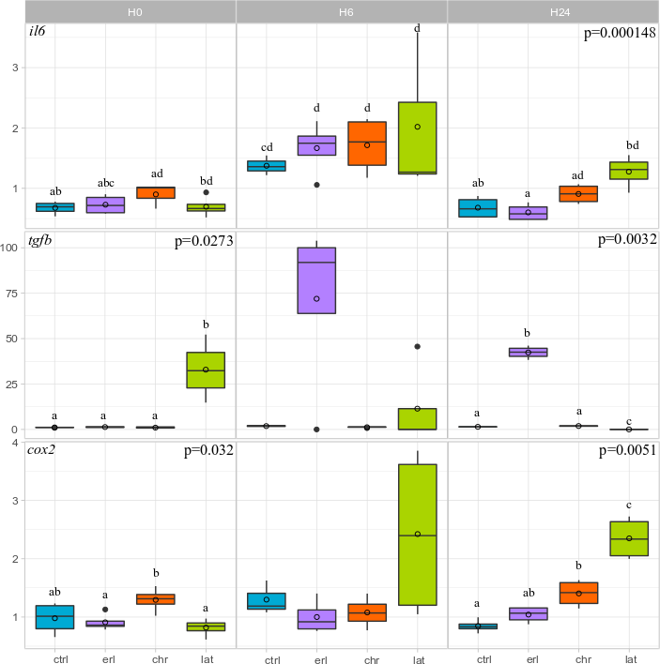
Signs of inflammation in Lat larvae
Early exposure
Chronic exposure
Late exposure
Relative gene expression
16

Slide 24
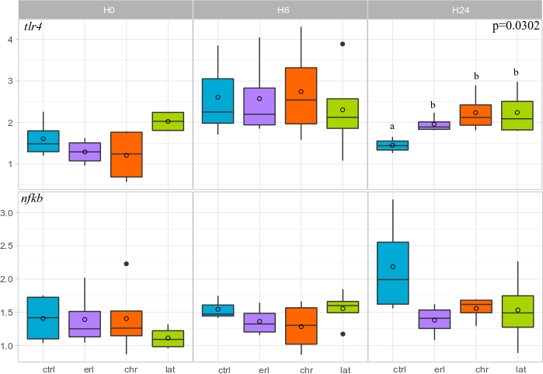
Previous infections keep tlr4 expression higher at 24h
Early exposure
Chronic exposure
Late exposure
Relative gene expression
17

