Slide 1



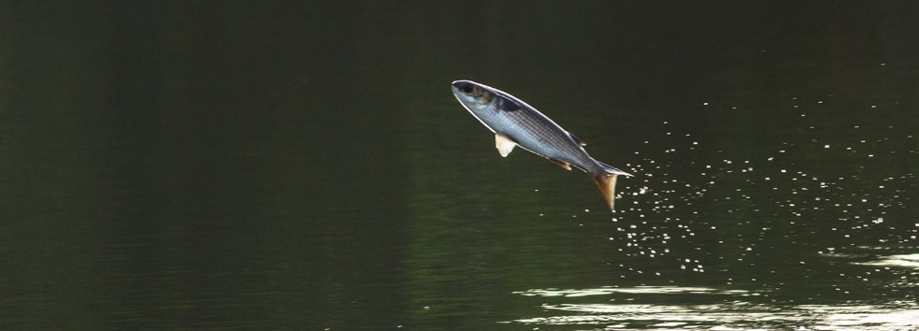
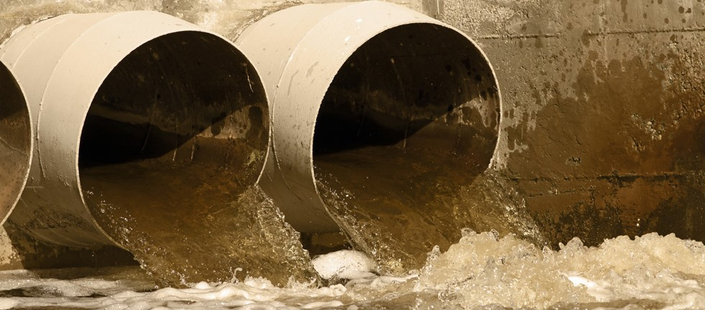

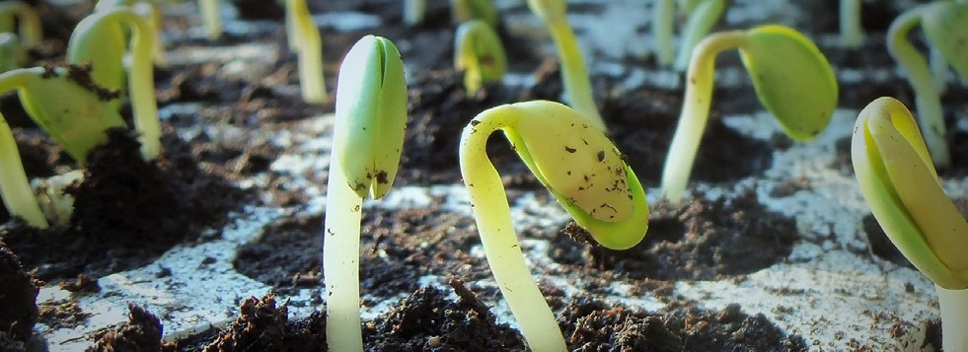

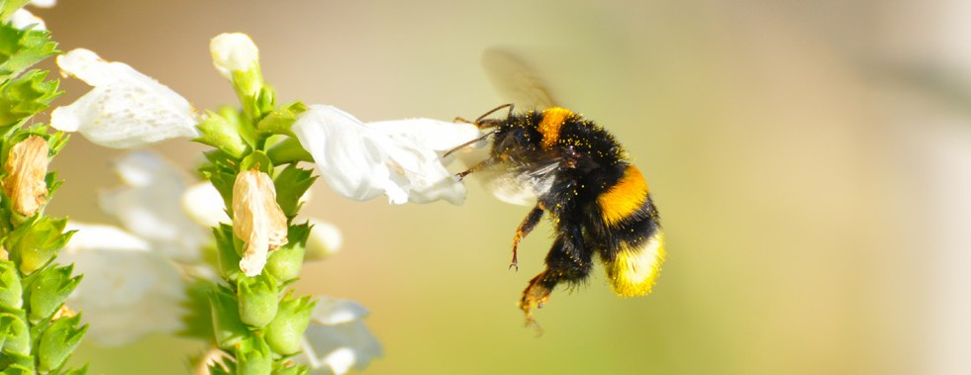
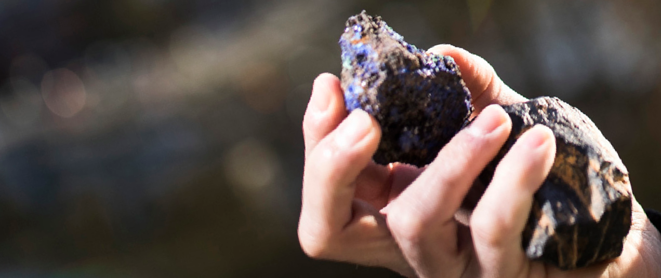

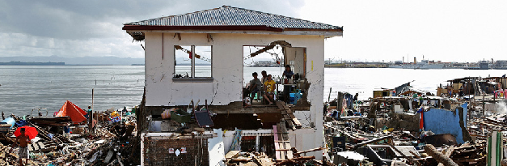

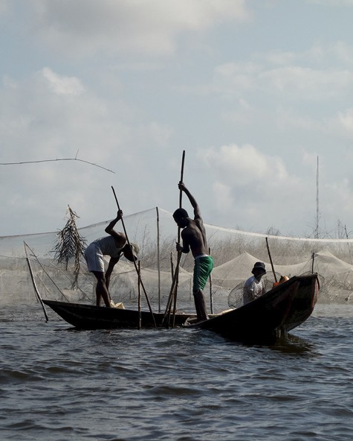
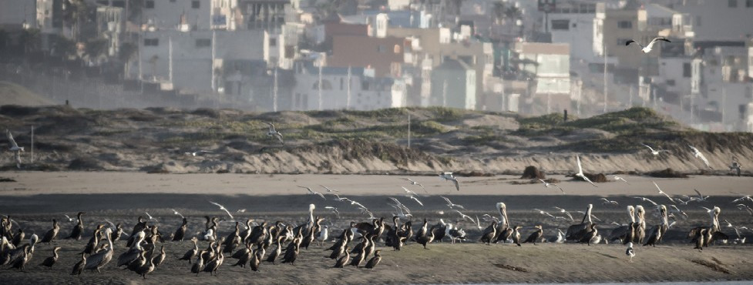

Institute of
Life, Earth & Environment
Objectives
Understand fundamental/applied processes regulating life on earth
Identify anthropogenic pressures on the environment
Manage natural resources, reduce pollution, conserve and restore biodiversity
Multiple disciplines for interdisciplinary approaches
We are especially searching collaborations for:
Biology
Chemistry
Law & Socio- / Economics
Evolution, Adaptation and Biodiversity
Life Earth
Environment
Geography
Fundamental questions related to the evolution of factors contributing to genomic variation and adap-tation, human impact on the environment and the evolution of organisms, biodiversity & ecosystem functioning.
Pollution & Environmental Toxicology
History
Pollutants and stressors act on individuals and entire ecosystems. The aim is to identify, evaluate and finally control toxic agents
Geology
Ecological theory
Models - Field data -
Experiments
Physiology - Behaviour - Proteomics - Epigenetics
Evolutionary processes at population & genome level - Extreme resistance
Individual response
Physiological, immune, nervous, reproductive system of aquatic organisms as bioindicators
Theoretic models & case studies (plankton microcosm experiments) – Atmospheric pollutants
Molecular spectroscopy
Art & Archeology
Physics
Biological mechanisms
Ecosystem change
Evolution
Innovative technology
Sustainable Plant & Animal Production
Spin-offs:
Find alternative solutions of chemical and pharmaceutical products, develop plant/insect-based alternatives to fishmeal
Characterization & Management of Natural Resources
Plant molecular & cellular biology
Association breeding – Agronomic performance of edible crops
Elicitors to stimulate plant defence
Immunostimulation – Vegetable fish food – Improve fish welfare – Temperate & tropical spec.
Sustainable extraction and processing of non-renewable resources to reduce environmental problems.
Ecosystem Services
Phytopathology & signal transduction
Non-renewable resources
Geological resources – Supergene ores – Aquifer & karstic flow processes
Natural resources – Architecture & art – From antiquity to modern age
Aquaculture – Restore aquatic ecosystems – Water quality analysis with ecological indicators – New georesources
Foster sustainable landscape management and planning, to increase the will-being of local actors
Aquaculture
Development of biological elicitors that enhance plant defenses to support an ecologically intensive agriculture
www.dev.fytofend.be
Integrated valuation frameworks
Combine social, economic & biophysical values – Participatory approach
ES Mapping – Agent-based modelling of landscape change – Integrated ES assessments
Human utilisation
Renewable resources
Methods
Environmental Impacts on Human Populations
Environmental DNA sequencing, metabarcoding and classic methodologies to monitor biodiversity
www.e-biom.com
Evaluate the economic, social & health risks due to environ-mental hazards and associated population vulnerabilities to design adaptation strategies
Environmental History
Environment & population
Distribution – Migration – Vulnerability – Land use – Natural disasters
Vector-born & zoonotic diseases – Accessibility to health services
Resilience indicators – Game – Spatial modelling – Focus groups – Integrated spatial analyses – Satellite image & mobile data
Since man appeared on earth he began to influence and alter his environment.
Health risks
Hydrological and hydrogeological monitoring solutions
https://traqua.be
Environmental & Natural Resource Management in the South
History & perception 18th-20th century
Urbanisation – Industrial exploitation – River pollution – Relationship between man & animals
Natural disasters – Volcanic eruptions & earthquakes
Approach
ILEE collaborates with partners located in Southern countries: Africa, Central & South America, South-Eastern Asia. The focus lies on:
Socio-historical aspects
Characterization & sustainable management of natural resources
Production of aquatic ecosystems and the sustainable development of aquaculture
Impact of environmental changes on human populations
Environmental history
CONTACT
Scientific Manager • ilee@unamur.be
Patrick Kestemont (President) • patrick.kestemont@unamur.be
Johan Yans (Vice-president) • johan.yans@unamur.be
http://ilee.unamur.be/
https://ilee.unamur.be

