Slide 1

Funding possibilities
CMK - ILEE

Slide 2
Mobility funding

Slide 3

Erasmus Belgica
Student mobility in another Belgian community
Study & internship
min. 2 (internship) or 3 (study) months - max. 12 months
Funding:
  lump sum of 100€
  scholarship of 100€/month for students who can prove specific accommodation
cfr. faculty of Law

Slide 4
PhD funding

Slide 5
Joint PhD call
Joint PhD fellowships in the framework of the cooperation between University of Namur and Hasselt University
2 positions per year
2 x 2 years
Appointment 50/50
Funding provided by:
  BOF UHasselt
  Fonds spécial de recherche UNamur
Deadline: 01.03.2024
Start date PhD: 01.10.2024
Notes:
niet nieuw - zou bekend moeten zijn

Slide 6
Project funding

Slide 7



Weave
Joint collaborative research projects
BILATERAL collaboration within Belgium:
  FWO as lead organization ‘Junior and Senior Research Projects’
    call opening: mid-January 2024
    deadline submission: April 1st 2024
    start: January 1st 2025
  FRS-FNRS as lead organization ‘Projets de Recherche’ call
    call opening: mid-january 2024
    deadline submission: July 2nd 2024
    start: January 1st 2025

Slide 8






Weave
TRILATERAL collaborations with foreign organizations:
  FWO, FRS-FNRS as Lead organizations or Partner agencies
  FWO = Lead, FRS-FNRS = partner: trilaterals with
    Luxembourg (FNR), Slovenia (ARRS), Poland (NCN), Germany (DFG), Austria (FWF) or Switzerland (SNSF)
  FRS-FNRS = Lead, FWO = partner: trilaterals with
    Luxembourg (FNR), Germany (DFG) or Switzerland (SNSF)

Slide 9

FWO EOS
Joint fundamental research projects in the framework
of the cooperation between University of Namur and
Hasselt University
Duration: 4 years
Next call: deadline and evaluation 2025
Start: January 1st 2026
EOS consortium: 1FL, 1FR + optional 4 more (federal/foreign)
Yearly budget: max. € 1.000.000
Min 1 PhD per community
Two-step submission procedure (pre-proposal & full proposal)

Slide 10
FYSSEN & ARES
The Fyssen foundation (PostDocs), this is for “french or foreign researchers, holders of a foreign Phd and who wish to achieve their project in a Laboratory in France; or either french or foreign researchers holders of a french Phd who wish to achieve their project in a Laboratory abroad (excluded co-tutorship country)”
https://www.fondationfyssen.fr/en/study-grants/aim-award/
The ARES (cooperation au developpement). Masters & bachelors:
https://www.ares-ac.be/en/actualites/929-scholarships-in-belgium-call-2024-2025

Slide 11
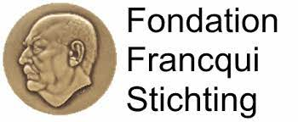
Francqui
Belgian cooperation to attract an international Francqui Professor
Yearly call - deadline May 15th
Class of Excellence
3 fields (yearly 3 mandates):
  Exact Sciences;
  Human Sciences;
  Biological and Medical Sciences.
Funding: travel and accommodation costs, closing colloquium, …

Slide 12

ETF
FOD Economie
Yearly call - Open Nov
3 lines:
  Thematic axis 1: renewable energy sources in the Belgian exclusive economic zone of the North Sea and biofuels;
  Thematic axis 2: nuclear energy applications;
  Thematic axis 3: security of supply and grid balance
Funding: (50-100%)

Slide 13

ERA MIN
2 yearly call - next early 2025
ERA-MIN3 is a global, innovative and flexible pan-European network of 24 European and non-European research funding organisations, aiming to continue strengthening the mineral raw materials community through the coordination of research and innovation programmes on non-fuel and non-food raw materials (metallic, construction, and industrial minerals).
Funding: 100%

Slide 14

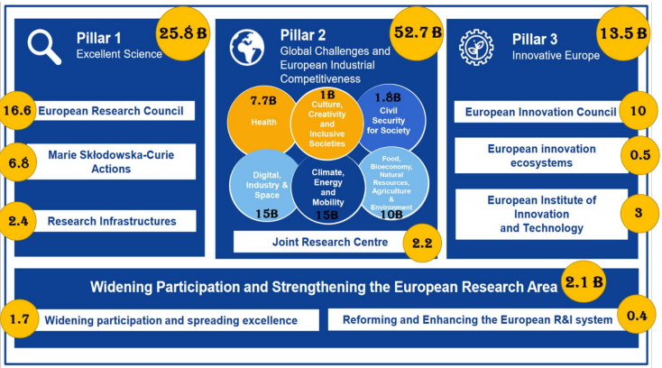
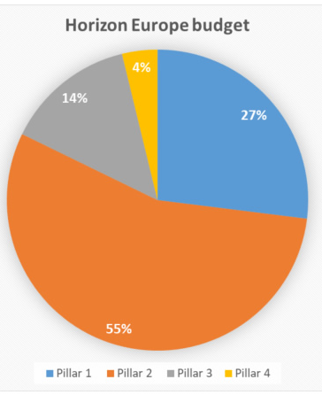
Horizon Europe (2021- 2027)

